Slide 2
Case 2012-7
Kimberly Stogner-Underwood, MD
Andrea Gilbert Jelinek, DO
Christine E. Fuller, MD

Slide 3
Drs Stogner-Underwood, Jelinek, and Fuller have nothing to disclose.

Slide 4
Clinical History
22 y/o male inmate
Neurologic symptoms x 2 months
MRI – 10 cm enhancing frontotemporal mass with extension into corpus callosum
HIV negative, and not otherwise immunocompromised

Slide 5
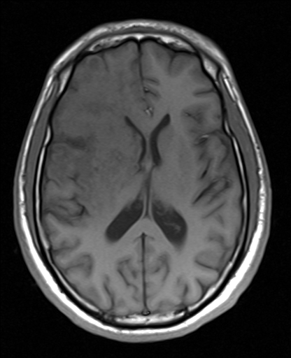
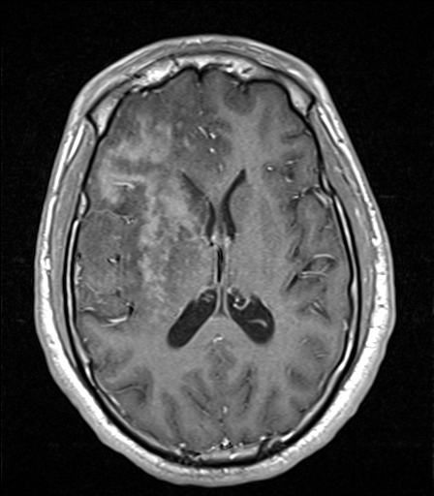
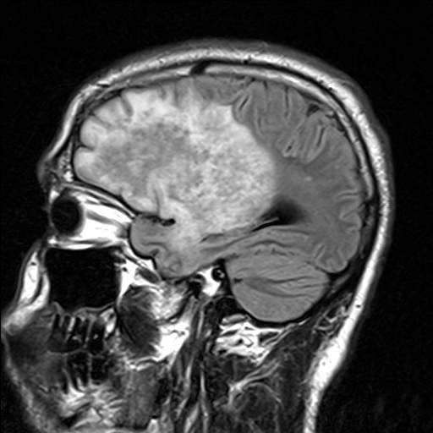
Neuroimaging - T1 Pre- and Post-Contrast, T2 FLAIR

Slide 6
Clinical History
Stereotactic biopsy of frontal mass
Lung lesion RUL – HSV+ on cytology
Blood, Tissue, CSF, and Respiratory cultures negative

Slide 7
Clinical History
Symptoms progressed despite treatment
Increased mass effect
Hemorrhage at base of brain
Death

Slide 8
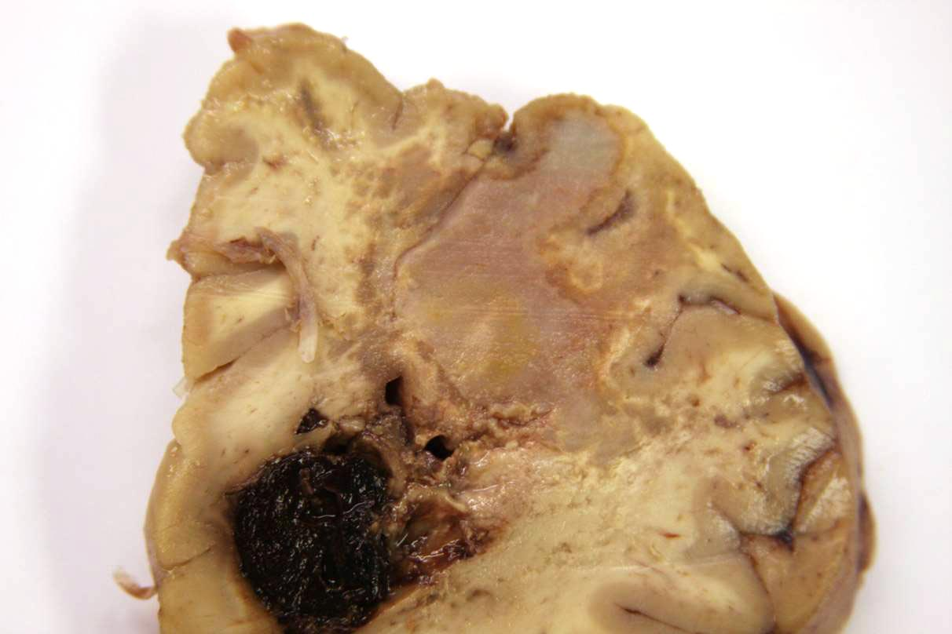
Autopsy Findings
Dense clotted material covered ventral brainstem and adjacent cerebellum
Right cerebellar hemisphere infarct
Right occipital lobe contained a firm, tan-yellow lesion
Large necrohemorrhagic lesion right frontotemporal region; hemorrhage in right lateral, 3rd, and 4th ventricles

Slide 9
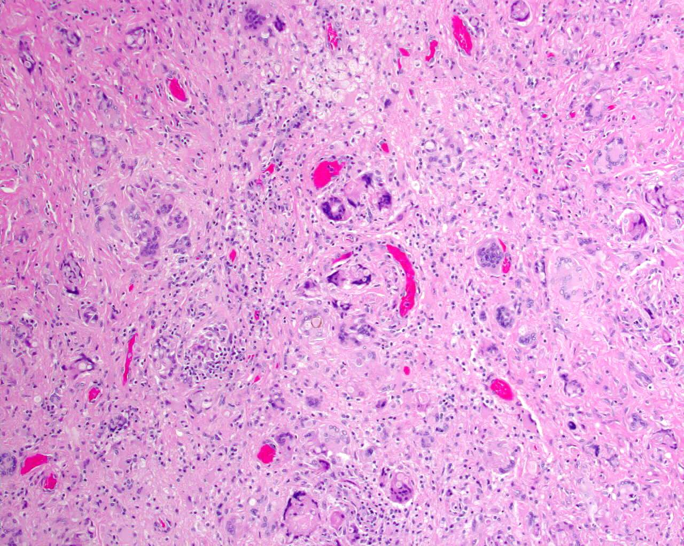

Slide 10
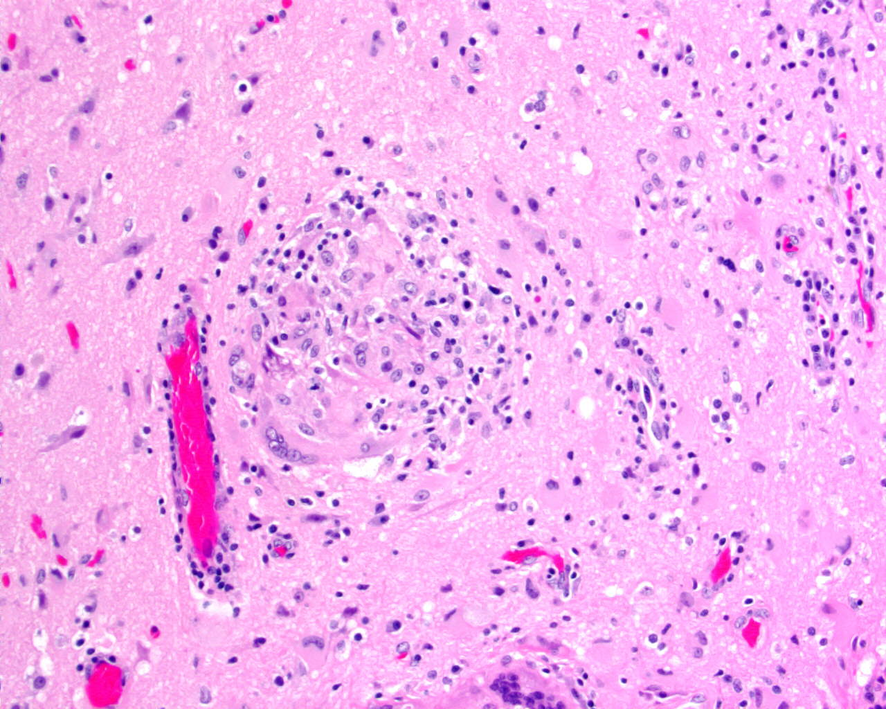

Slide 11
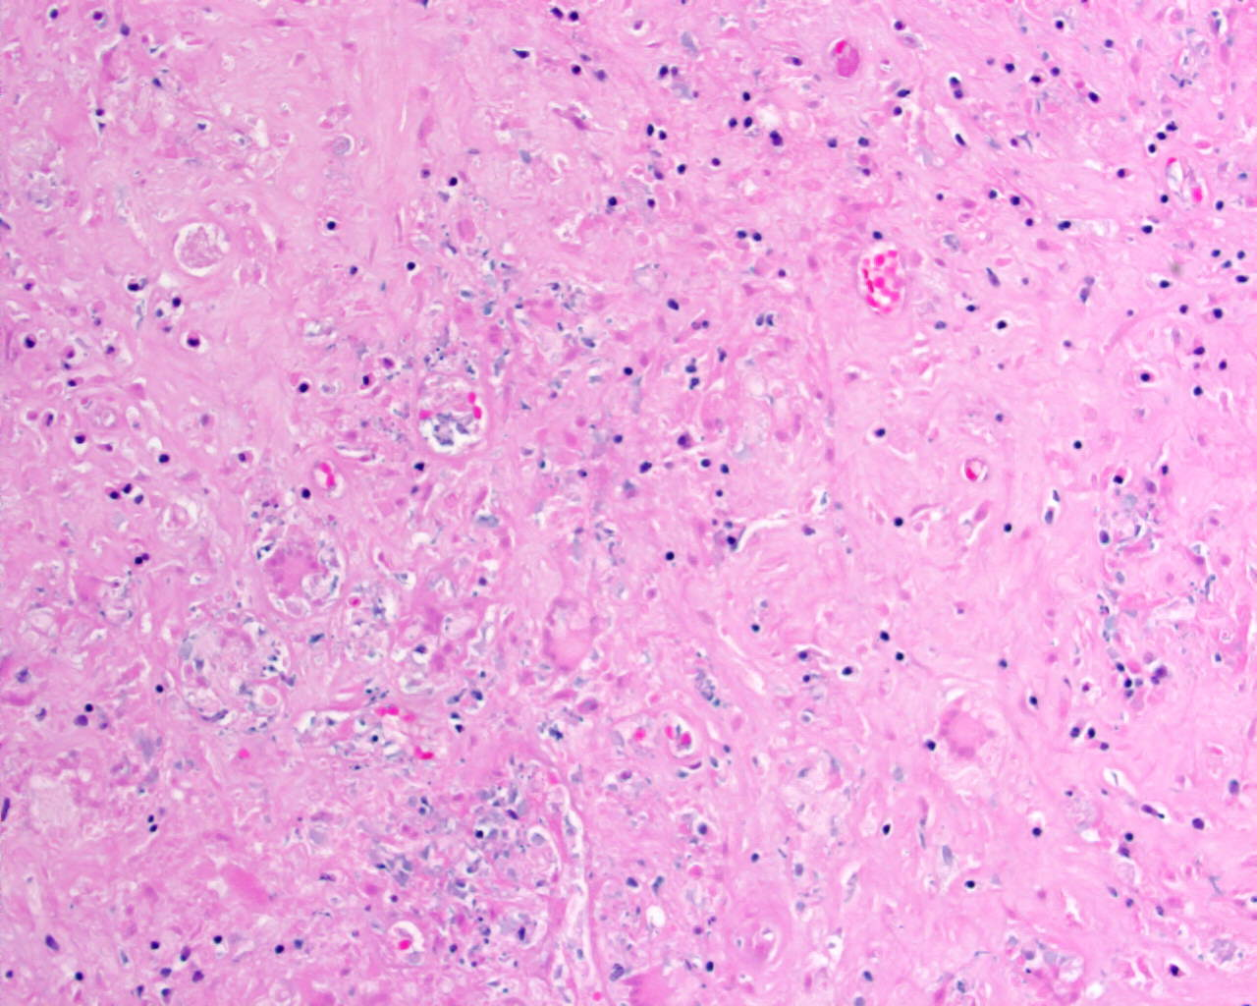

Slide 12
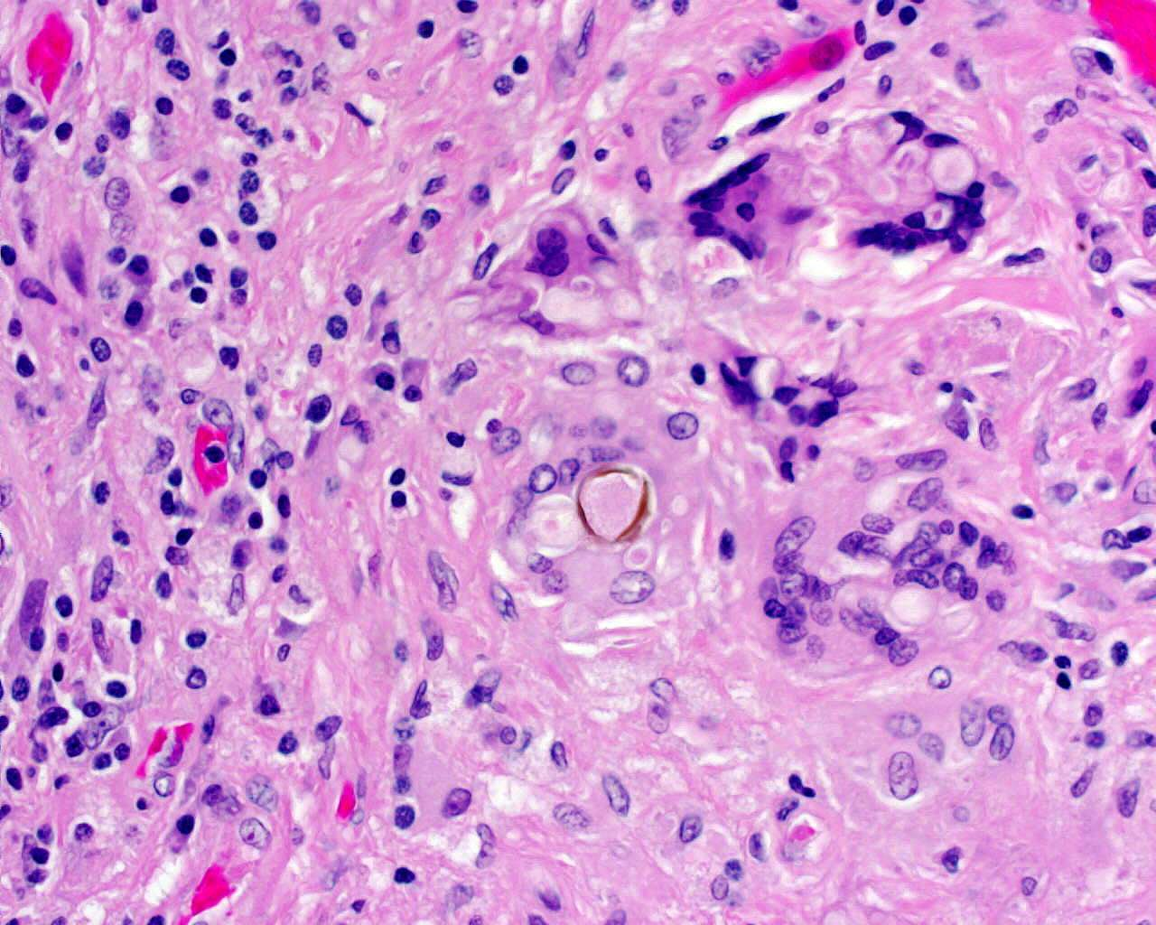

Slide 13
Comments…..
Differential Diagnosis
Additional studies?

Slide 14
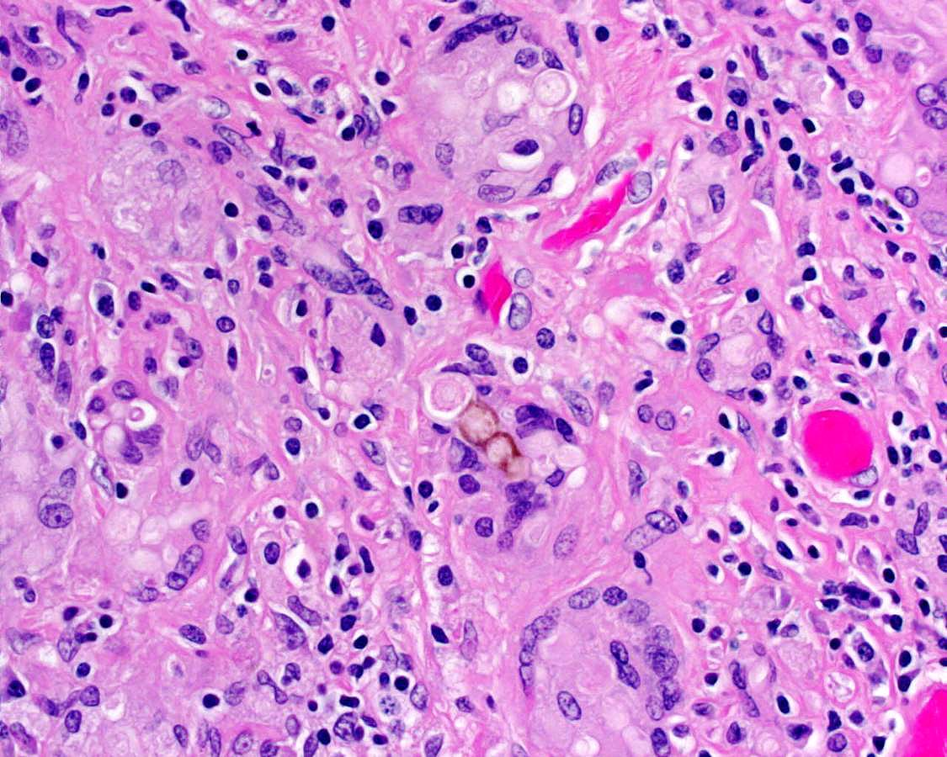
Brain mass

Slide 15
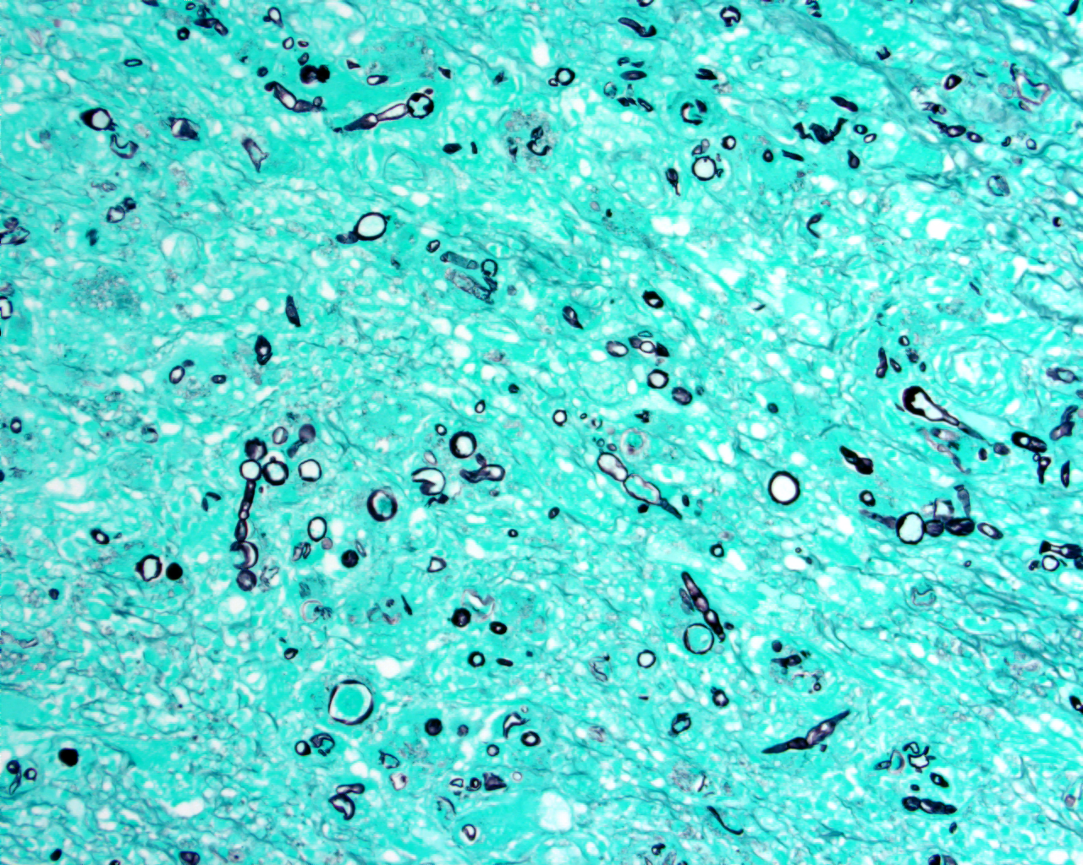
GMS

Slide 16
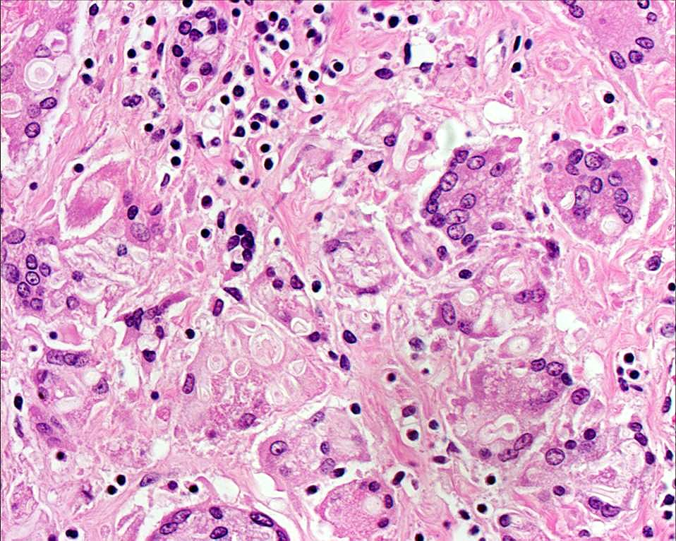
Lung mass

Slide 17
Culture
Few Dematiaceous Mold
Identified by sequencing
Bipolaris species

Slide 18
Diagnosis
Fungal abscess with Bipolaris species
aka Cerebral Phaeohyphomycosis or Chromoblastomycosis

Slide 19
Cerebral Phaeohyphomycosis
Caused by dematiaceous fungi
Soil, plants
Neurotropism in some species
High mortality rate

Slide 20
Cerebral Phaeohyphomycosis
CNS infection in immunocompetent or immunocompromised patients
Immunocompromised – Disseminated disease
Immunocompetent – CNS only
2nd-3rd decade
M:F = 3:1

Slide 21
Cerebral Phaeohyphomycosis
Can mimic a neoplasm or bacterial abscess on imaging
Ring-enhancing lesion
Can show irregular enhancement as seen in this case

Slide 22
Sources of CNS Infection
Hematogenous spread – Most common
Lung, Paranasal sinuses
Initial infection may be asymptomatic
Other sources of fungemia – Skin infection, IV drug use
Direct extension
Paranasal sinuses
Trauma/Surgery

Slide 23
Fungi Causing Cerebral Phaeohyphomycosis
Cladophialophora bantiana – Most common
Exophiala dermatitidis
Rhinocladiella mackenziei
Bipolaris spicifera and other Bipolaris species
Ochroconis gallopavum
Fonsecaea species
Chaetomium species
Curvularia species
Neoscytalidium dimidiatum

Slide 24
Histologic Features
Melanin pigment in cell wall
Thick-walled branched and unbranched hyphae with terminal vesicular structures
Budding forms
Structures are seen alone or in chains within foreign body type giant cells
Histiocytes, lymphocytes, and plasma cells

Slide 25
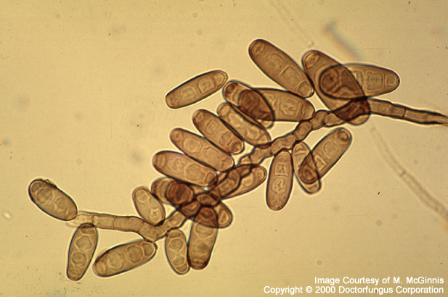
Bipolaris species
Isolated from plant and soil debris
Main pathogenic species: specifica, australiensis, hawaiiensis
Infects both immunocompetent and compromised hosts
Colonies: fast growing, wooly, olive green to black
Septate brown hyphae
Poroconidia: cylindrical, 3-6 fused cells; geniculate growth pattern
http://www.doctorfungus.org/thefungi/bipolaris.php

Slide 26
So how did our patient pick up Bipolaris?
Job in prison: cleaning showers and toilets
Outside in “the yard”
Gift from some friends or the Warden

Slide 27
References
Flizzola, et al. Phaeohyphomycosis of the central nervous system in immunocompetent hosts: report of a case and review of the literature. Int J Infect Dis. 2003 Dec;7(4):282-6.
Li, DM, de Hoog, GS. Cerebral phaeohyphomycosis – a cure at what lengths? Lancet Infect Dis. 2009 Jun;9(6):376-83.
Rosow, L., et al. Cerebral phaeohyphomycosis caused by Bipolaris spicifera after heart transplantation. Transpl Infect Dis. 2011 Aug;13(4):419-23.

