Slide 1


Slide 2
AMERICAN ASSOCIATION OF NEUROPATHOLOGISTS
2012 MEETING; JUNE 21-24
PALMER HOUSE HOTEL; CHICAGO
DSS Case #2
J-M BILBAO
SANDRA COHEN
AL-NOOR DHANANI
BEVERLEY YOUNG
SUNNYBROOK HOSPITAL, UNIVERSITY OF TORONTO

Slide 3
This 76-year-old woman was seen because of progressive weakness of 4 years
History of hysterectomy and hydronephrosis secondary to ureteric stenosis.
Ø family history of neurological or neuromuscular disease. Ø medications
Four years previously she began to experience numbness in the sole of Rt foot
progressing to the knee, and followed by weakness in both legs. She developed
difficulties standing and climbing stairs requiring the use of a cane, and with
swallowing that required treatment with bougies.
There are no complaints of bowel or bladder function.
PE: wide gait, unable to walk on her heels, slurred speech, slight facial weakness:
she can not puff her cheeks and cannot whistle. Weakness: diffuse in neck flexors and
Extremities 4+, ankle dorsiflexors 4, and toe dorsi-flexors 1. Reflexes: 1+ in UEs but
absent in LEs. Normal sensation
NC: length dependent motor>sensory axonal polyneuropathy. EMG: no spontaneous
activity, slight myopathic changes
CPK: 26
Clinical Dx: myopathy +distal polyneuropathy: metabolic + spinal stenosis
MUSCLE BIOPSY

Slide 4
Notes:
VARIATION IN SIZE AND SHAPE, atrophy and hypertrophy, endomysial fibrosis, small angulated fiber, extensive inflammation

Slide 5
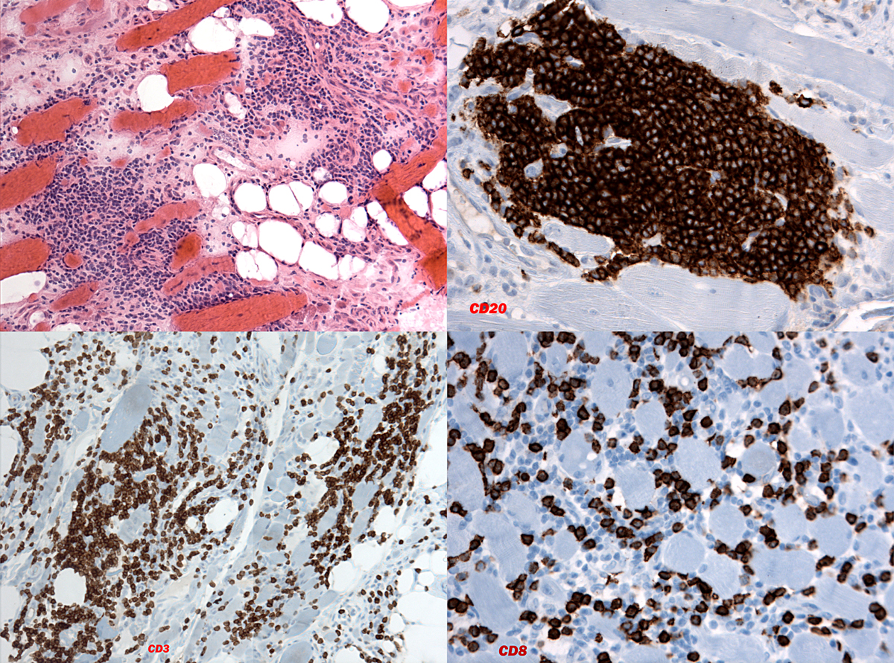

Slide 6
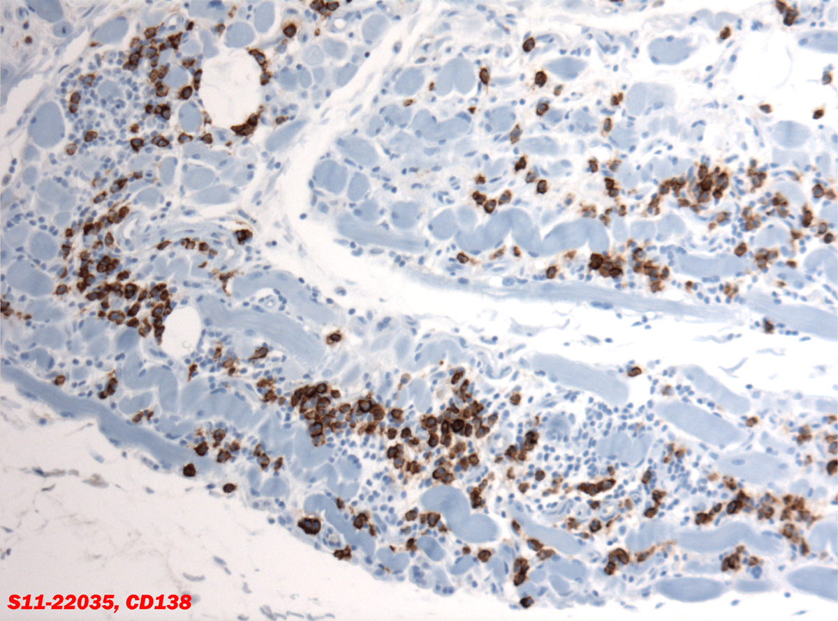

Slide 7
PROVIDED: PARAFFIN SECTION: H&E, CRYOSECTION: H&E
CRYOSECTION: IMMUNOSTAIN, SEMITHIN SECTION: TOLUIDINE BLUE,
COMPOSITE MICROPHOTOGRAPHS: IMMUNOSTAINS
DIAGNOSIS
WHAT IS THE IMMUNOSTAIN PROVIDED?
COMMENTS
QUESTIONS

Slide 8
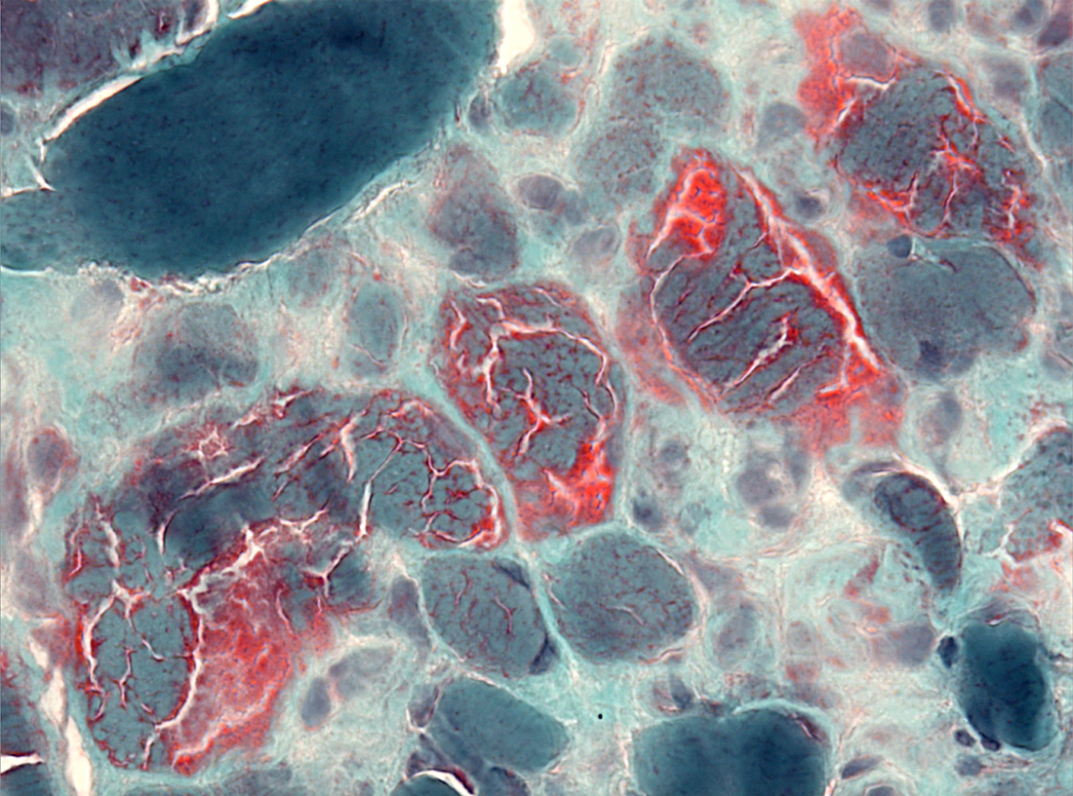

Slide 9
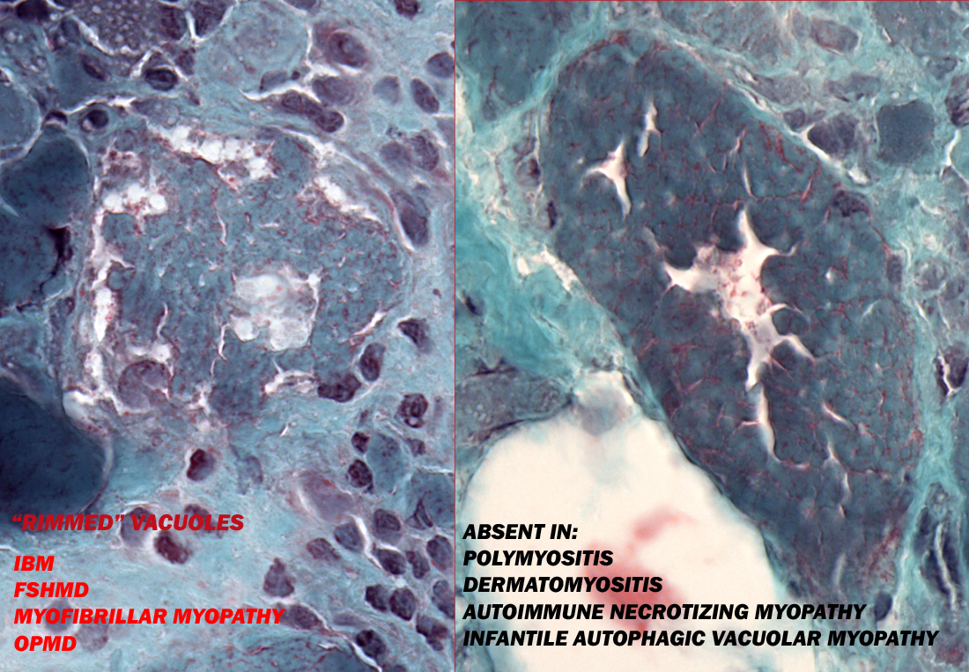

Slide 10
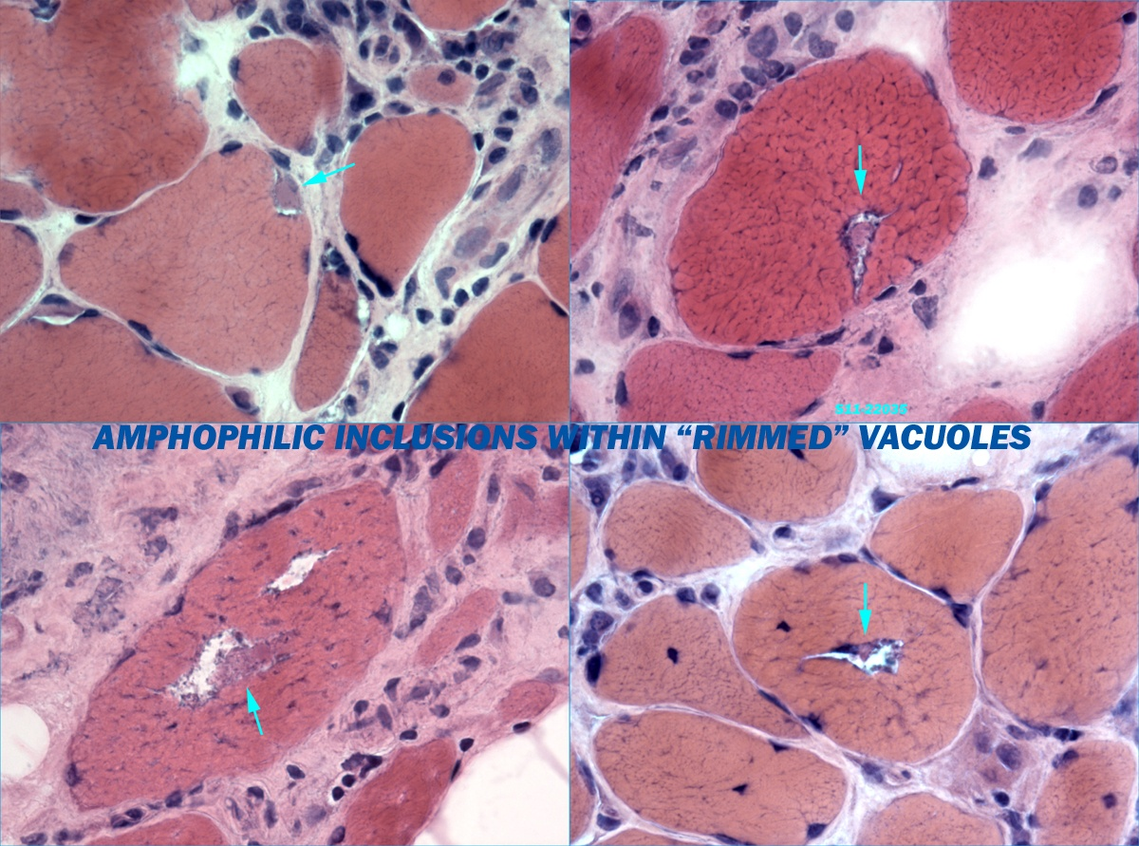

Slide 11
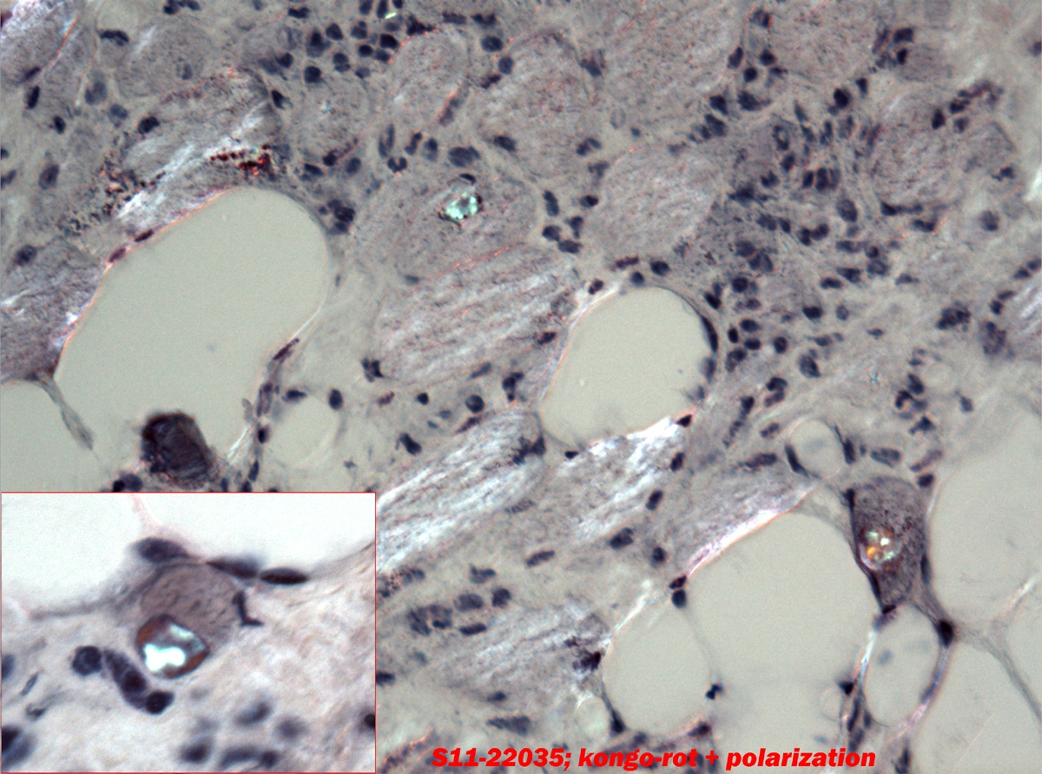

Slide 12
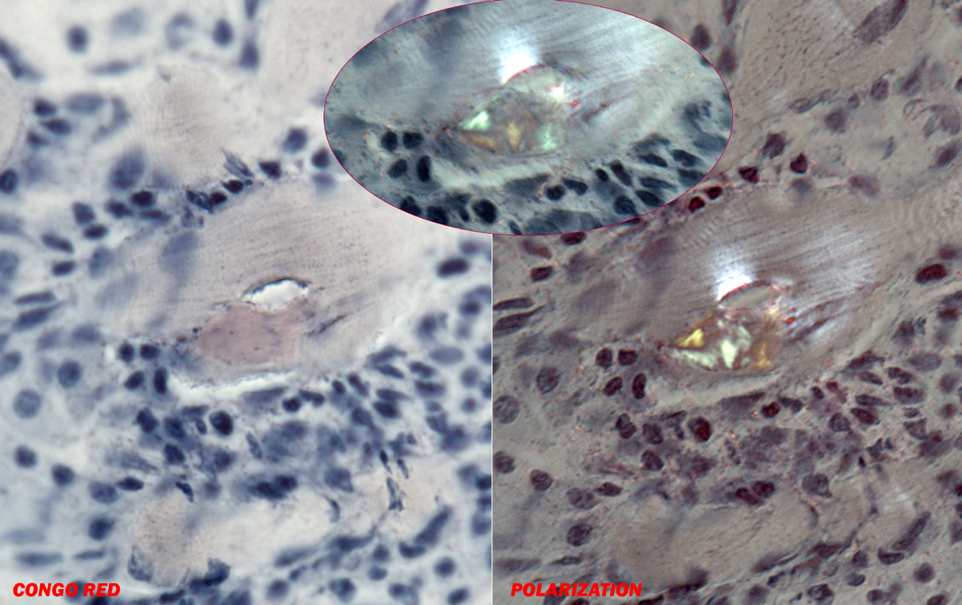

Slide 13
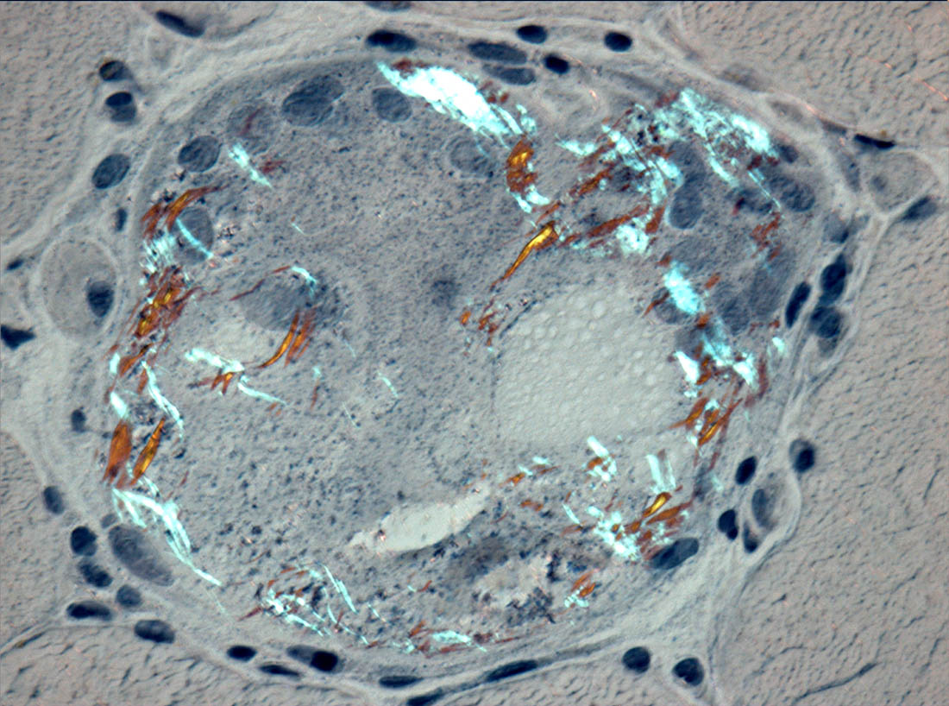

Slide 14
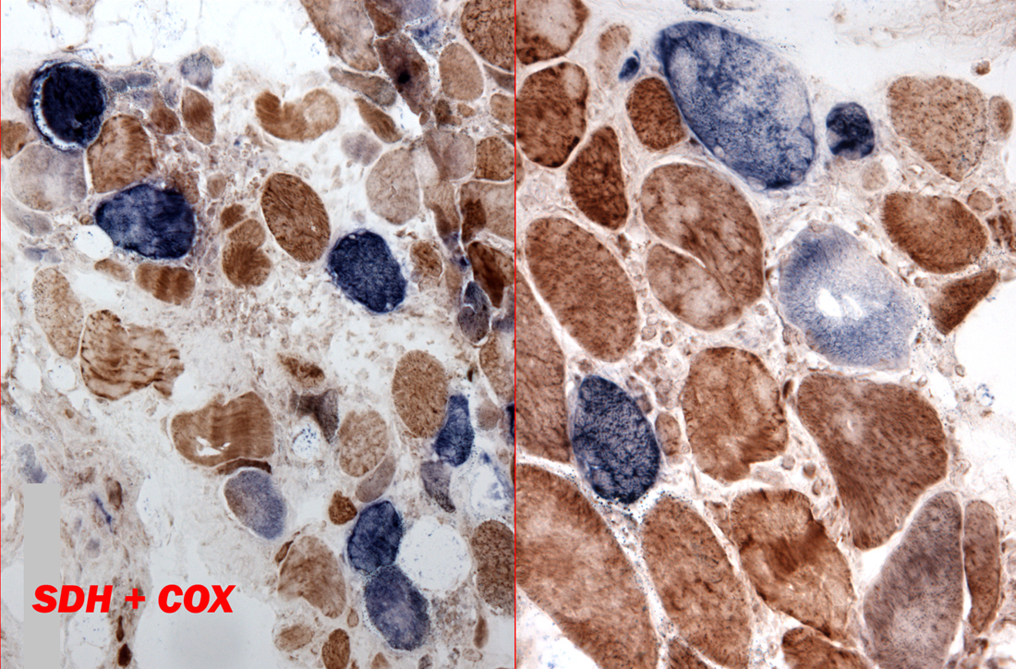

Slide 15
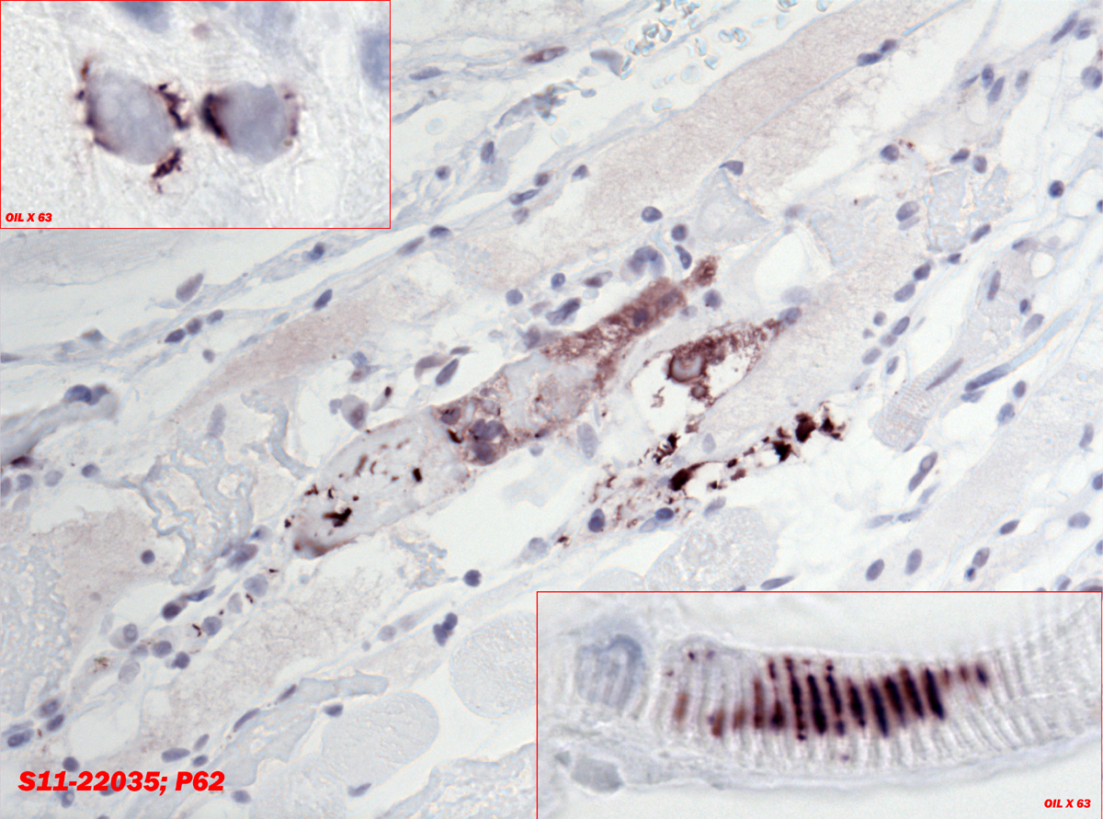

Slide 16
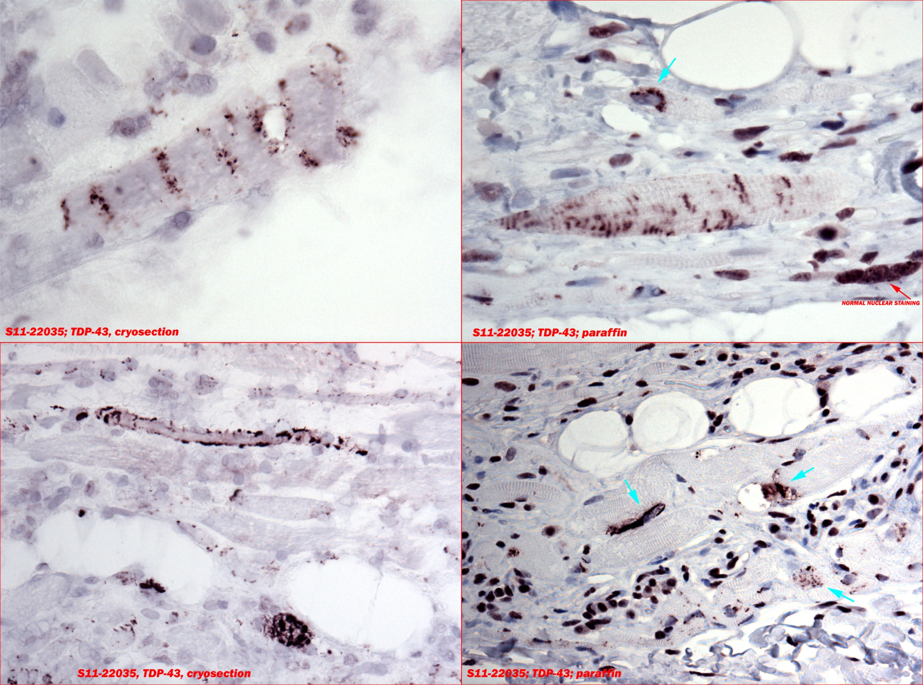

Slide 17
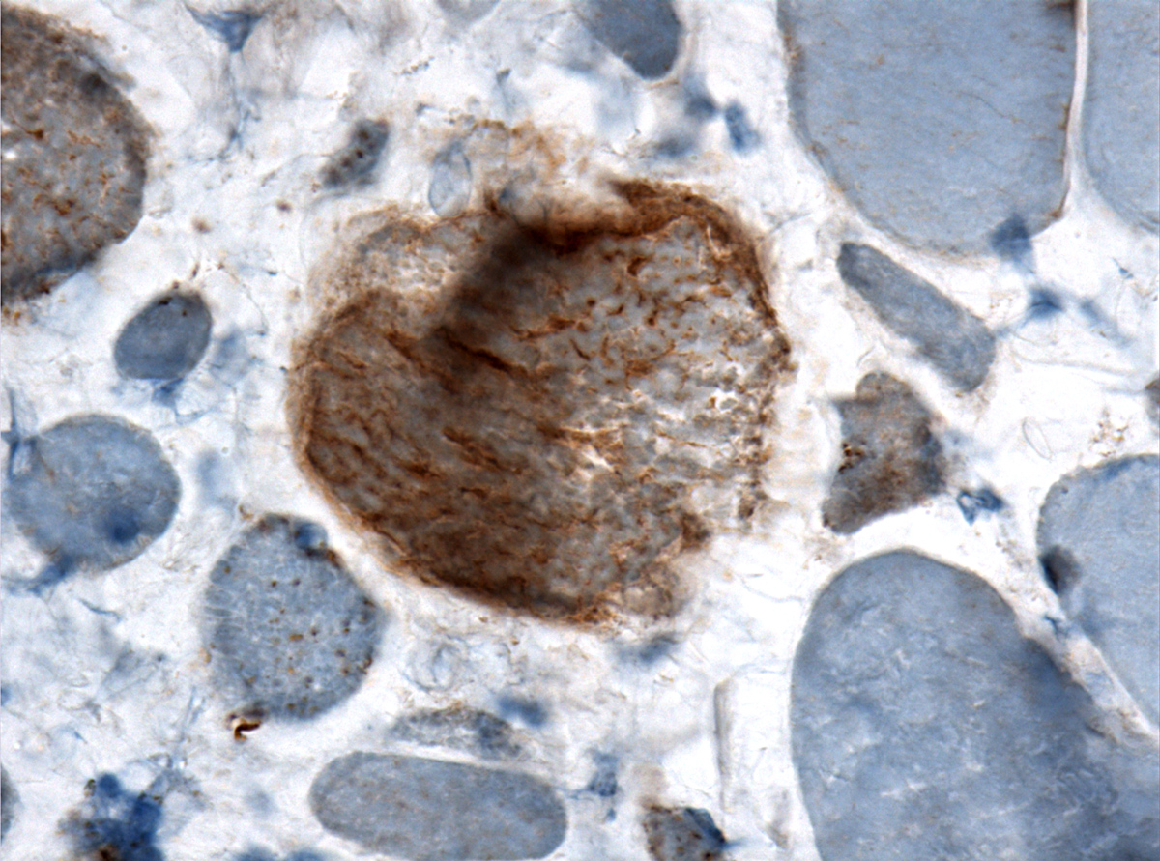

Slide 18
TAR DNA BINDING PROTEIN 43
Highly conserved protein ubiquitously expressed
in nucleiD
Hyperphosphorylated TP-43 is a major constituent
in glial and neuronal inclusions in sALS, FTLD-U
and FTLD-motor neuron disease
TDP-43 accumulation has recently been
Identified as the signature protein in “rimmed”
Vacuoles in many myopathies.

Slide 19
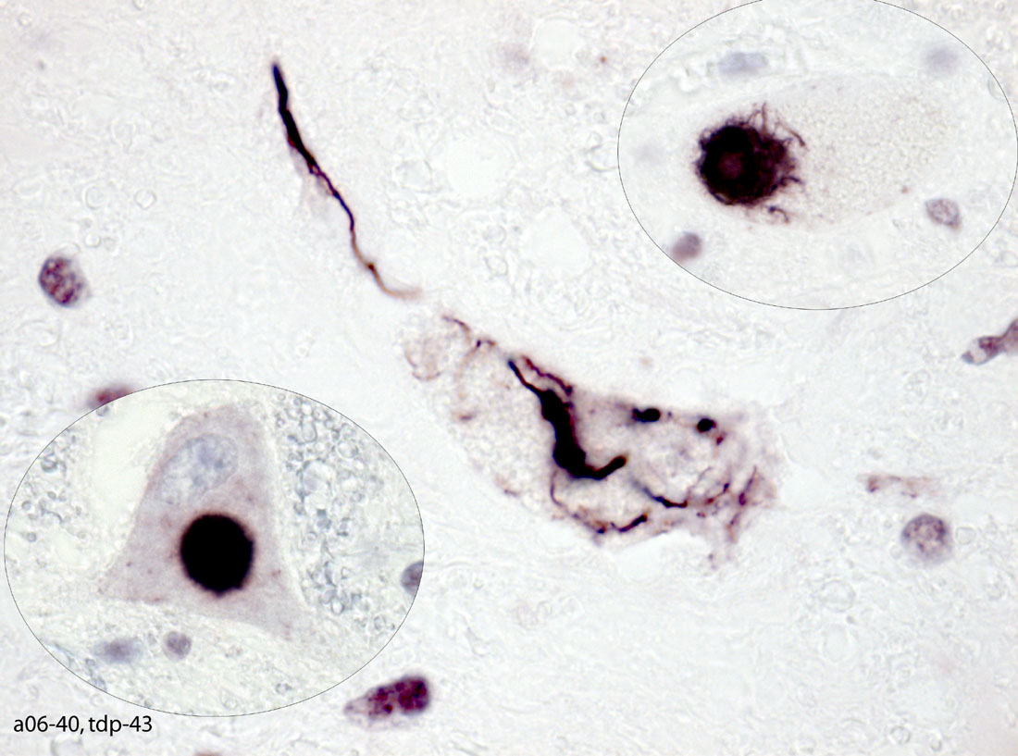
ALS, ventral horn

Slide 20
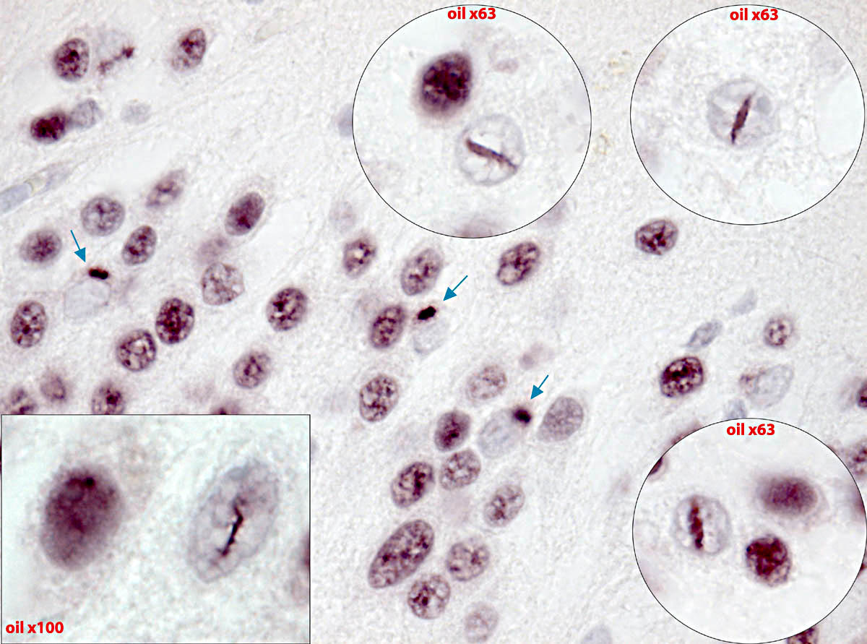
Fascia dentata: FTLD-TDP43

Slide 21
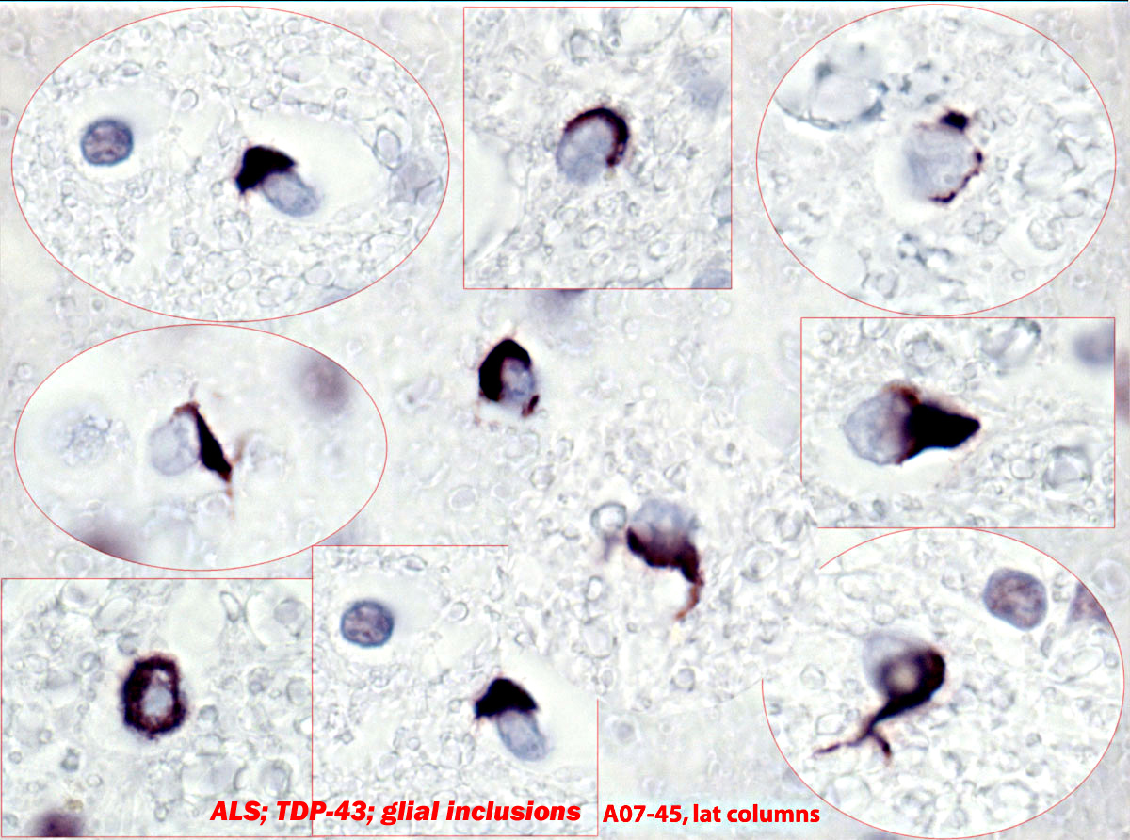

Slide 22
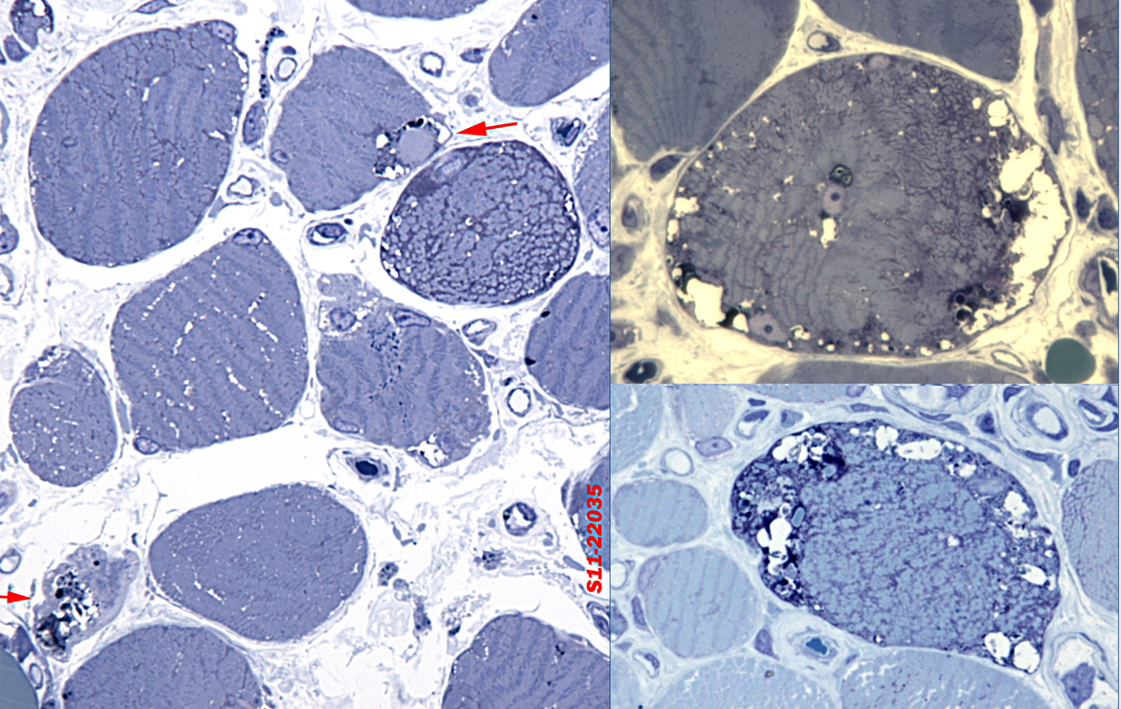

Slide 23
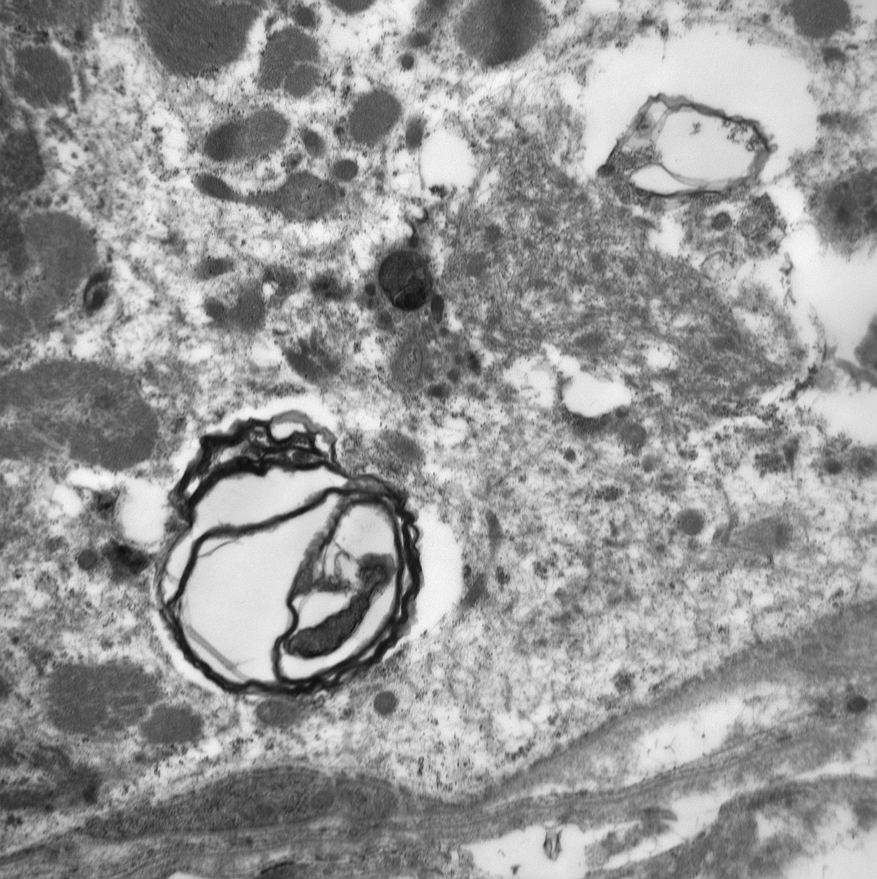
OSMIOPHILIC CYTOMEMBRANES
15-18 nm FILAMENTS

Slide 24
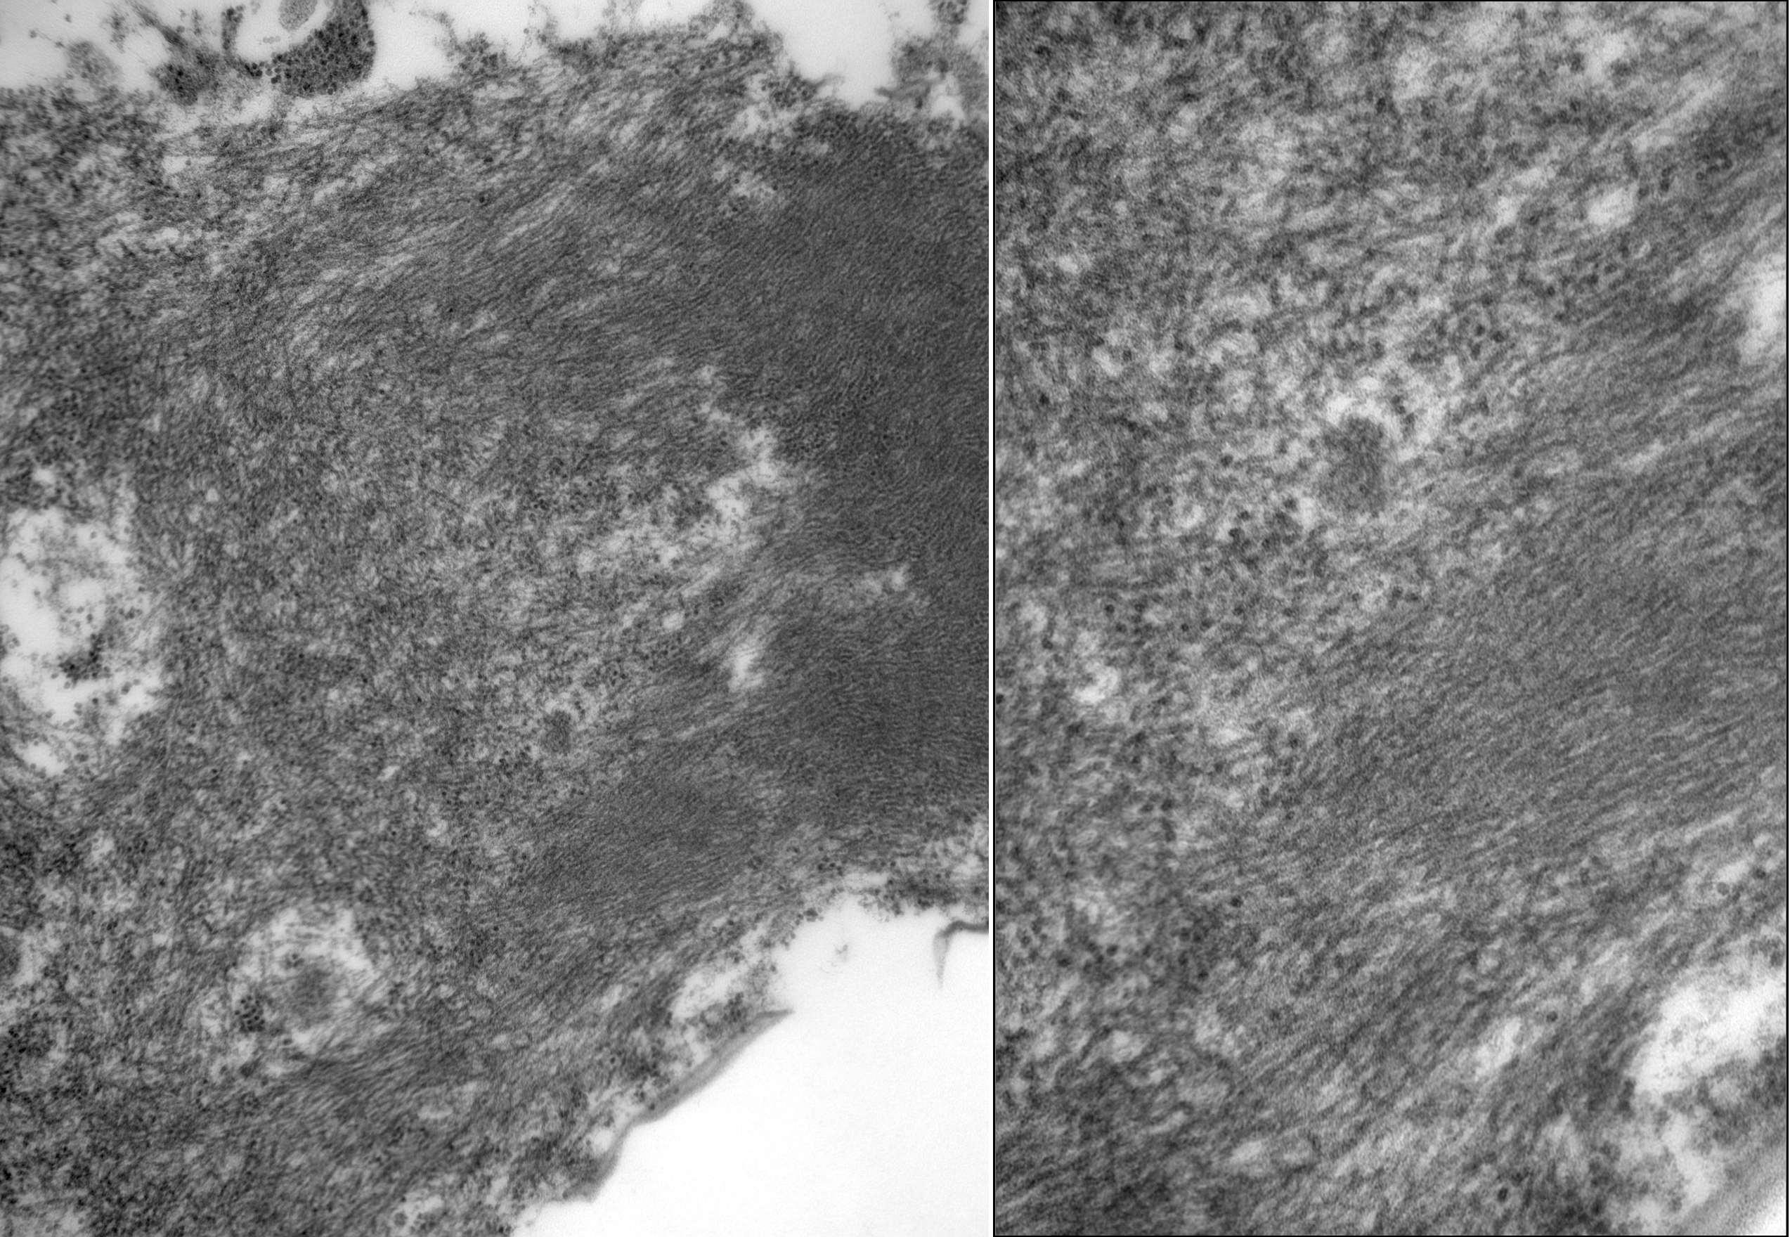
in parallel or haphazardly

Slide 25
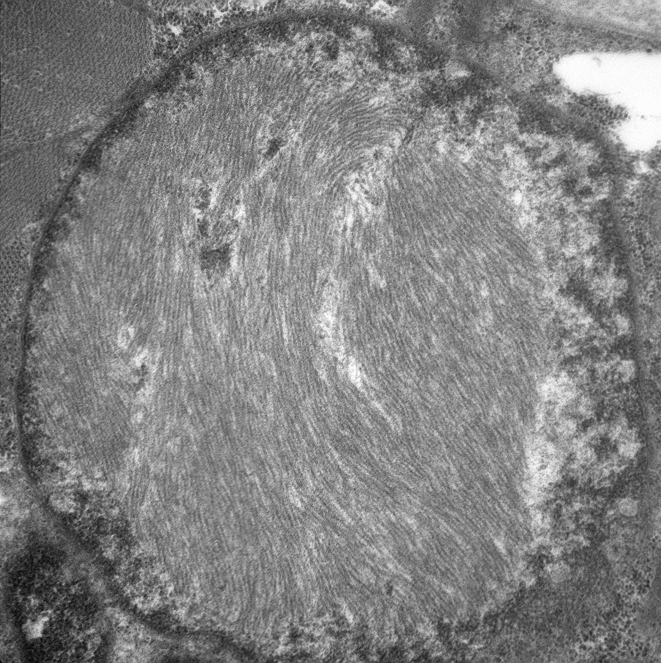
INTRANUCLEAR INCLUSIONS

Slide 26
DIAGNOSTIC CRITERIA FOR Sporadic Inclusion Body Myositis
Endomysial inflammation
Partial invasion (CD8 +ve)
“rimmed” vacuoles
PLUS:
Congo red +ve sarcoplasmic inclusions
Or Crystal Violet
Or HF-tau (SMI31)
Or TDP43 (in vacuoles or in non-vacuolated sarcoplasm)
Or 15-18 nm filaments (sarcoplasmic and/or intranuclear)
p62
Overexpression of MHC1
COX deficient myofibers

Slide 27
TDP-43 positive aggregates
Myopathies with rimmed vacuoles
Sporadic inclusion body myositis 14/18 (77.8 %)
Oculopharyngeal muscular dystrophy 5/6 (83.3%)
Distal myopathy with rimmed vacuoles 3/3 (100%)
Myopathies without rimmed vacuoles
Dermatomyositis 0/3 (0%)
Polymyositis 0/5 (0%)
Metabolic-mitochondrial myopathy 0/5 (0%)
Neurogenic atrophy 0/4 (0%)
Facioscapulohumeral dystrophy 0/2 (0%)
Duchenne muscular dystrophy 0/3 (0%)
Becker muscular dystrophy 0/1 (0%)
Congenital central core disease 0/3 (0%)
Normal biopsy 0/5 (0%)
Kϋsters et al Acta Neuropathol (2009) 117:209–211

Slide 28
AANP 2012 DSS case # 2
DIAGNOSIS: s INCLUSION BODY MYOSITIS
(significant clinical improvement after 3 months of steroids)
DYSPHAGIA MAY BE A PROMINENT FEATURE IN IBM
SOME PATIENTS MAY EXPERIENCE SIGNIFICANT IMPROVEMENT
FOLLOWING STEROID TREATMENT
ABNORMAL TDP43 MAY BE UBIQUITOUS AND IS PRESENT IN
VACUOLES AND IN THE SARCOPLASM OF
NON-VACUOLATED MYOFIBERS
FOR THE DIAGNOSIS OF IBM, IMMUNOSTAINING FOR
TDP43 MAY BE HELPFUL WHEN NO “RIMMED” VACUOLES ARE
OBSERVED.

Slide 29
References
C C Weihl,P Temiz, S E Miller, G Watts,C Smith, M Forman, P I Hanson,V Kimonis,7 A Pestronk1:TDP-43 accumulation in inclusion body myopathy muscle suggests a common pathogenic mechanism with frontotemporal dementia. J Neurol Neurosurg Psychiatry 2008;79:1186–1189
Benno Küsters · Bas J. A. van Hoeve · Helenius Jurgen Schelhaas · Henk ter Laak · Baziel G. M. van Engelen · Martin Lammens:TDP-43 accumulation is common in myopathies with rimmed vacuoles. Acta Neuropathol (2009) 117:209–211
MOHAMMAD SALAJEGHEH, JACK L. PINKUS,. PAUL TAYLOR, ANTHONYA. AMATO, REMEDIOS NAZARENO, ROBERT H. BALOH, and STEVEN A. GREENBERG:SARCOPLASMIC REDISTRIBUTION OF NUCLEARTDP-43 IN INCLUSION BODY MYOSITIS. MUSCLE & NERVE July 2009
ASHOK VERMA,and RUP TANDAN, TDP-43: A RELIABLE IMMUNOHISTOCHEMISTRY MARKER FOR INCLUSION BODY MYOSITIS?. Muscle Nerve 40: 8–9, 2009
Anna Nogalska,Chiara Terracciano,Carla D’Agostino,W. King Engel,Valerie Askanas:p62/SQSTM1 is overexpressed and prominently accumulated in inclusions of sporadic inclusion-body myositis muscle fibers, and can help differentiating it from polymyositis and dermatomyositis. Acta Neuropathol (2009) 118:407–413

Slide 30
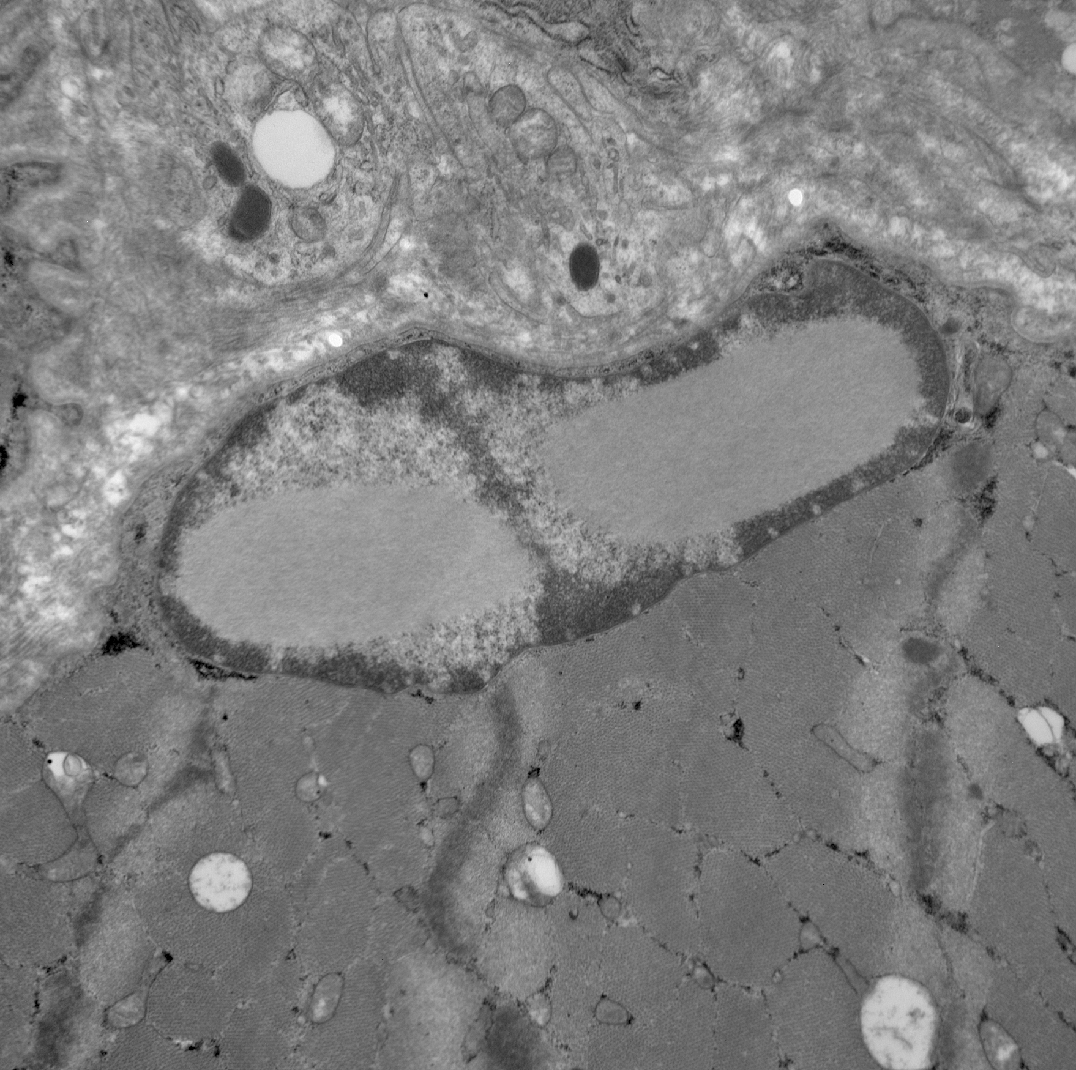
DIFFERENTIAL DIAGNOSIS OF INTRANUCLEAR INCLUSIONS
INTRANUCLEAR FIBROUS BODIES

Slide 31
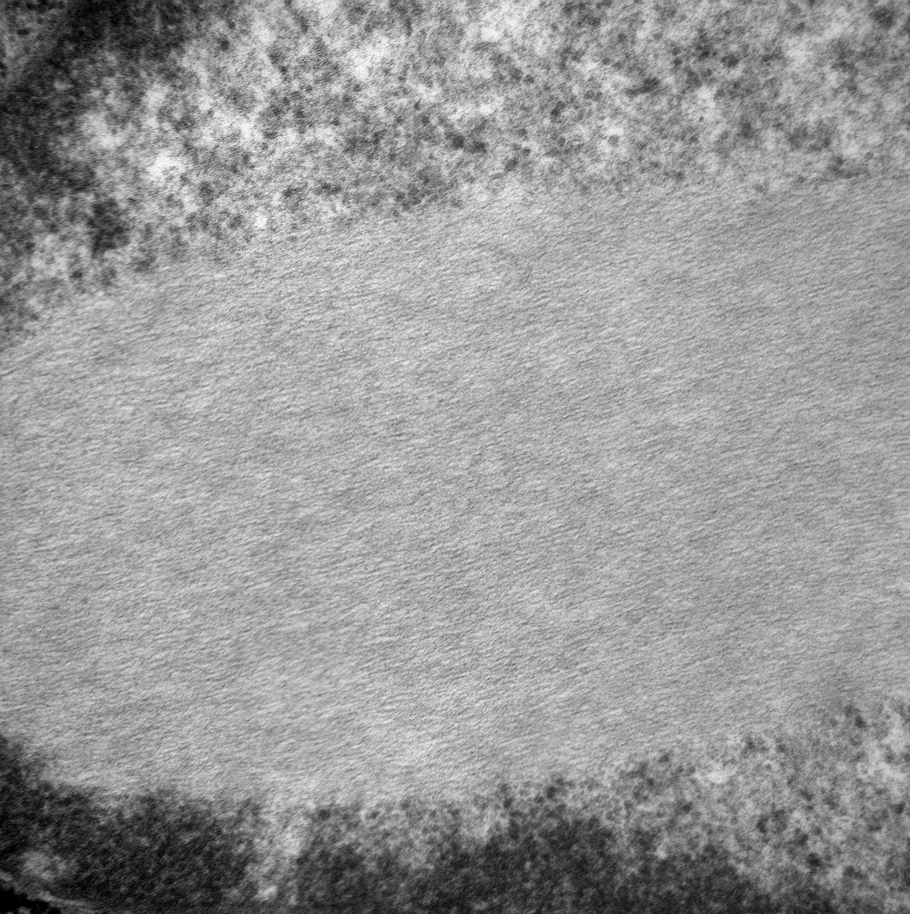
5 to 7 nm: thin filaments

Slide 32
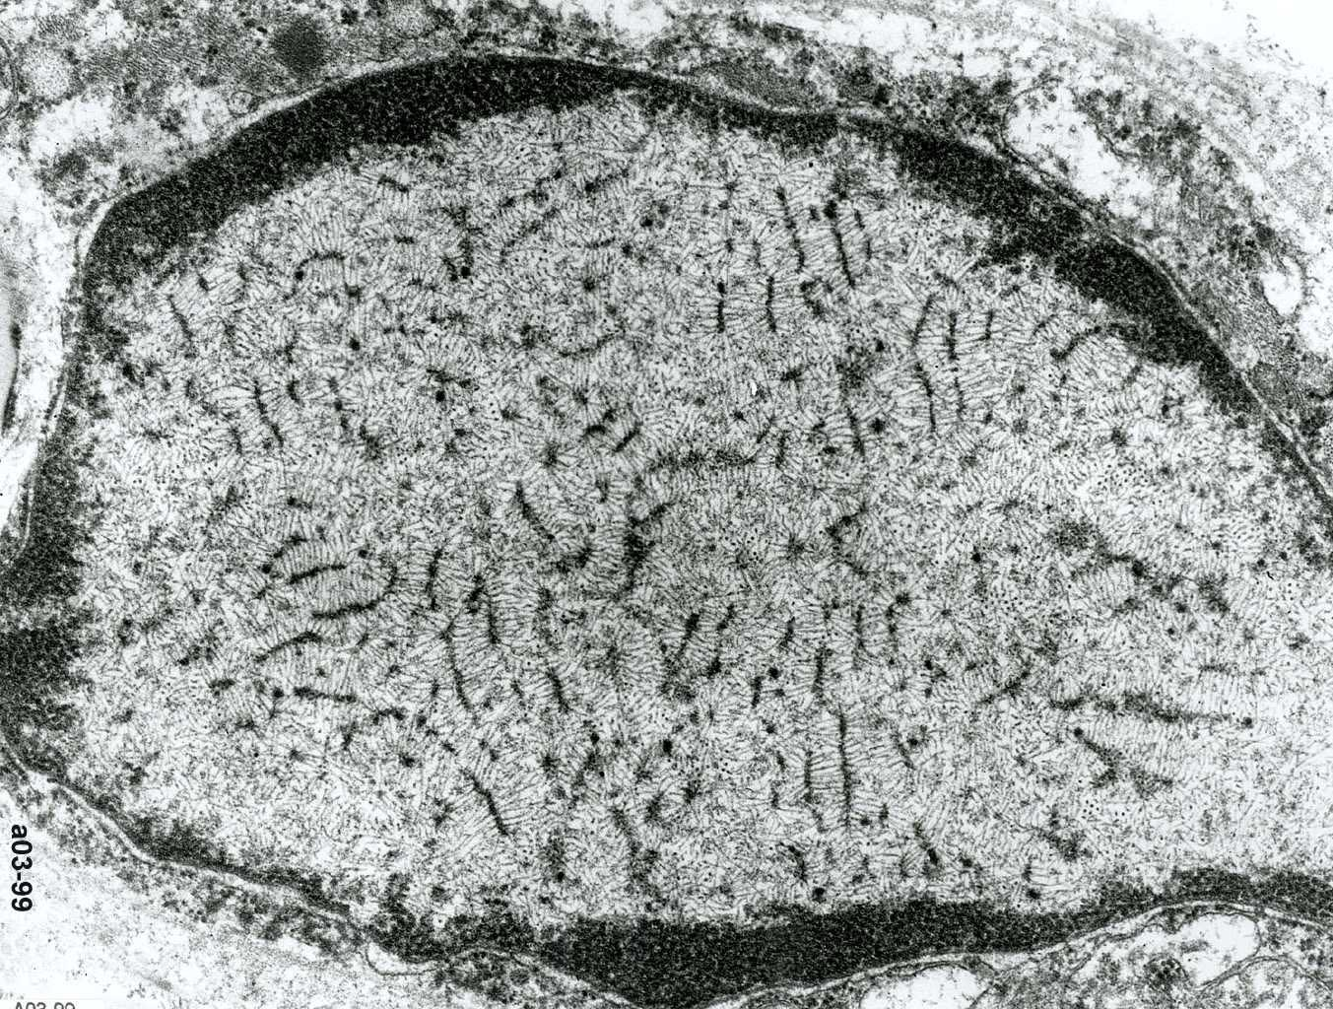
OCULOPHARYNGEAL MUSCULAR DYSTROPHY

Slide 33
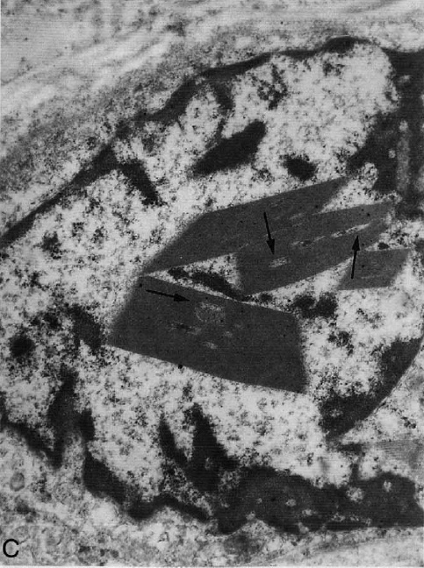
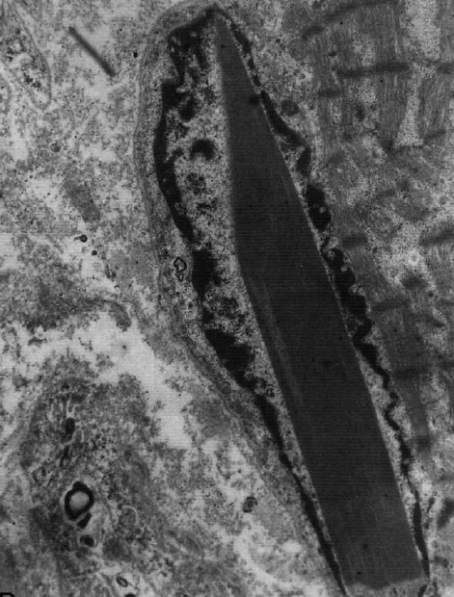
INTRANUCLEAR NEMALINE RODS

Slide 34
Inclusion Body Myositis
A progressive inflammatory skeletal muscle disease
Usually sporadic, a few familial cases have been reported
Most common disease of aging, affecting elderly patient over the age of 50
More common in males

Slide 35
Clinical Features
Proximal and distal muscle weakness
Asymmetrical
weakness and wasting the of quadriceps
Finger flexors and ankle dorsiflexors
Dysphagia
Slow progression but can lead to severe disability
Polyneuropathy 15%
SLE, Sjogren, thrombocytopenia
CK may be normal or elevated up to 10 times
MRI is helpful in delineating specific patterns of muscle involvement

