Slide 1
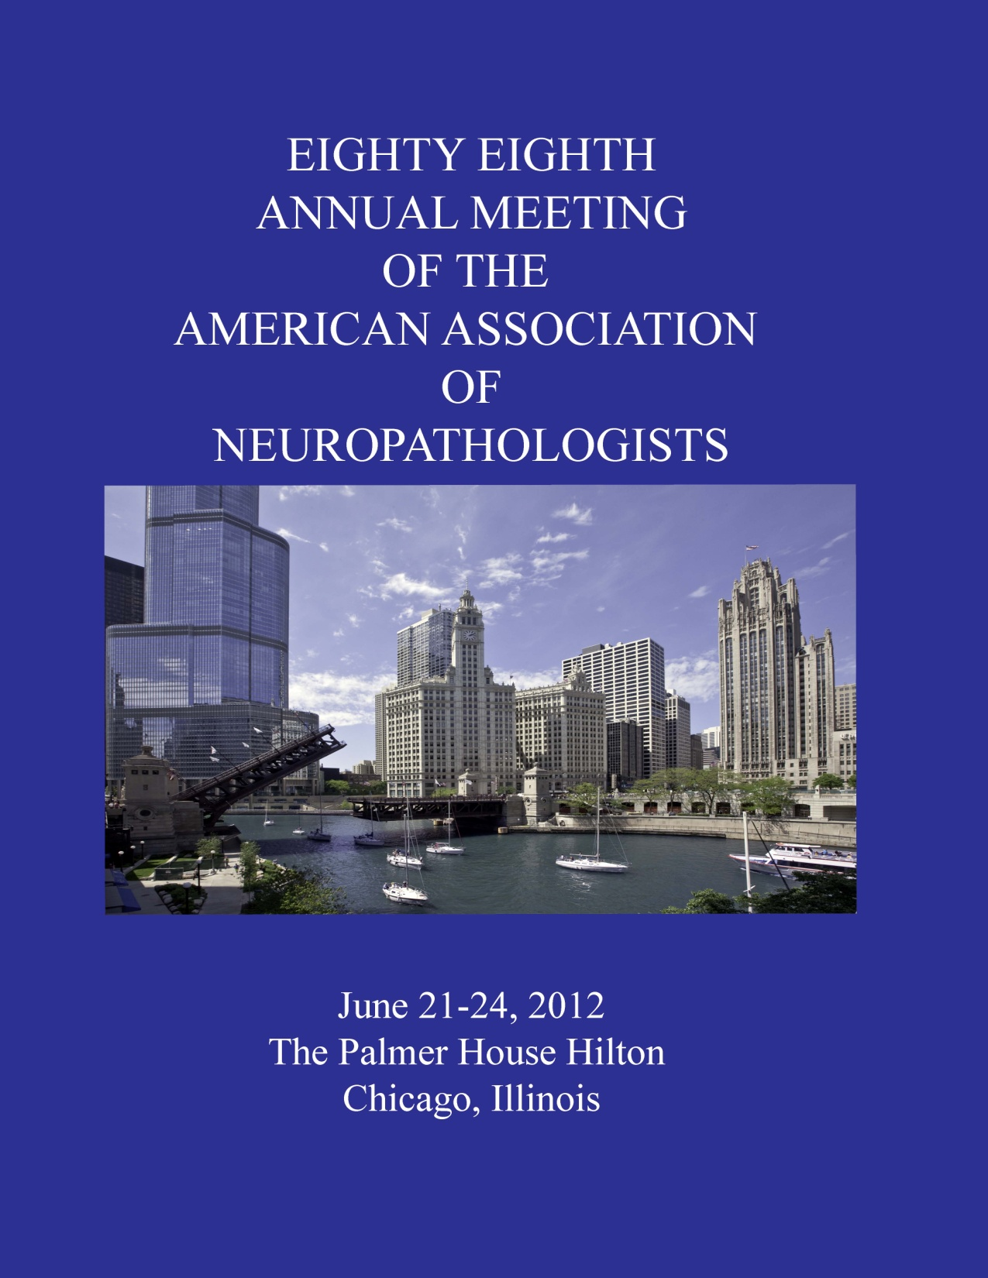

Slide 2

Case 2012-09
Diagnostic Slide Session
AANP - Annual Meeting
Saturday, June 23, 2012
David Pisapia, M.D.
Neuropathology Fellow
Department of Pathology & Cell Biology

Slide 3
Clinical History
5/2010
CLL
67-year-old woman
Notes:
3

Slide 4
Clinical History
5/2010
8/2011
CLL
Bendamustine
Notes:
4

Slide 5
Clinical History
5/2010
8/2011
11/2011
CVP
CLL
Bendamustine
Notes:
5

Slide 6
Clinical History
5/2010
8/2011
11/2011
5 days PTA
CVP
CLL
Bendamustine
Chest pain
Sinus tach
Metoprolol
Digoxin
Notes:
6

Slide 7
Clinical History
5/2010
8/2011
11/2011
Admission
5 days PTA
Ataxia
Vertigo
Paresthesia
Weakness
CVP
CLL
Bendamustine
Chest pain
Sinus tach
Metoprolol
Digoxin
Notes:
7

Slide 8
Clinical History
5/2010
8/2011
11/2011
Admission
5 days PTA
Day 4
Ataxia
Vertigo
Paresthesia
Weakness
CVP
CLL
Bendamustine
Chest pain
Sinus tach
Metoprolol
Digoxin
Comatose
Brain Biopsy
Notes:
8

Slide 9
Clinical History
5/2010
8/2011
11/2011
Admission
Day 6
5 days PTA
Day 4
Ataxia
Vertigo
Paresthesia
Weakness
CVP
Decerebrate
posturing
CLL
Bendamustine
Chest pain
Sinus tach
Metoprolol
Digoxin
Comatose
Brain Biopsy
Notes:
9

Slide 10
Clinical History
5/2010
8/2011
11/2011
Admission
Day 6
5 days PTA
Day 4
Day 8
Ataxia
Vertigo
Paresthesia
Weakness
CVP
Decerebrate
posturing
CLL
Bendamustine
Chest pain
Sinus tach
Metoprolol
Digoxin
Comatose
Brain Biopsy
Death
8 days

Slide 11
T2 FLAIR
Day 2
Day 3
Day 5
Punctate signal on diffusion-weighted imaging (DWI) progressed to diffuse DWI signal throughout the white matter
No contrast enhancement was seen at any point
Notes:
ADD FIGURE LEGEND
There was no contrast enhancement.

Slide 12
Clinical Differential Diagnosis
Richter’s transformation
Primary CNS lymphoma with leukemic phase
Opportunistic infection
Vasculopathy
Notes:
Add comment about radiology DDX

Slide 13
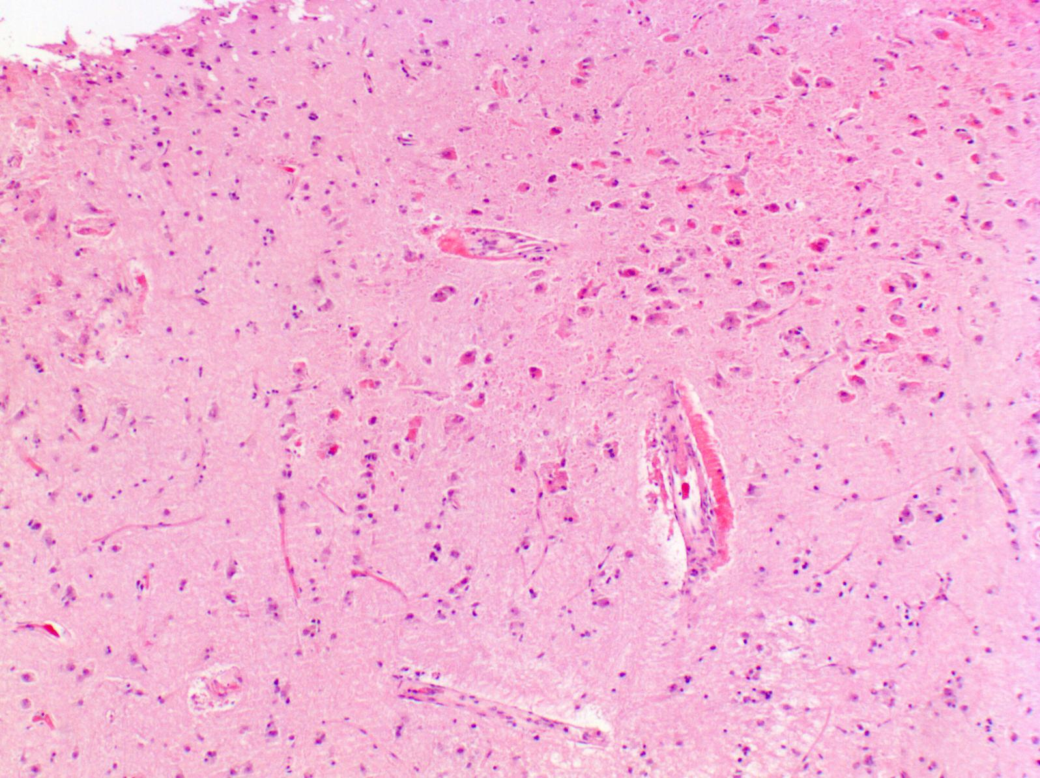
Right frontal cortex
Notes:
H&E stained sections shows accumulation of eosinophilic material around cortical blood vessels.

Slide 14
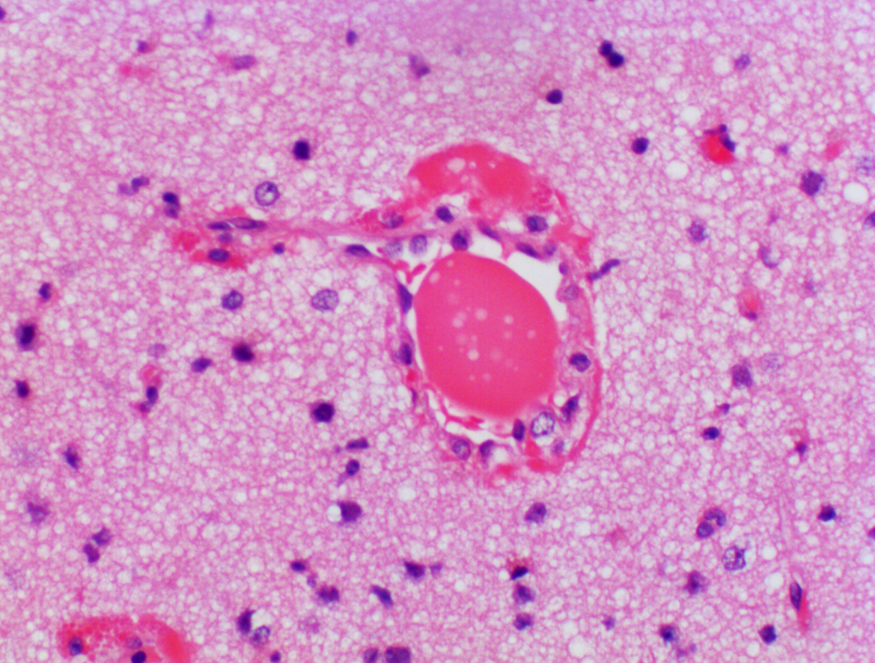
Notes:
Higher power shows this bubbly amporphous material in both perivascular and intralunial compartments.
14

Slide 15
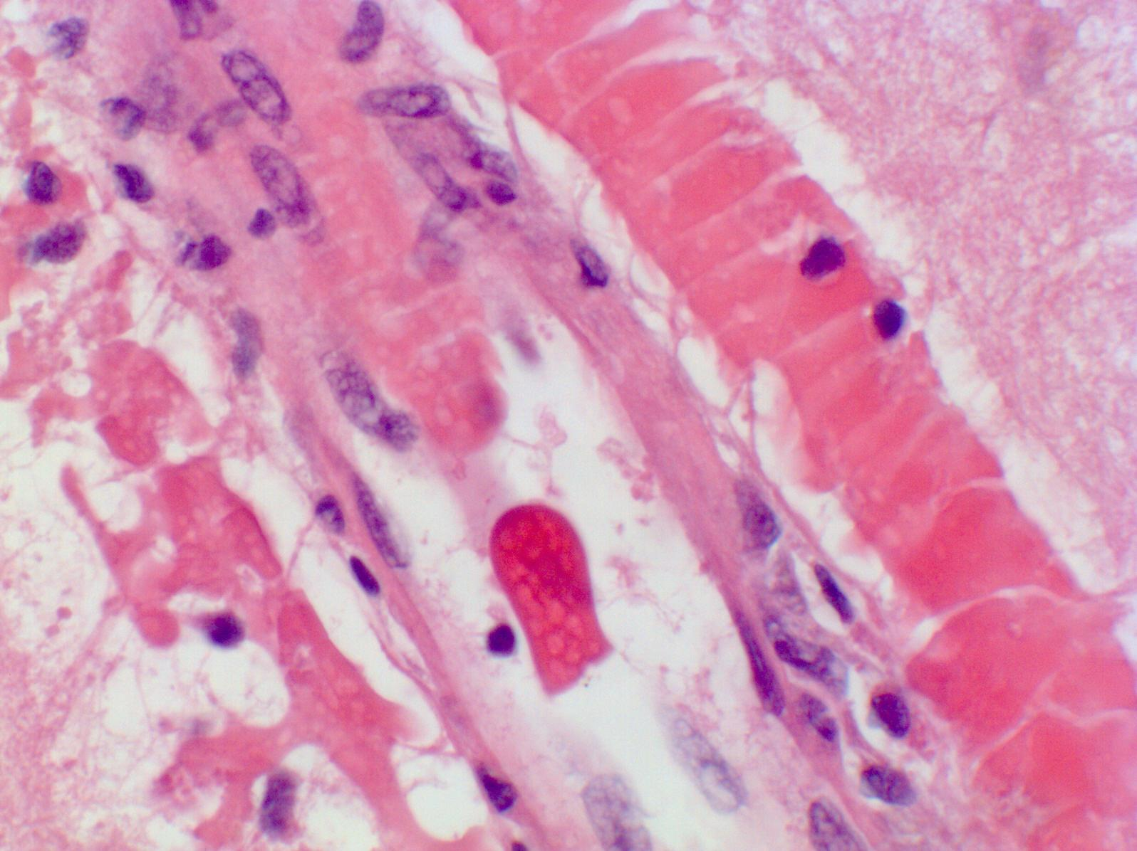

Slide 16
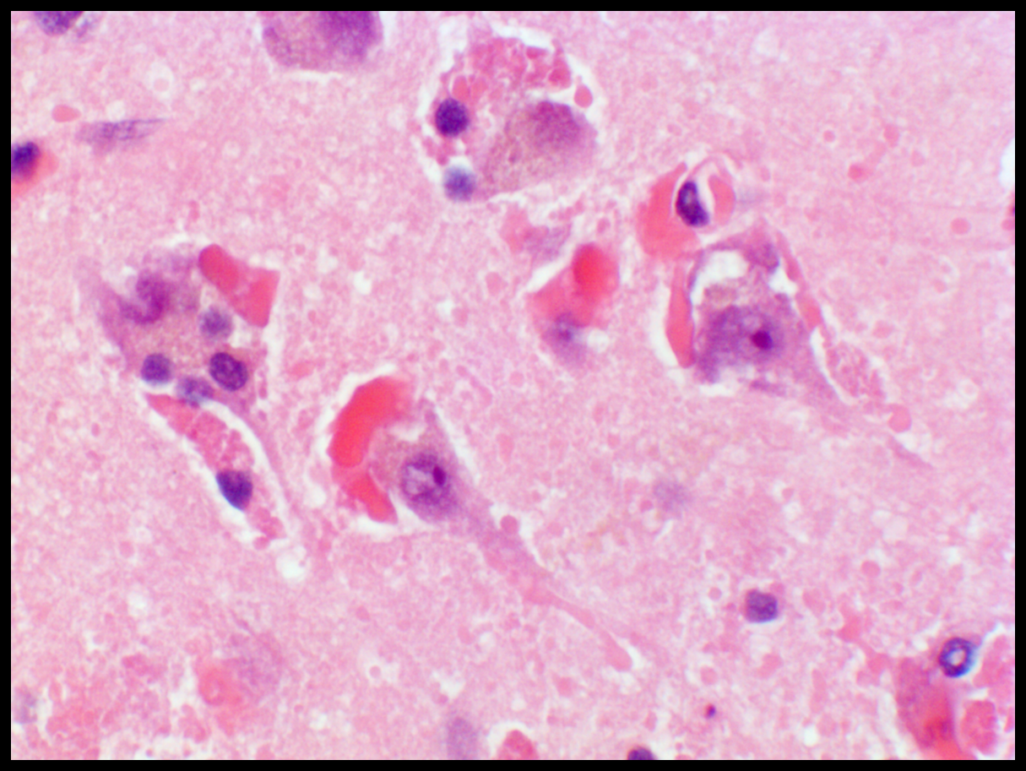
Notes:
The eosinophilic material is present in association with neurons. Some non-neuronal cells –potentially astoglical or microglial - also contain eosinoophilic material.

Slide 17
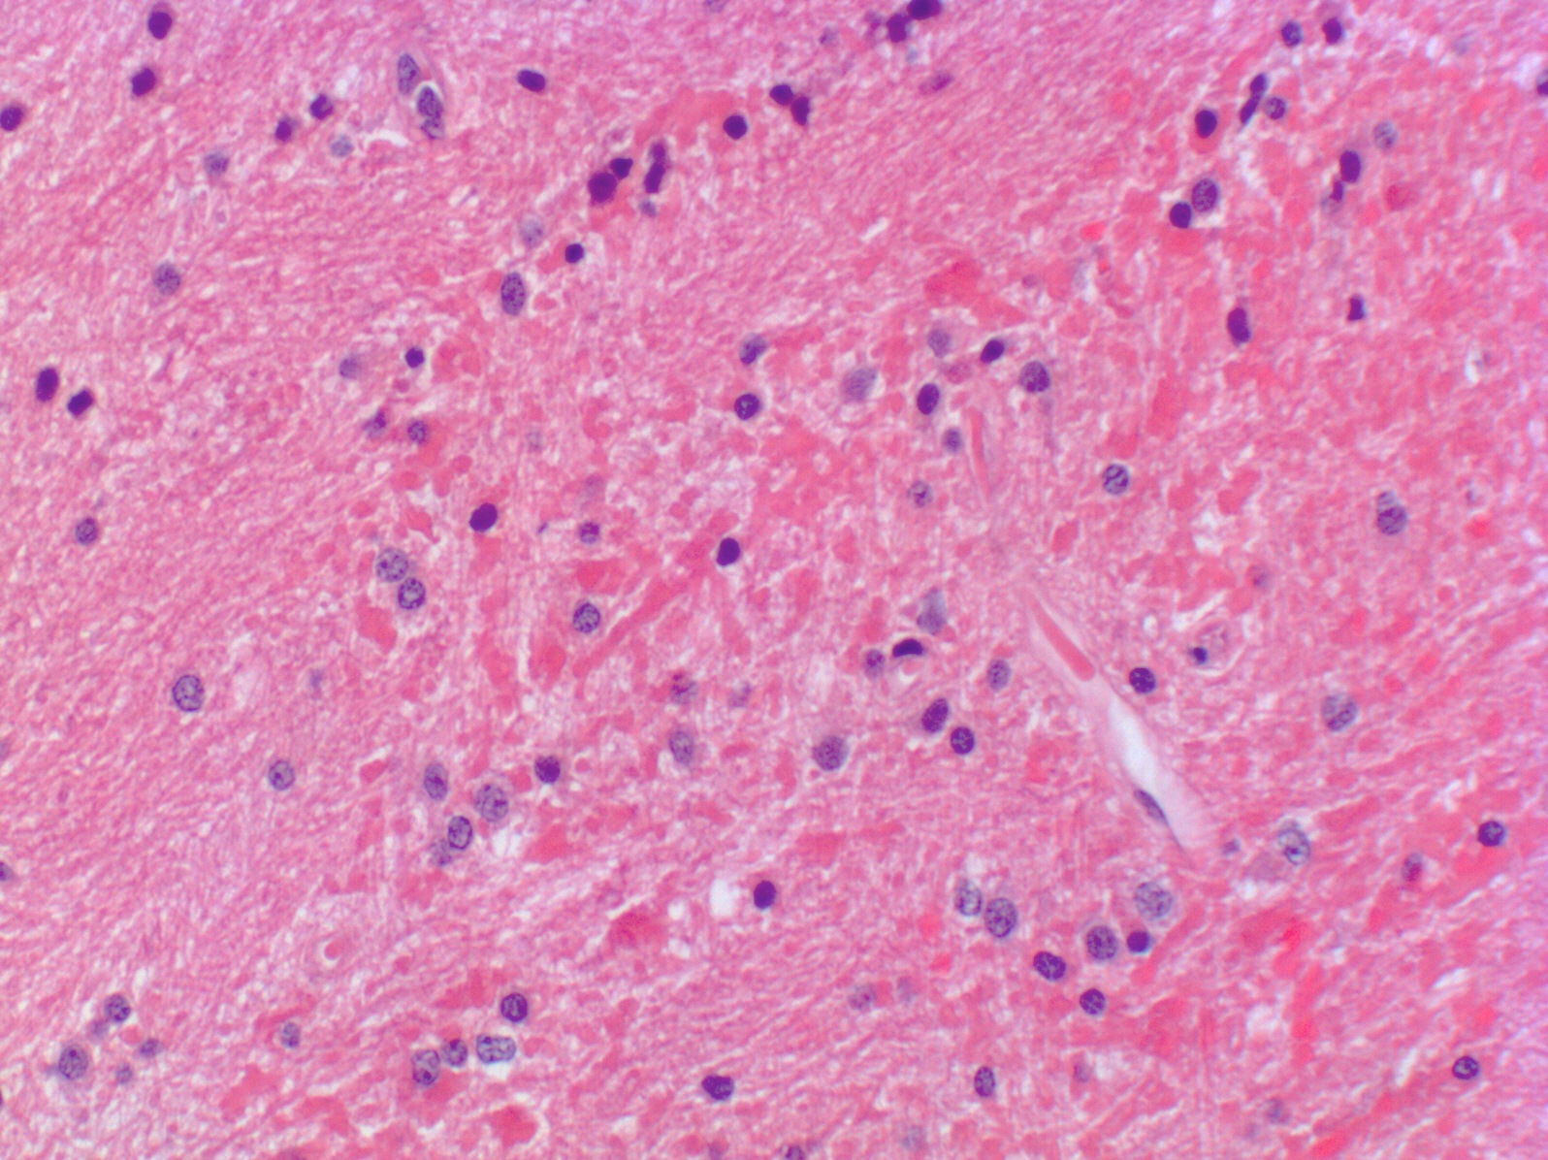
Notes:
Within the white matter, club shaped eosinophilic structures are also apparent.

Slide 18
Diagnosis?

Slide 19
Differential diagnosis
Vasculopathy (e.g., toxic)
Neoplastic
Infectious (e.g., viral)
Notes:
Upon reviewing the H&E slides, our differential was broad. We favored a vasculopathic process.

Slide 20
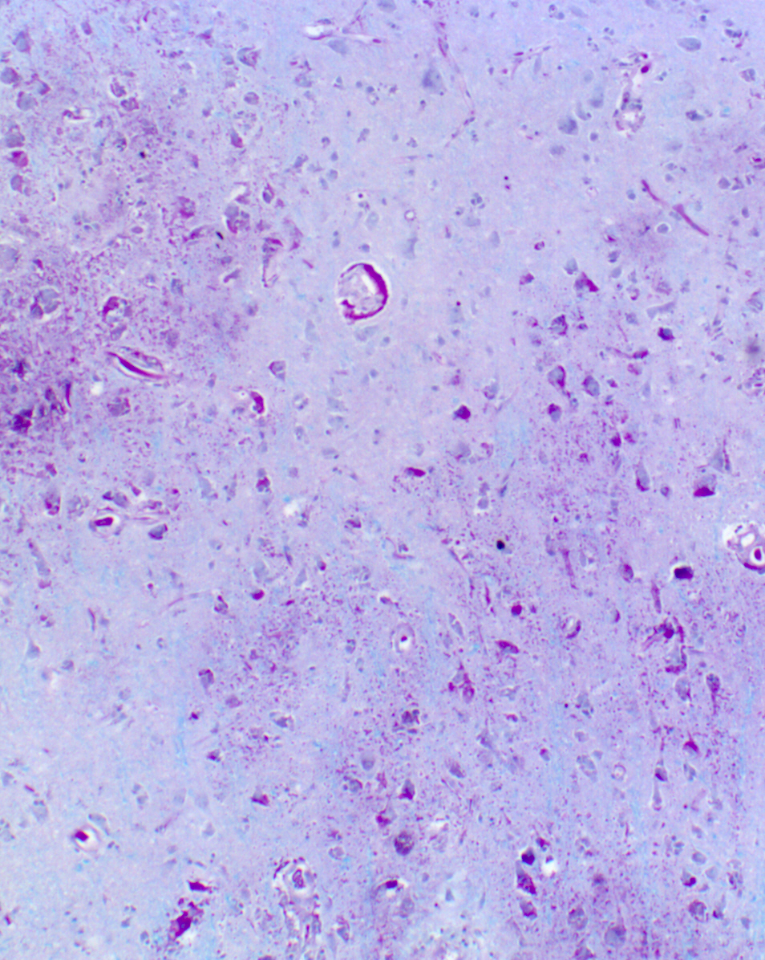
PAS +
Congo red –
Beta-amyloid –
GFAP –
NF: swollen axons
LFB: no evidence of demyelination
PAS
Notes:
PAS stain highlights the diffuse and patchy character of the material.

Slide 21
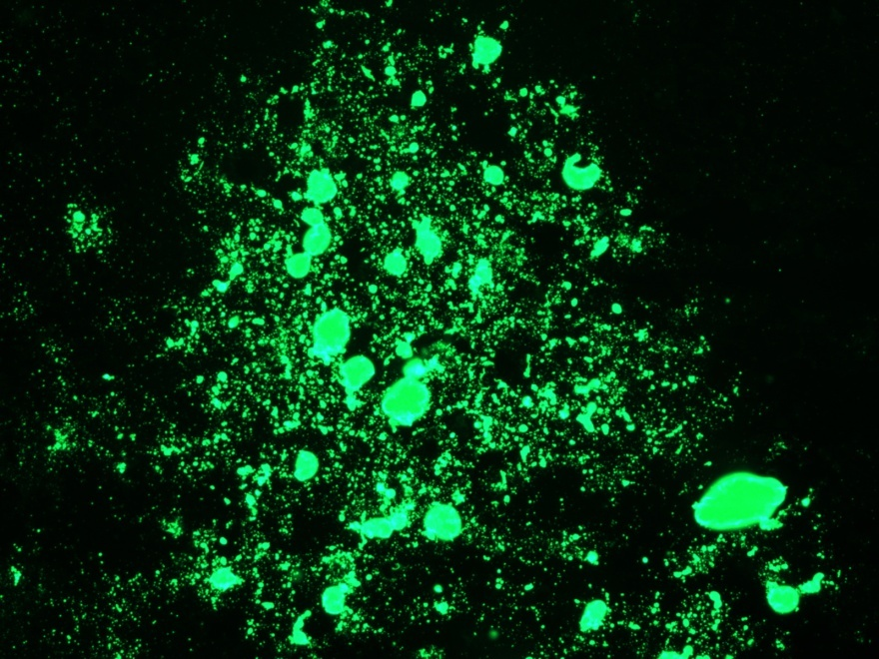
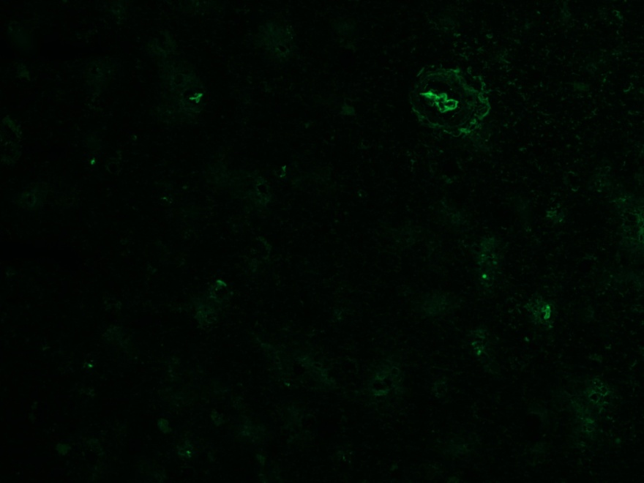
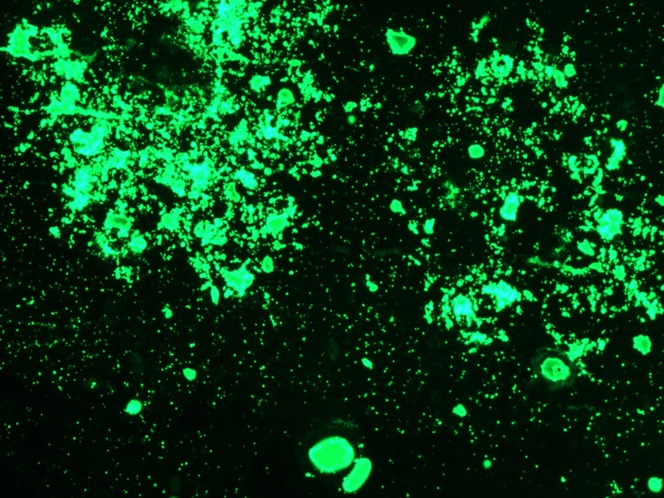
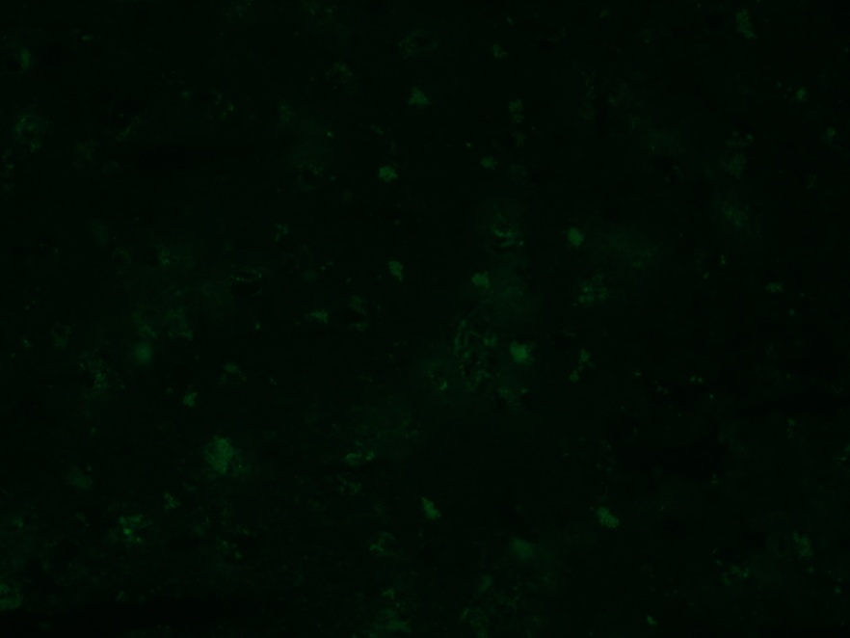
IgM
IgG
Lambda
Kappa
Notes:
In collaboration with our renal pathology colleagues – DR. Vivette Dagotti – we performed IF studies on fresh frozen tissue that was set aside at the time of biopsy.
This analysis reveals this material to have 3+ intensity for IgM and Lambda light chain. IgG, IgA and Kappa were negative (CONFIRM OTHER STUFFS)

Slide 22
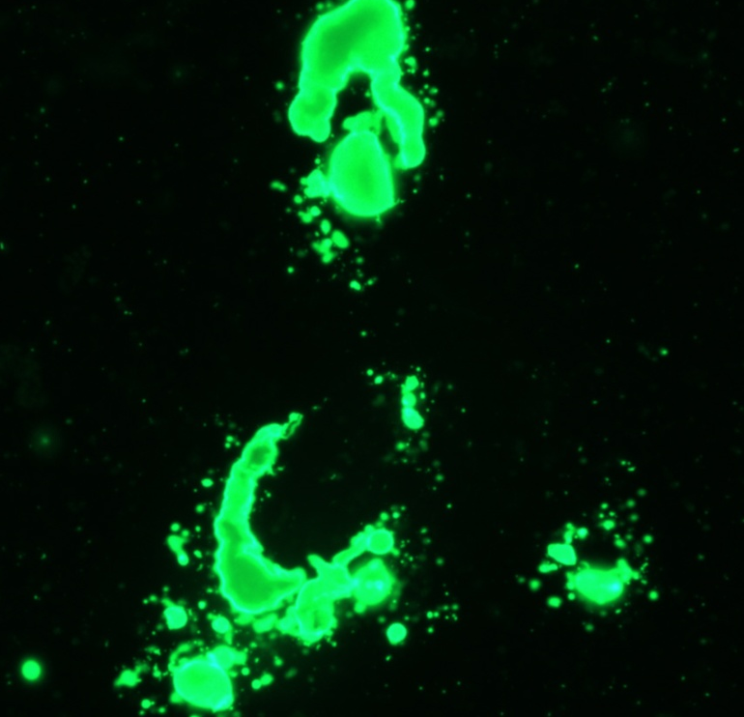
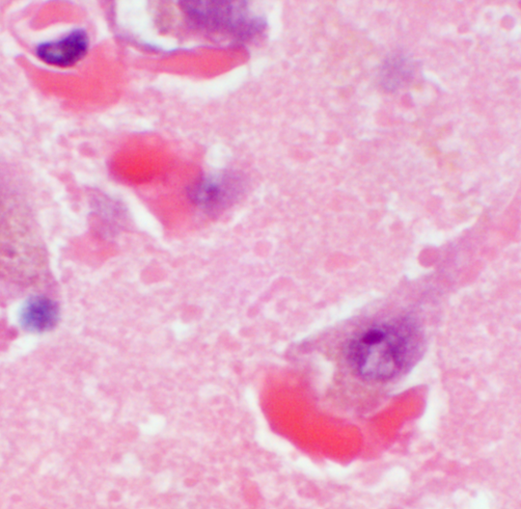
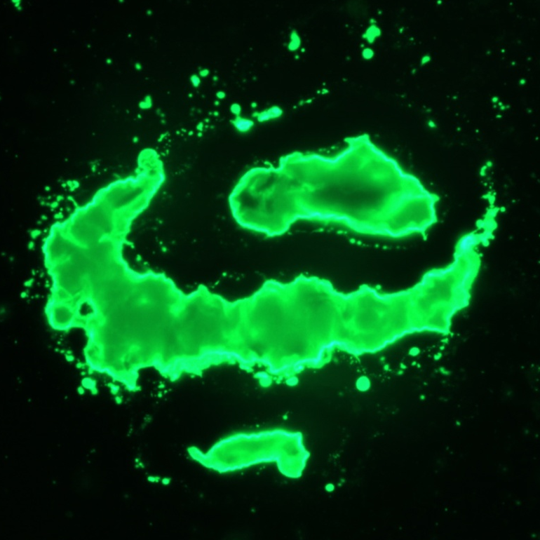
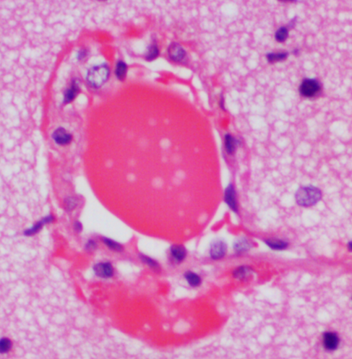
Notes:
IF confirmed that the material present in and around blood vessels as well as that around neurons and within non-neuronal cells was also positive.

Slide 23
Final diagnosis:
Encephalopathy associated with monoclonal IgM lambda protein deposition
Notes:
Note: Immunofluorescence, flow cytometry and IFE are show that the source of these immunoglobulins is likely the patients hematological malignancy.

Slide 24
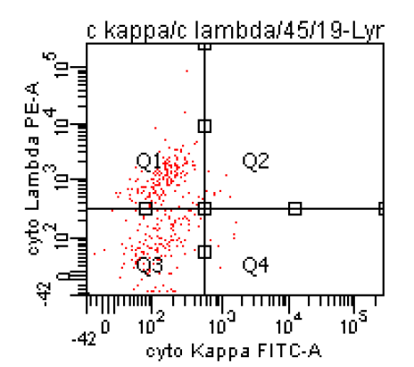
CSF flow cytometry
LAMBDA
KAPPA
Notes:
CSF flow identified a population of lambda restricted CD45+ lymphocytes

Slide 25
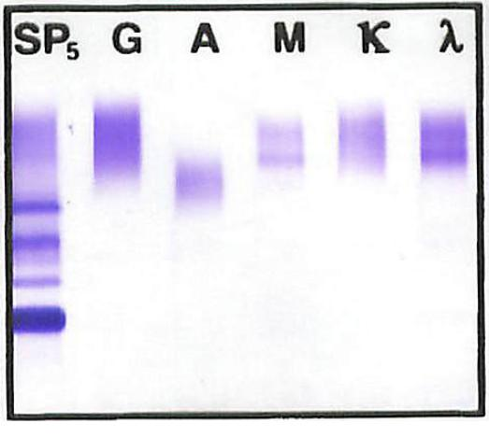
Serum immunofixation electrophoresis (IFE)
Three weeks prior to admission
Notes:
Serum immunofixation electrophoresis showed a weak monoclonal IgM band that is non-quantifiable.

Slide 26
Monoclonal gammopathies in CLL and LPL
CLL
LPL
2.5%
IgM paraprotein
WM
Yin et al. Am J Clin Pathol. 2005 Apr;123(4):594-602

Slide 27
Monoclonal gammopathies in CLL and LPL
B-cell
Neoplasms
CLL
LPL
2.5%
IgM paraprotein
WM
Monoclonal
paraproteins

Slide 28
Features of CLL in this patient
PARAMETER | RELATIONSHIP TO CLL
CD5 dim/partial | ATYPICAL
CD43 negative | ATYPICAL
CD23 positive | TYPICAL
13q deletion | TYPICAL
TP53 deletion | POOR PROGNOSTIC INDICATOR

Slide 29
Nervous system manifestations in patients with
IgM gammopathy (in WM)
Peripheral
Neuropathy
Direct tumor
involvement
Hyper-
viscosity
IgM
Transformation
to high grade
lymphoma
Paraprotein
Deposition
Autoantibody

Slide 30

Acknowledgments
Clinical Pathology
Tilla Worgall
Hematopathology
Govind Baghat
Bashir Alobeid
Neuroradiology
Alexander Khandji
Neurology
Kiwon Lee
Neuropathology
John Crary
James Goldman
Peter Canoll
Phyllis Faust
Kurenai Tanji
Jean Paul Vonsattel
Andy Teich
Nadia Tsankova
Renal pathology
Vivette D’Agati

Slide 31
References
Baehring, JM, Hochberg, FH, et al. Neurological manifestations of Waldenstrom Macroglobulinemia. Nature Clinical Practice, Neurology. 2008 Oct;4(10):547-56.
Lehmann, H.C. et al. Central nervous system involvement in patient’s with monoclonal gammopathy and polyneuropathy. European Journal of Neurology. 2010, 17: 1075-1081.
Malkani, R.G. et al. Bing-Neel syndrome: an illustrative case and a comprehensive review of the published literature. Journal of Neurooncology. 2010 96:301-312.
Vitolo U et al. Lymphoplasmacytic lymphoma-Waldenstrom's macroglobulinemia. Crit Rev Oncol Hematol. 2008 Aug;67(2):172-85.

Slide 32
Bing-Neel Syndrome
First described in 1936 by Jens Bing and Axel Neel
Has no “precise pathologic correlate”
  (1984) Scheithauer et al.
“Should be reserved for invasion of lymphoplasmacytic neuraxis by lymphoplasmacytic cells of WM origin”
  (2008) FH Hochberg et al.

