Slide 1
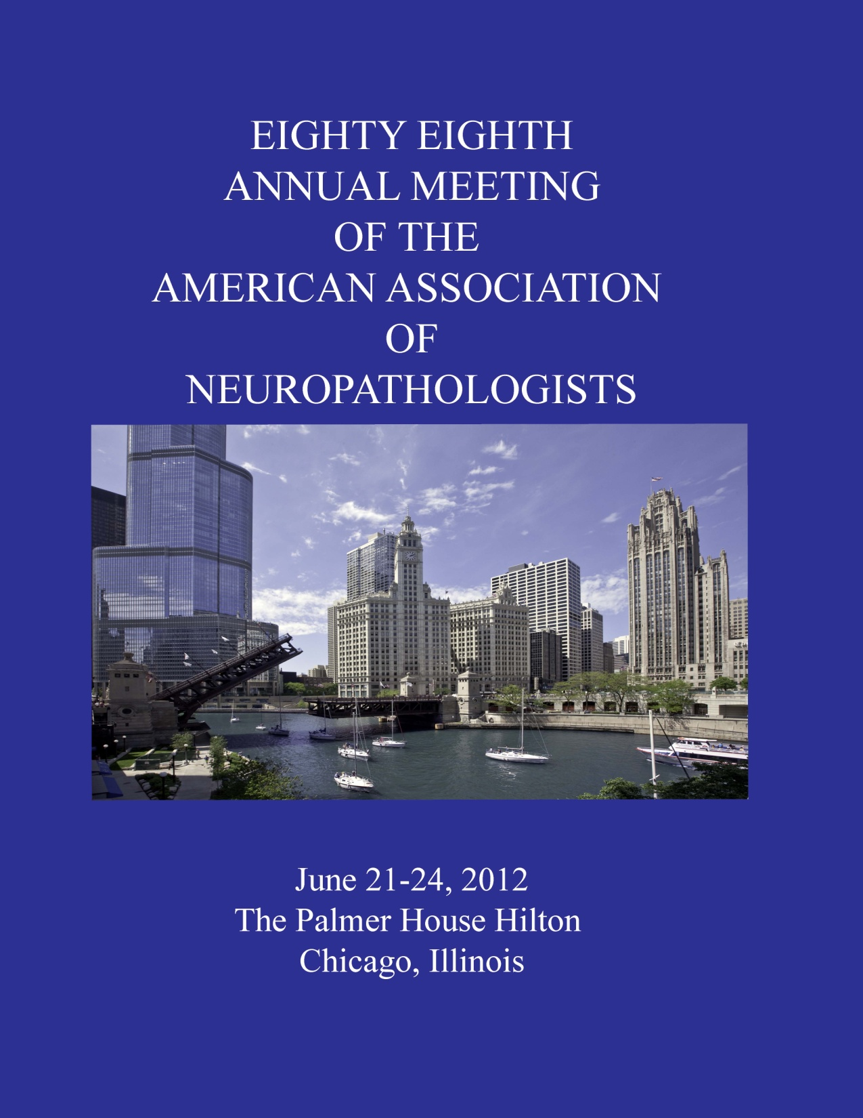

Slide 2
DSS Case 1
Amanda O. Fisher-Hubbard¹, MD, James J. Dowling², MD, PhD, Paul E. McKeever¹, MD, PhD, Sandra Camelo-Piragua¹, MD
Departments of Pathology¹ and Neurology², University of Michigan, Ann Arbor, MI

Slide 3
7 y/o Chinese boy with mild scoliosis
Clinical History
  Walking at 16 mo, more falls at 18 mo
  Cannot run, jump, throw a ball
  Difficulty with stairs, buttons, and zippers
  Cognitively normal
  Brain MRI: normal
  EMG: myopathic features
  No family history of nerve or muscle abnormalities

Slide 4
7 y/o Chinese boy with mild scoliosis
Physical Exam
  Non-dysmorphic
  Normal cardiac exam
  Cranial nerves were intact
  Normal muscle bulk
  Normal sensory exam
  Mildly decreased tone
  Mild weakness, prox > dist
  Gowers’ sign
  DTRs decreased
Laboratory Findings
  Creatine kinase reported to be within normal limits for age
Prior muscle biopsy in China
  “Abnormal”
Biopsy of right vastus lateralis muscle
Notes:
Our Lab: Male: 38 - 240 IU/L

Slide 5
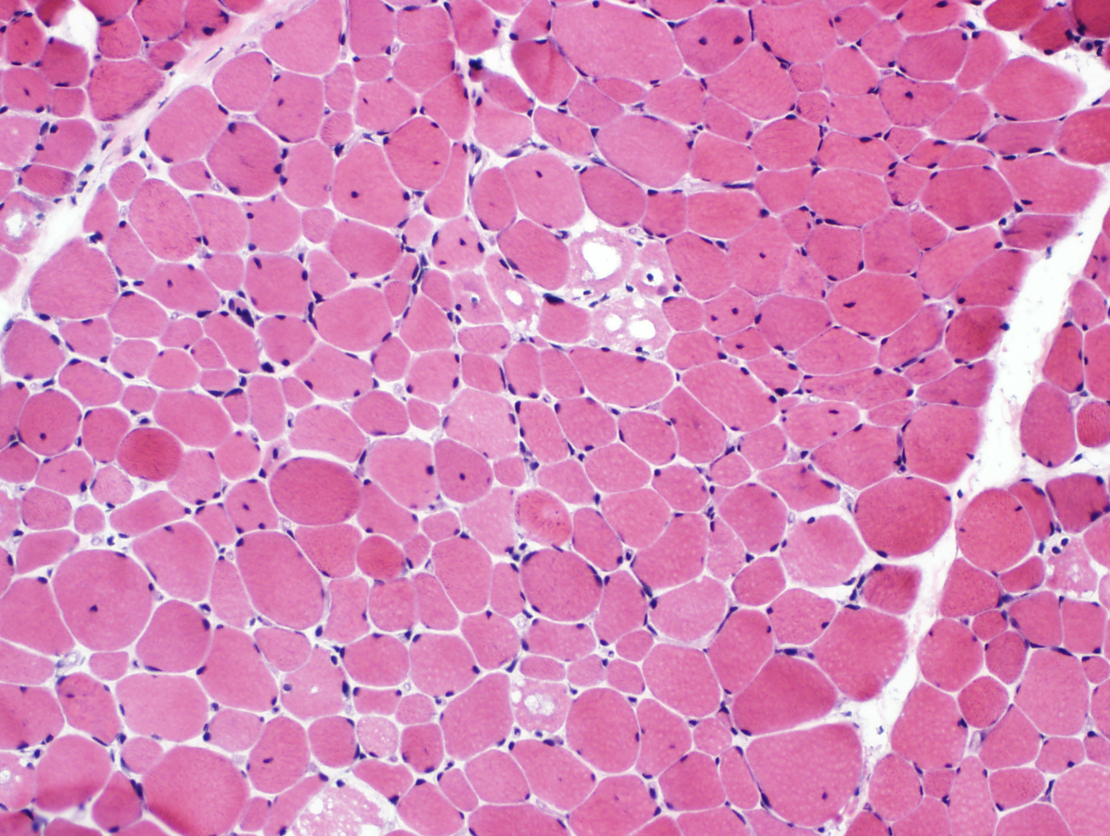
H&E

Slide 6
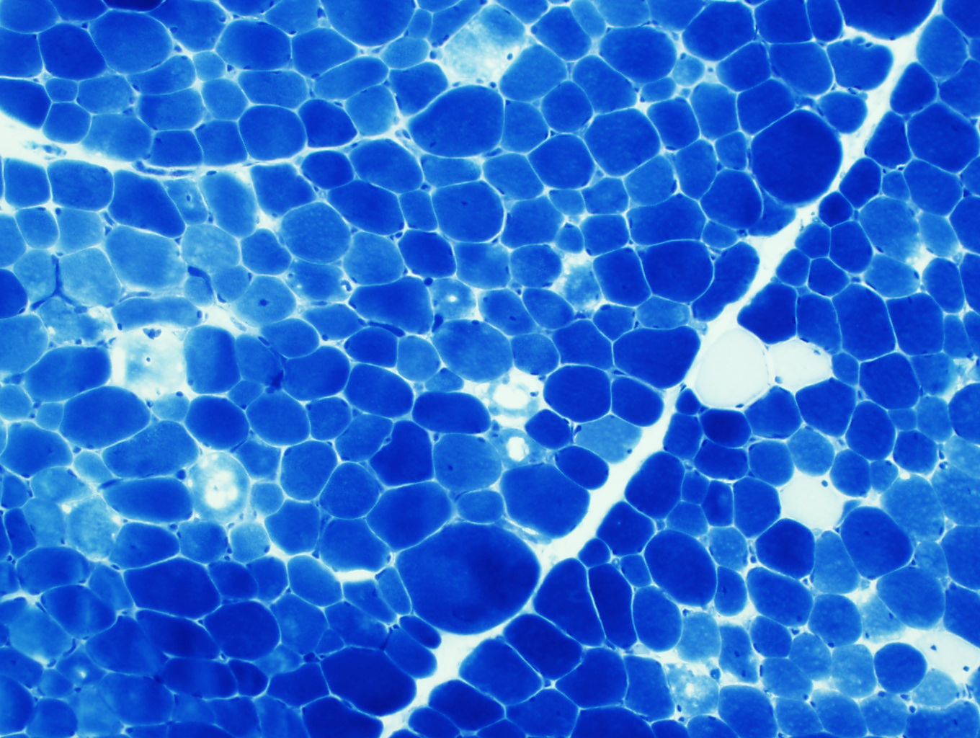
Tol Blue

Slide 7
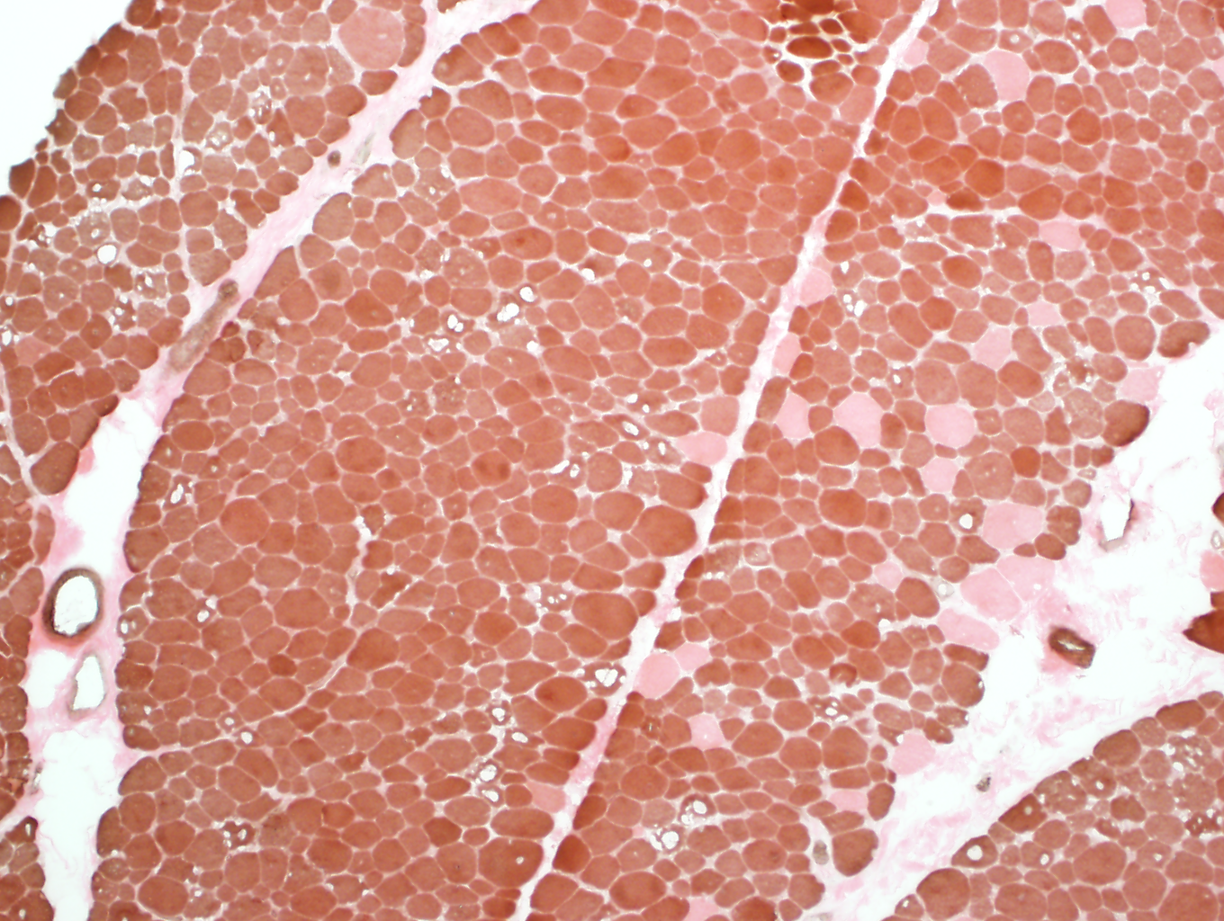
ATPase pH 4.2

Slide 8
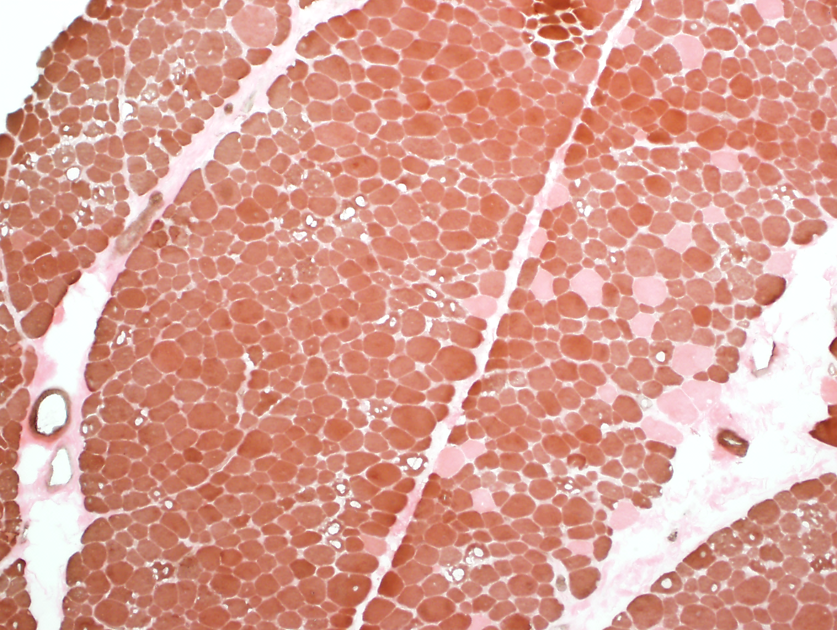
Tol Blue
ATPase pH 4.2

Slide 9
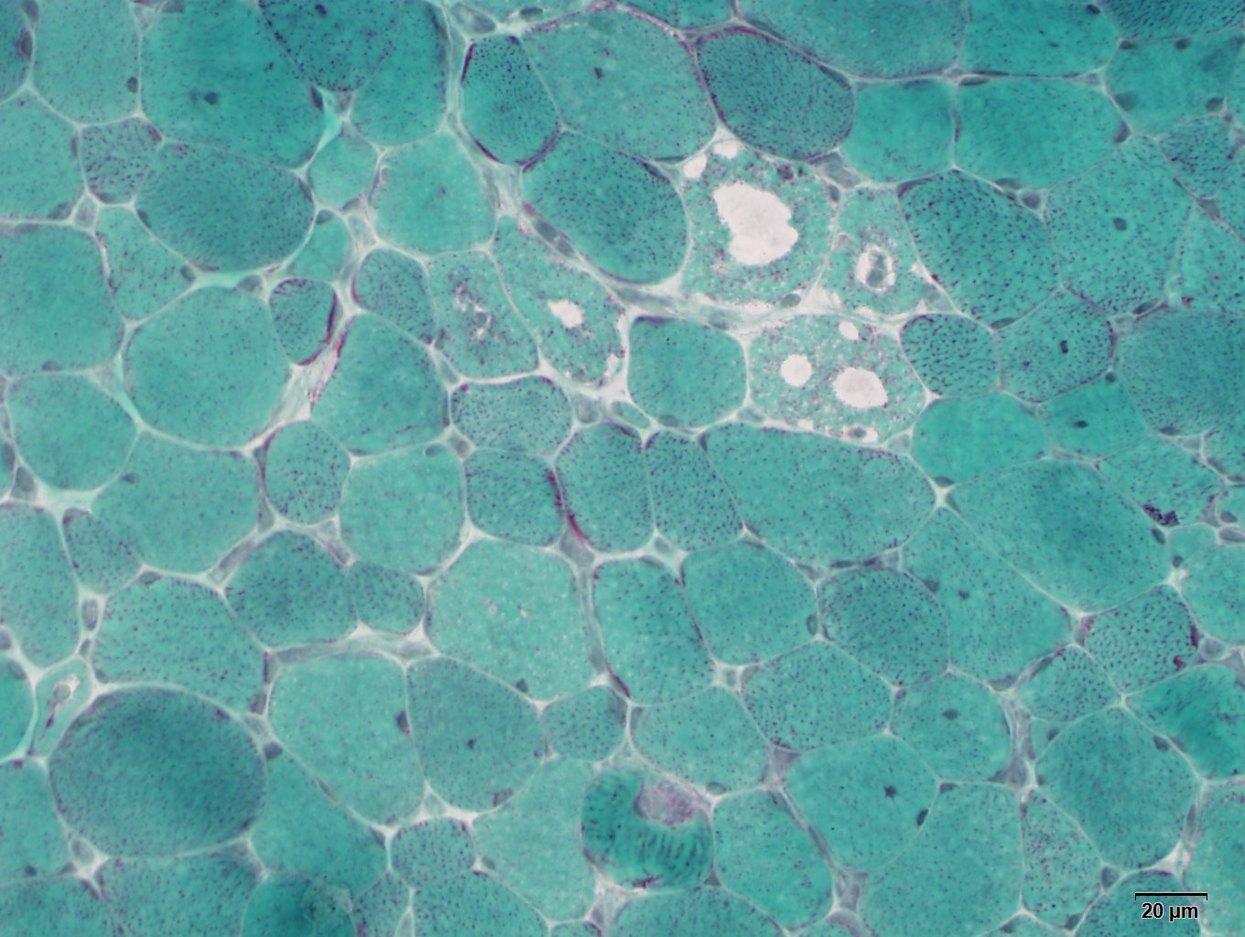
Gömöri trichrome

Slide 10
Discussion

Slide 11
Differential Diagnosis
Congenital myopathy
Storage Disease
Notes:
Central core disease
Multi-minicore myopathy
?Centronuclear M
Nemaline myopathy
Cap disease
Congenital fiber type disproportion
Metabolic myopathy (storage disease, mitochondrial disorder)

Slide 12

Quantification & Morphometry
Type 1 predominant (>90%)
Type 1 fibers 27.2% smaller than Type 2 fibers
 | Range (um) | Mean (um) Normal 34 ± 3 | Variability coeff Normal <250
Type 1 | 9.4 – 64.7 | 25.9 ± 9.3 | 358.7
Type 2 | 15.4 – 81.1 | 35.6 ± 12.0 | 751.8
$$\frac{SD ×1000}{mean}$$

Slide 13
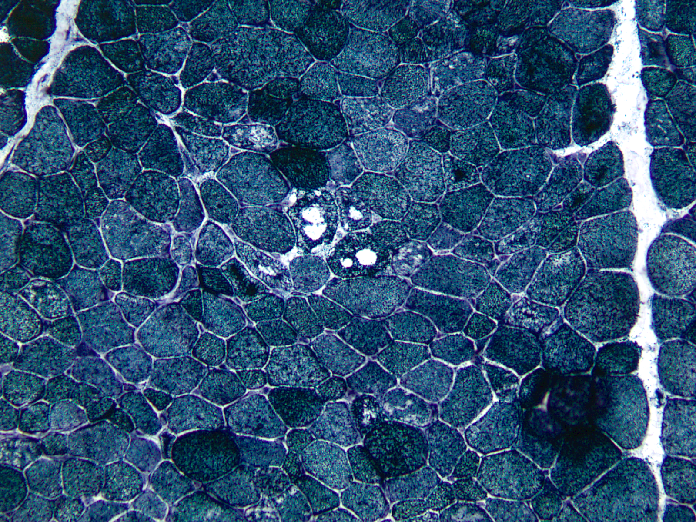
NADH

Slide 14
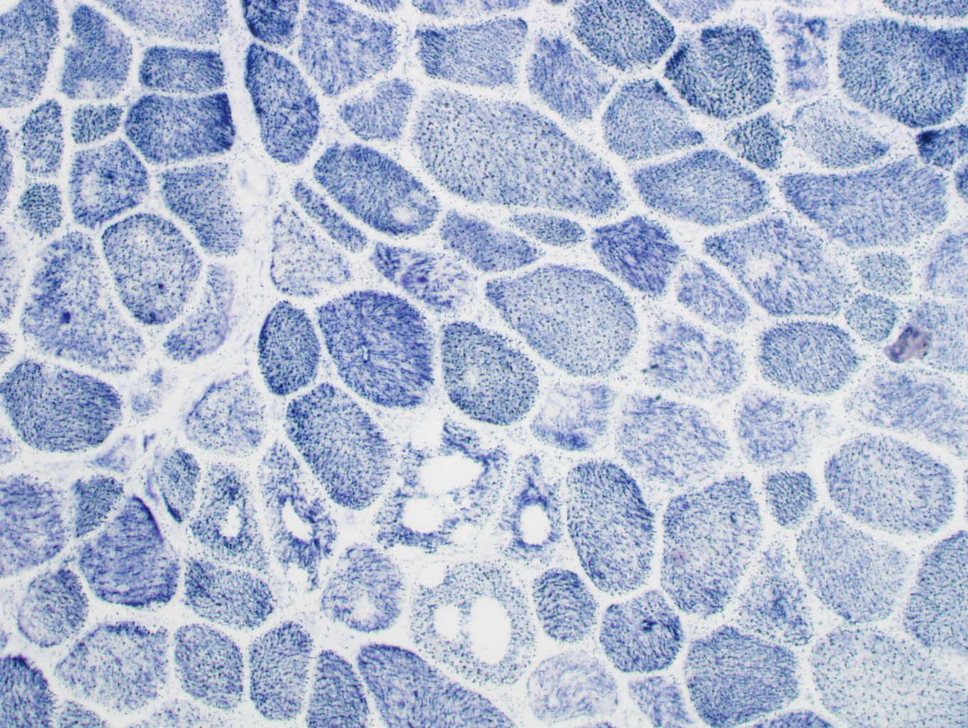
SDH

Slide 15
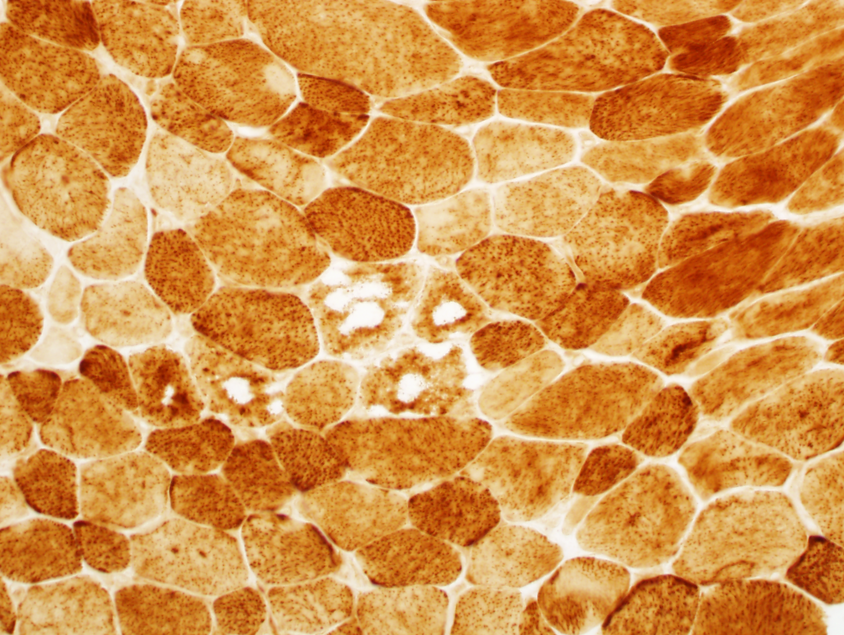
COX

Slide 16
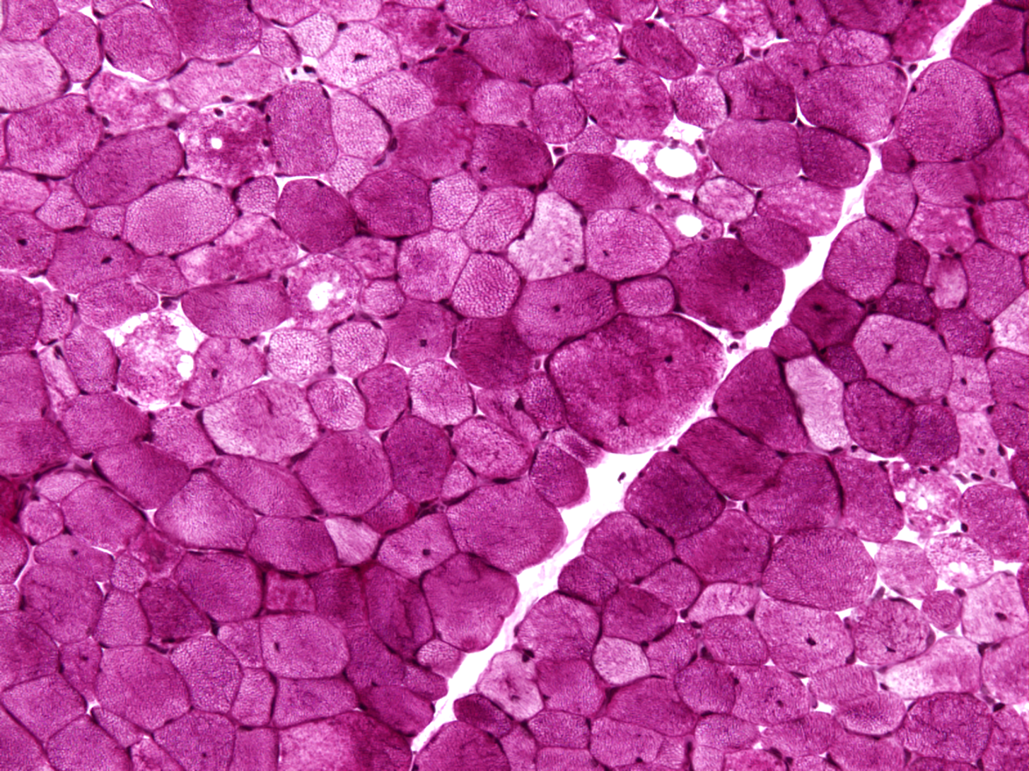
PAS

Slide 17
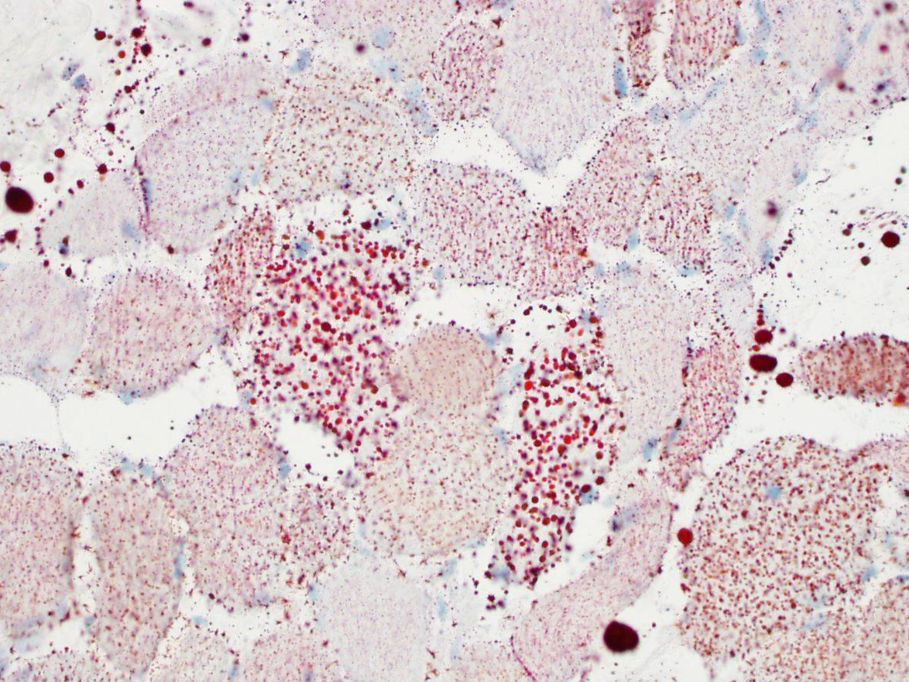
ORO

Slide 18
Additional Stains
Myophosphorylase
Myoadenylate deaminase
Phosphofructokinase
Alkaline and acid phosphatases
Nonspecific esterase
NORMAL

Slide 19
Dystrophin IHC Panel
Dystrophins:
  Rod domain, N-terminus, C-terminus
Sarcoglycans
  alpha, beta, gamma, delta
Beta-dystroglycan
Merosin
Lamin A/C
Laminin B1
Emerin
Caveolin 3
Dysferlin
NORMAL

Slide 20
Ultrastructure Analysis

Slide 24
Summary of Findings
Type 1 predominance (>90%)
Fiber size disproportion (Type 1 27.2% smaller than Type 2)
Empty vacuoles: no glycogen or lipids, no autophagic
No nemaline rods or other abnormal inclusions
No cores/minicores
Normal Dystrophin immunohistochemistry panel

Slide 25
Diagnosis
Type 1-predominant muscle with fiber type disproportion and vacuolization
No definitive abnormalities on EM

Slide 26
Differential Diagnosis
Congenital myopathy
Storage Disease
Notes:
Central core disease
Multi-minicore myopathy
?Centronuclear M
Nemaline myopathy
Cap disease
Congenital fiber type disproportion
Metabolic myopathy (storage disease, mitochondrial disorder)

Slide 27
Genetics
Congenital myopathy testing, sequenced:
  Ryanodine receptor 1 (RYR1)
  Actin, alpha 1 (ACTA1)
  Selenoprotein N, 1 (SEPN1)
  Tropomyosin (TPM2, TPM3)
Spinal muscular atrophy (SMN1)
Notes:
RYR1 – central core disease, and minicore myopathy with external ophthalmoplegia
ACTA1 – nemaline myopathy, CFTD
SEPN1 – multiminicore disease and congenital muscular dystrophy with spinal rigidity and restrictive respiratory syndrome
TPM2 – nemaline myopathy and distal arthrogryposis syndromes
TPM3 – CFTD, autosomal dominant nemaline myopathy

Slide 28
Genetics
Congenital myopathy testing, sequenced:
  Ryanodine receptor 1 (RYR1)
  Actin, alpha 1 (ACTA1)
  Selenoprotein N, 1 (SEPN1)
  Tropomyosin (TPM2, TPM3)
Spinal muscular atrophy (SMN1)
NO MUTATIONS DETECTED
Notes:
RYR1 – central core disease, and minicore myopathy with external ophthalmoplegia
ACTA1 – nemaline myopathy, CFTD
SEPN1 – multiminicore disease and congenital muscular dystrophy with spinal rigidity and restrictive respiratory syndrome
TPM2 – nemaline myopathy and distal arthrogryposis syndromes
TPM3 – CFTD, autosomal dominant nemaline myopathy

Slide 29
Genetics
Congenital myopathy testing, sequenced:
  Ryanodine receptor 1 (RYR1)
    Heterozygous in exon 44 for undocumented variant
      c.7209 C>T
    Heterozygous for intronic undocumented variant
      c.13660-10 T>C
Notes:
RYR1 – central core disease, and minicore myopathy with external ophthalmoplegia
ACTA1 – nemaline myopathy, CFTD
SEPN1 – multiminicore disease and congenital muscular dystrophy with spinal rigidity and restrictive respiratory syndrome
TPM2 – nemaline myopathy and distal arthrogryposis syndromes
TPM3 – CFTD, autosomal dominant nemaline myopathy

Slide 30
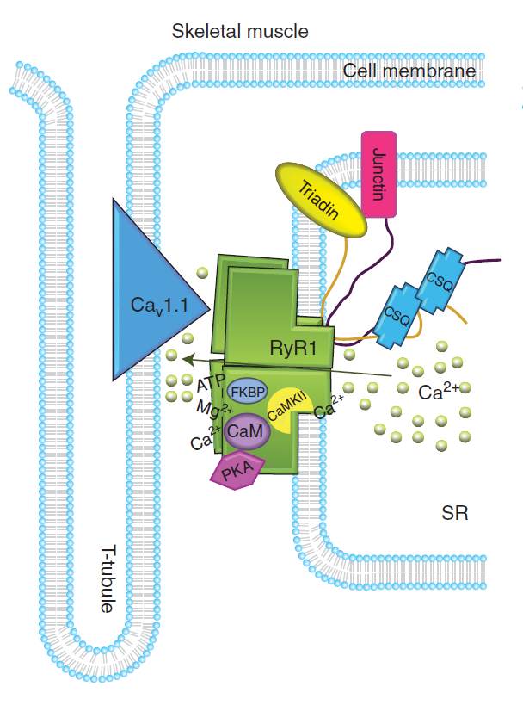
Ryanodine Receptor
Largest known ion channel
Muscle sarcoplasmic reticulum membrane
Channels that release intracellular calcium during excitation-contraction coupling
Three mammalian isoforms
  RYR1: skeletal muscle
    Malignant hyperthermia
    Congenital myopathies
  RYR2: cardiac muscle
    Catecholaminergic polymorphic VT
    Arrhythmogenic right ventricular dysplasia 2
  RYR3: brain
Lanner JT, et al. Cold Spring Harb Perspect Biol. 2010.

Slide 31
Congenital Myopathies
Disease | Gene(s) involved
Central core disease | RYR1
Multi-minicore myopathy | SEPN1, RYR1
Myotubular/centronuclear myopathy | MTM1/DMN2, RYR1
Nemaline myopathy | ACTA1, NEB, TPM3, TPM2, TNNT1
Cap disease | TPM2, TPM3, ACTA1
Congenital fiber type disproportion | TPM3, RYR1, ACTA1, TPM2, SEPN1
Notes:
Central core disease
Multi-minicore myopathy
?Centronuclear M
Nemaline myopathy
Cap disease
Congenital fiber type disproportion

Slide 32
Congenital Fiber Type Disproportion
“There has been more debate about the features that define CFTD than with any other congenital myopathy”
Fiber size disproportion
  12% (Brooke MH, 1973)
  25% (Brooke MH, 1990; Dubowitz V, 1995)
Type 1 smallness and predominance
Must exclude all other forms of congenital myopathy
Develop features of another diagnosis with time?

Slide 33
CFTD Clinical Features
Floppy babies
Weakness of limbs, neck, trunk, facial muscles
May have elongated face, high arched palate, contractures
Congenital hip dislocation, torticollis, scoliosis
Variable course, usually improve with age
Cardiomyopathy very rare

Slide 34
Summary
Congenital myopathies are heterogeneous disorders
Diagnoses made with a combination of clinical history, histology, histochemistry, electron microscopy
Many have characteristic and/or defining mutations
  Still being identified
CFTD is a “diagnosis of exclusion”

Slide 35
References
Journal articles
Brooke MH. Congenital fiber type disproportion. In: Kakulas BA, ed. Clinical studies in myology. Proceedings of the 2nd International Congress on Muscle Diseases, held in Perth, Australia, Nov. 22–29, 1971. Experta Medica 1973:147–59.
Brooke MH. Congenital fiber type disproportion. (Abstract). J Neurol Sci 1990;98:100.
Camacho A, et al. Clinical and histologic changes in the follow-up of a congenital myopathy. Pediatr Neurol. 2005 Aug;33(2):139-41.
Clarke NF. Congenital fiber-type disproportion. Semin Pediatr Neurol. 2011 Dec;18(4):264-71.
Clarke NF. Congenital fibre type disproportion--a syndrome at the crossroads of the congenitalmyopathies. Neuromuscul Disord. 2011 Apr;21(4):252-3.
Clarke NF, et al. Cap disease due to mutation of the beta-tropomyosin gene (TPM2). Neuromuscul Disord. 2009 May;19(5):348-51.
Clarke NF, North KN. Congenital fiber type disproportion—30 years on. J Neuropathol Exp Neurol. 2003 Oct;62(10):977-8
Hung RM, et al. Cap myopathy caused by a mutation of the skeletal alpha-actin gene ACTA1. Neuromuscul Disord. 2010 Apr;20(4):238-40.

Slide 36
References
Journal articles (continued)
Lanner JT, et al. Ryanodine receptors: structure, expression, molecular details, and function in calcium release. Cold Spring Harb Perspect Biol. 2010 Nov;2(11):a003996.
North KN. Clinical approach to the diagnosis of congenital myopathies. Semin Pediatr Neurol. 2011 Dec;18(4):216-20.
Ohlsson M, et al. TPM3 mutation in one of the original cases of cap disease. Neurology. 2009 Jun 2;72(22):1961-3.
Robinson R, Carpenter D, Shaw MA, Halsall J, Hopkins P. Mutations in RYR1 in malignant hyperthermia and central core disease. Hum Mutat. 2006 Oct;27(10):977-89.
Vogel H, Zamecnik J. Diagnostic immunohistology of muscle diseases. J Neuropathol Exp Neurol. 2005 Mar;64(3):181-93.
Zhou H, et al. Molecular mechanisms and phenotypic variation in RYR1-related congenital myopathies. Brain. 2007 Aug;130(Pt 8):2024-36.
Texts
Dubowitz V, CA Sewry CA. Muscle Biopsy: A Practical Approach, 3rd ed. Philadelphia: Saunders Elsevier, 2007.
Dubowitz V. Muscle disorders in childhood, 2nd ed. London: Saunders, 1995.

