Slide 1
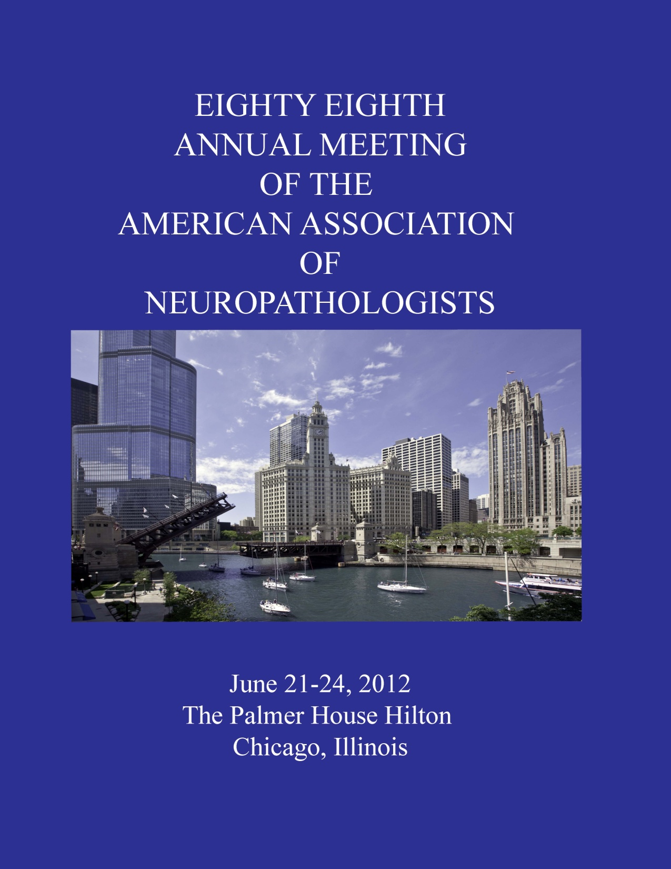

Slide 2
Diagnostic Slide Session 2012 Case 10
Brent A. Orr M.D., Ph.D.¹, Gary L. Gallia M.D., Ph.D. ^{2,3}, and Fausto J. Rodriguez M.D.^{1,3}
¹ Department of Pathology
² Department of Neurosurgery
³ Department of Oncology
The Johns Hopkins School of Medicine
Notes:
NEEDS TO HAVE ALL AUTHORS

Slide 3
Clinical History
38 year old female with a four year history of neurologic problems including seizures that were increasing in frequency
MRIs: slowly increasing white matter T2 hyperintensities with minimal peripheral enhancement
Two previous biopsies yielded non-specific diagnoses
Came to Johns Hopkins Hospital for additional diagnostic/treatment options

Slide 4
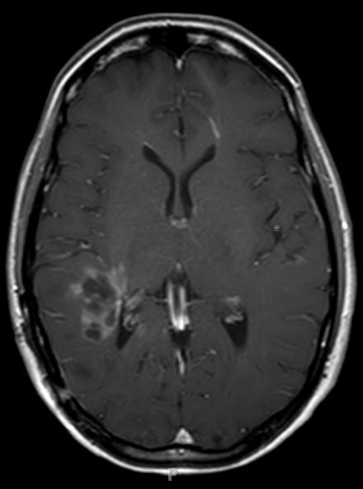
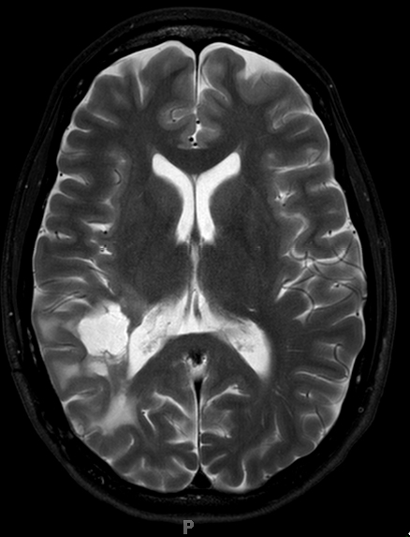
Imaging
T1 weighted image with contrast
T2 weighted image

Slide 5
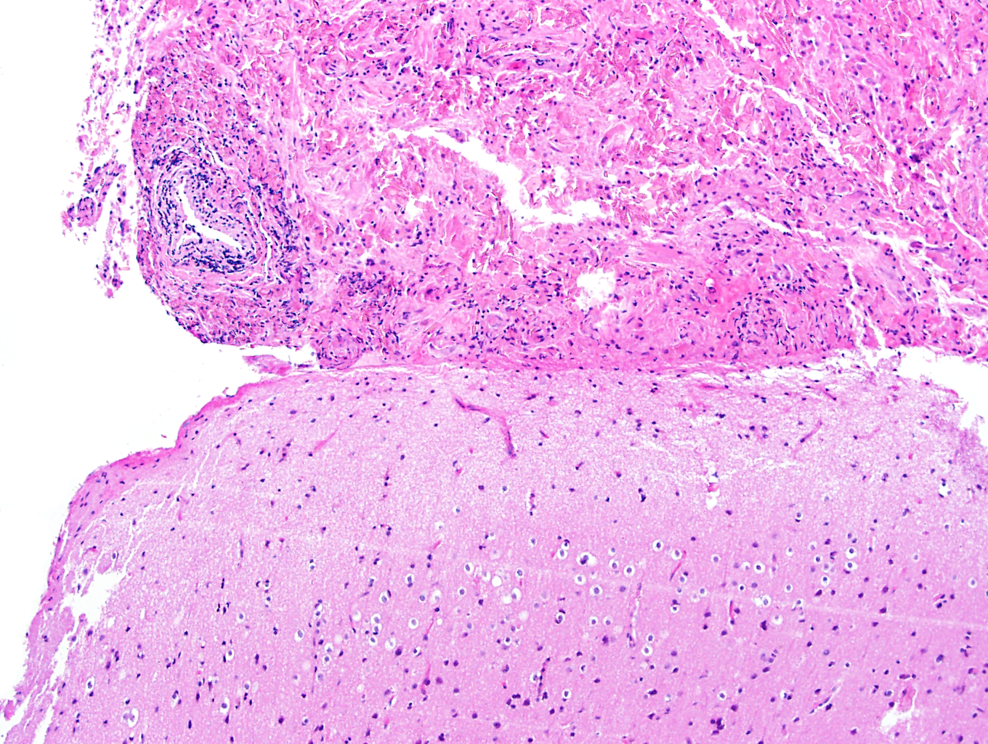
Notes:
Low power 2

Slide 6
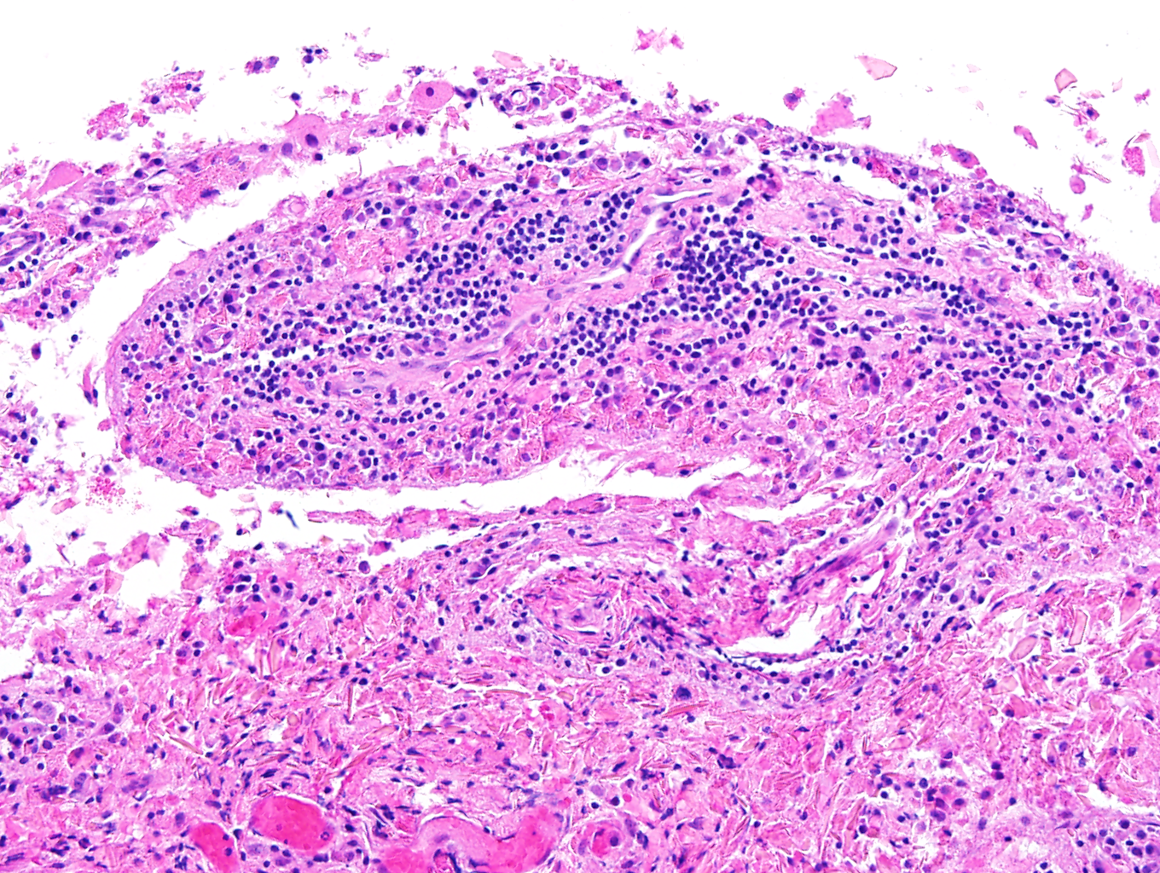
Notes:
perivascular inflammation

Slide 7
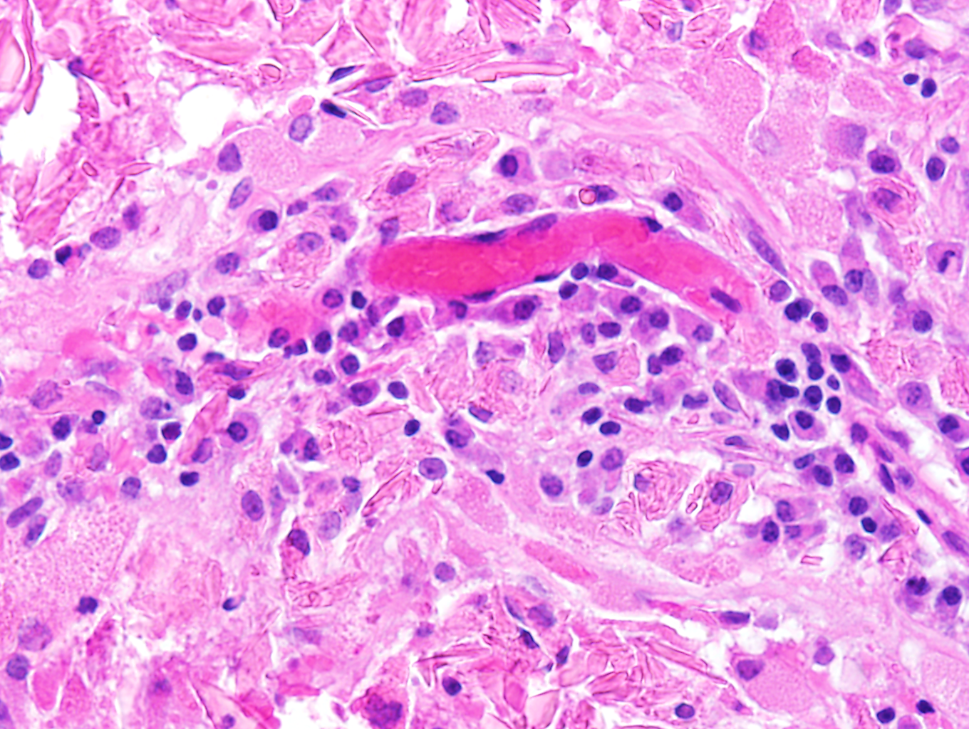
Notes:
High power plasma cells

Slide 8
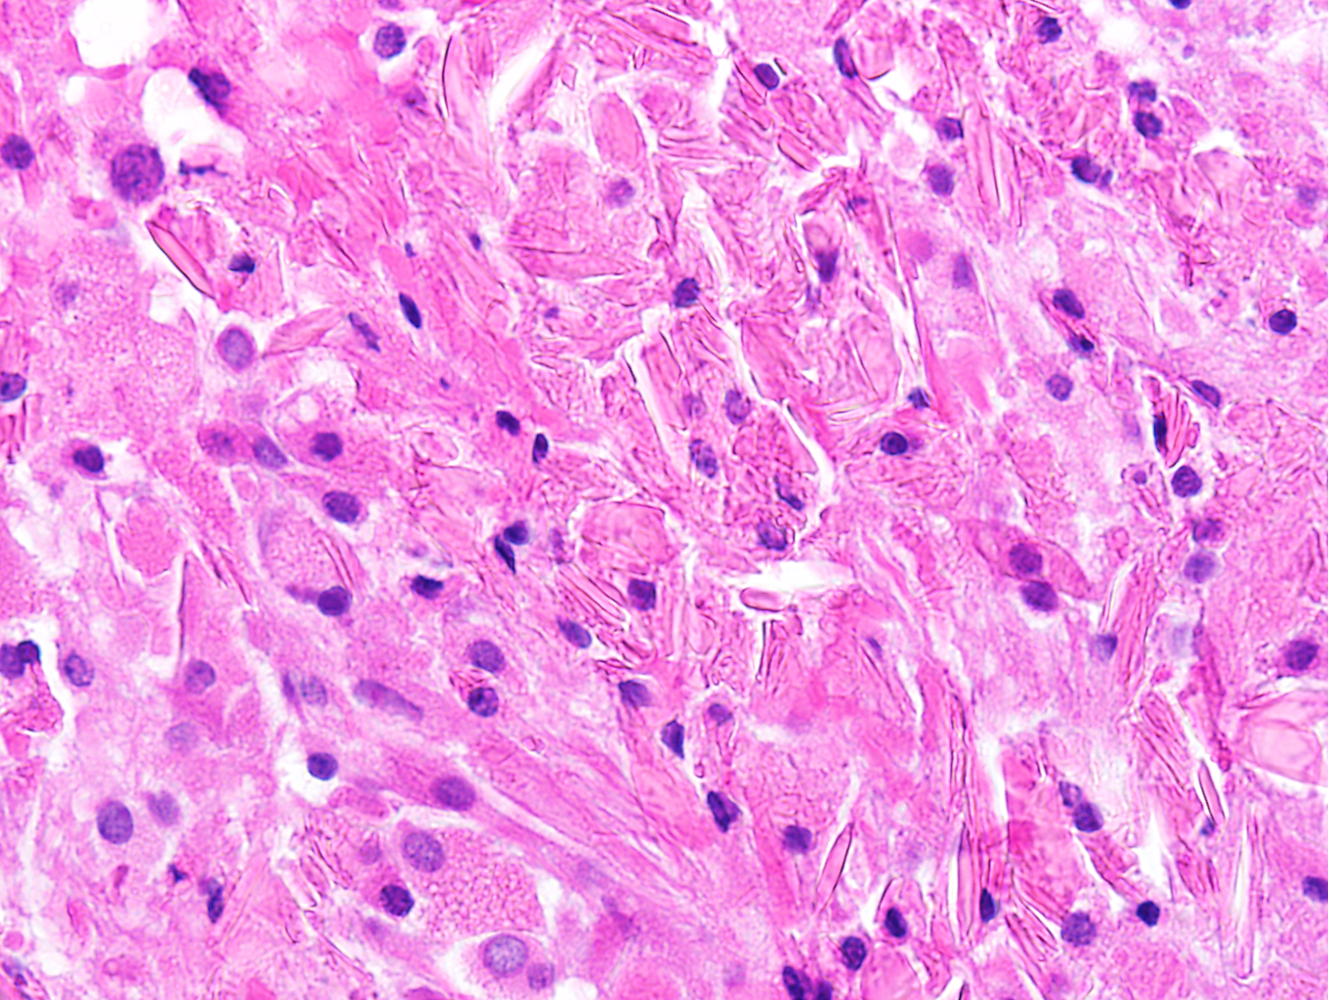
Notes:
Crystals

Slide 9
Diagnosis?

Slide 10
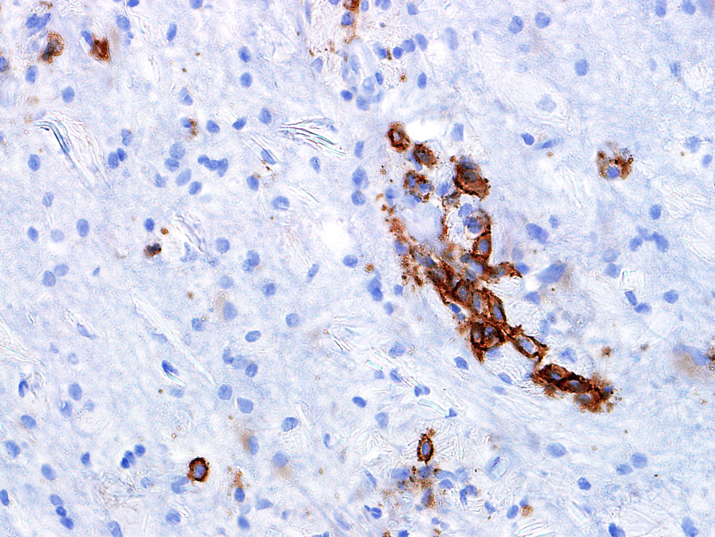
CD138

Slide 11
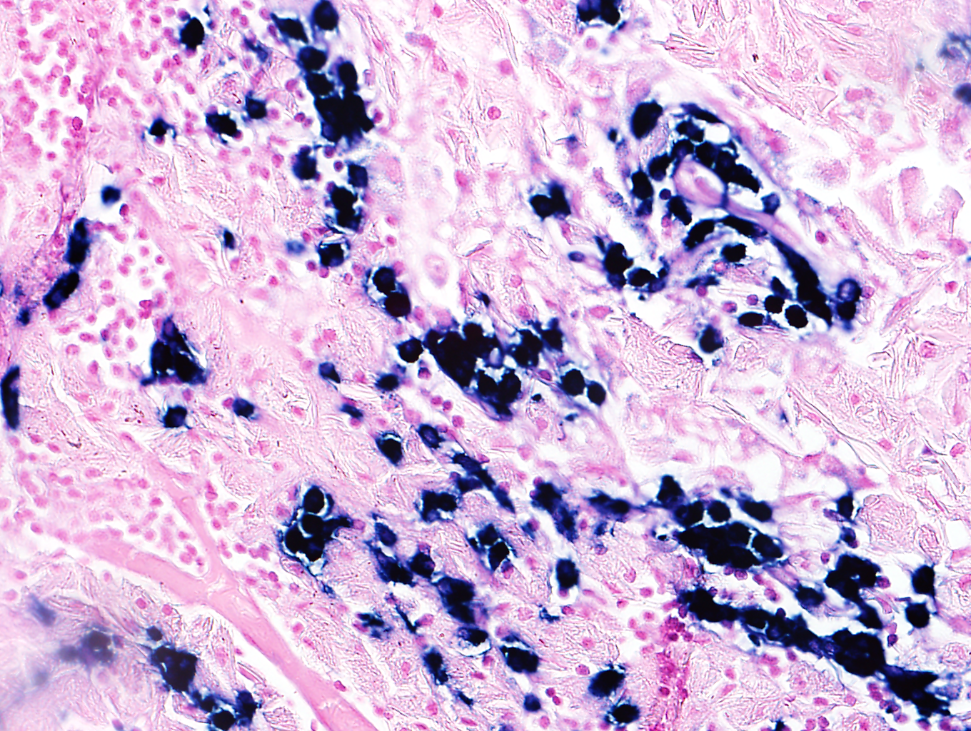
IgΚ (CISH)
Notes:
Kappa CISH

Slide 12
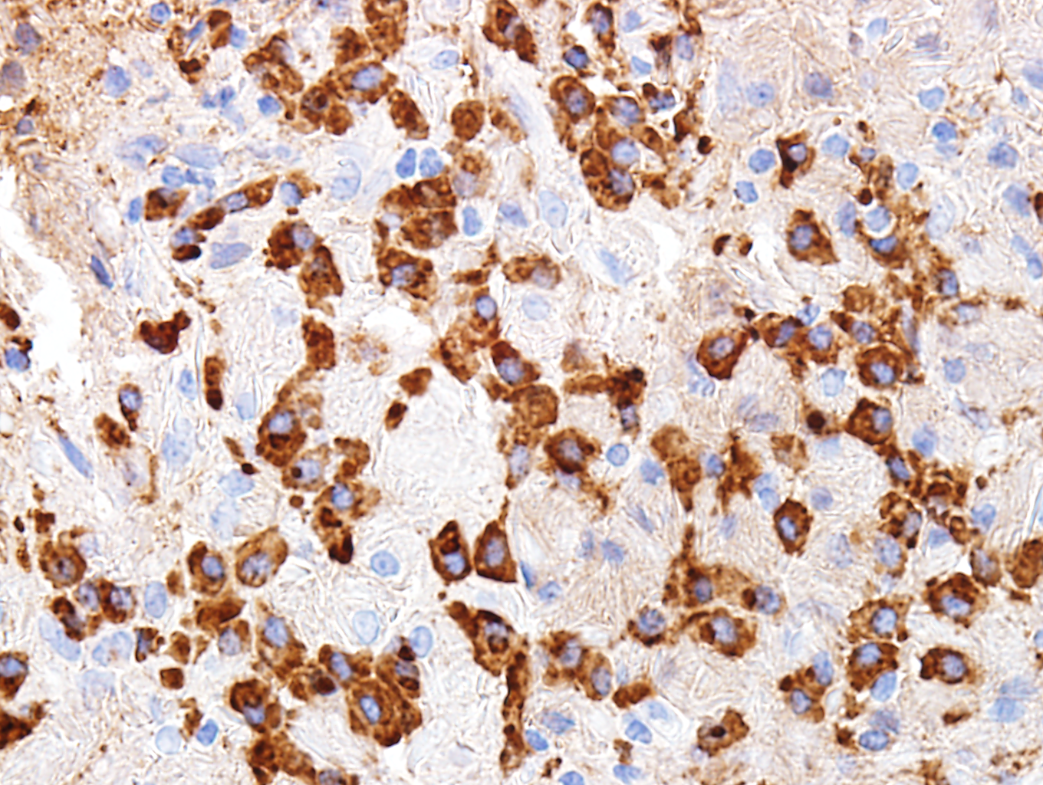
IgA
Notes:
IgA

Slide 13
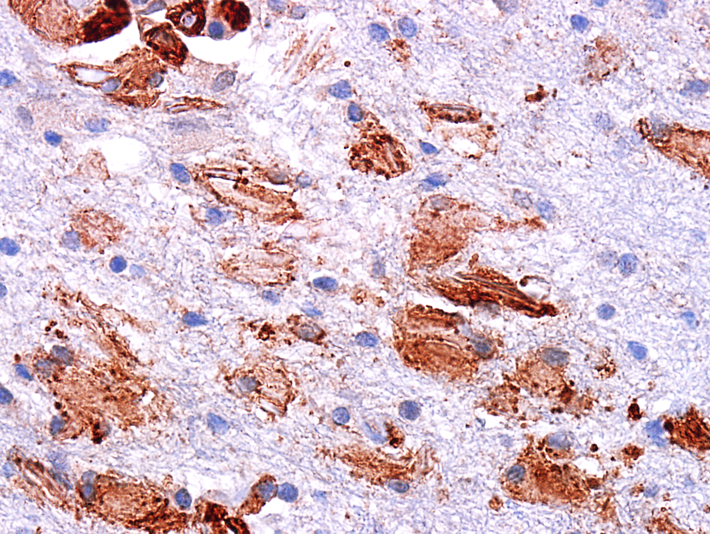
CD68

Slide 14
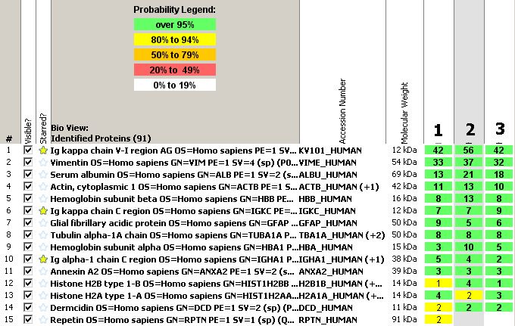
Tandem Mass Spectrometry Analysis
Database Search

Slide 15
Diagnosis
Crystal-Storing Histiocytosis associated with kappa light chain restricted plasma cells

Slide 16
Crystal-Storing Histiocytosis
Extremely rare pathology
  approximately 80 cases reported, most commonly in head and neck or lung/pleura
  only 3 cases reported previously in CNS
Most often associated with disorders that feature a monoclonal gammopathy
Intralysosomal aggregates of paraproteins, usually immunoglobulins, form crystals
Generally κ-light chain restricted with no specific heavy chain

Slide 17
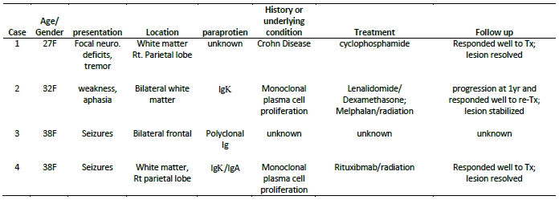
Summary of CSH cases reported in the central nervous system
Patients all relatively young females
All localized disease with no evidence of serum M-protein
Good treatment response
Notes:
There is no sex difference noted in CSH when all sites are included
The average age of woman developing is CSH is 61 in all sites

Slide 18
Differential Diagnosis for CSH in the CNS
Multiple Sclerosis
Acute leukoencephalopathy
Primary brain neoplasm
Hematopoietic malignancy (*)
  extramedullary plasmacytoma
  lymphoplasmacytic lymphoma
Notes:
Multiple sclerosis and Acute leukoencephalopathy-ruled out based on clonal plasma cell proliferation
Hematopoietic malignancy has an asterisk because they can also be the underlying cause of CSH

Slide 19
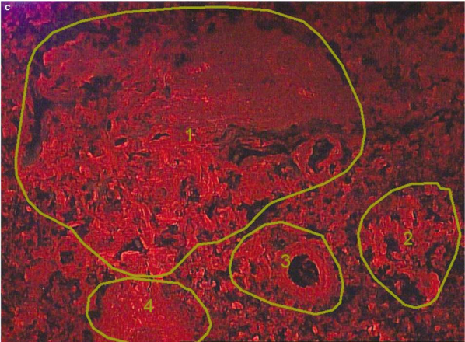
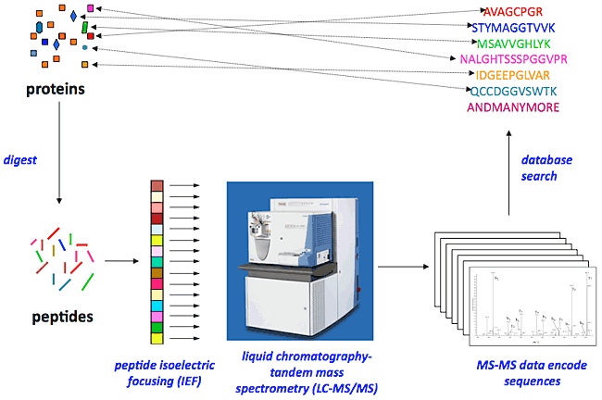
Proteomic Analysis by Mass Spectrometry
Microdissection Protein digestion Tandem MS
Database Search

Slide 20
Ancillary studies for CSH and Proteinaceous Deposits
 | PROS | CONS
IHC | Easy/routine Add information about underlying cause | Contamination with serum proteins Loss of antigenicity in crystals Limited number of simultaneous markers that can be tested
EM | Can confirm crystals and cell type | Unable to determine identity of paraprotein
LC-Mass Spectrometry | Multiple proteins identified including complex mixtures | Time consuming

Slide 21
Acknowledgements
Dr. Ahmet Dogan, Mayo Clinic

Slide 22
References
Costanzi C, Bourdette D, Parisi JE, Woltjer R, Rodriguez F, et al. (2012) Crystal-storing histiocytosis: An unusual relapsing inflammatory CNS disorder. Multiple Sclerosis and Related Disorders 1(2): 95.
2. Dogan S, Barnes L, Cruz-Vetrano WP. (2012) Crystal-storing histiocytosis: Report of a case, review of the literature (80 cases) and a proposed classification. Head Neck Pathol 6(1): 111-120.
3. Kaminsky IA, Wang AM, Olsen J, Schechter S, Wilson J, et al. (2011) Central nervous system crystal-storing histiocytosis: Neuroimaging, neuropathology, and literature review. AJNR Am J Neuroradiol 32(2): E26-8.
4. Rodriguez FJ, Gamez JD, Vrana JA, Theis JD, Giannini C, et al. (2008) Immunoglobulin derived depositions in the nervous system: Novel mass spectrometry application for protein characterization in formalin-fixed tissues. Lab Invest 88(10): 1024-1037.

