Slide 1

DIAGNOSTIC SLIDE SESSION 2013
CASE 6

Slide 2
Disclosure Statement
Nothing to disclose

Slide 3
Clinical Summary
A 30 year old man with recent treatment for Streptococcal pharyngitis developed weakness of the left upper and lower extremities and left facial droop.

Slide 4
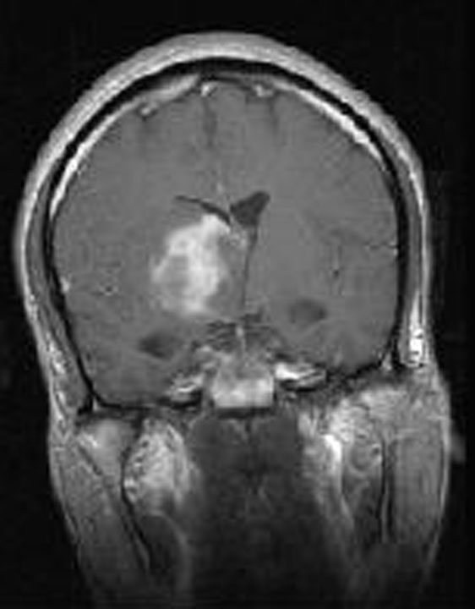
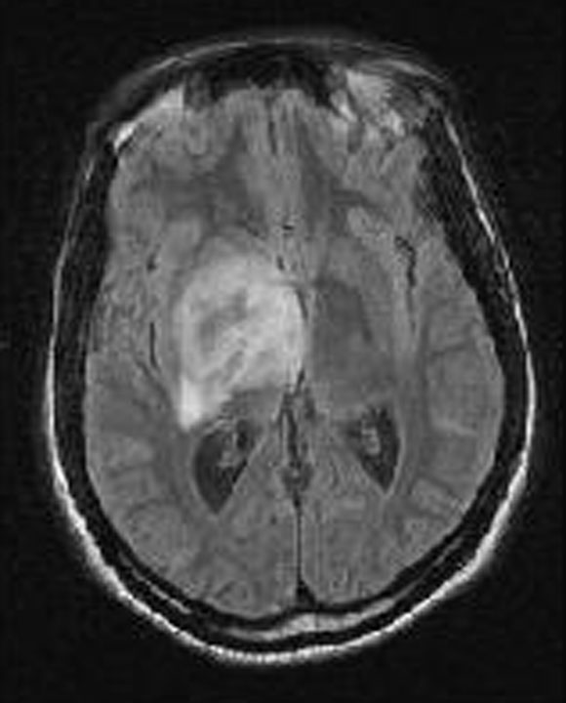
MRI Preoperative

Slide 5
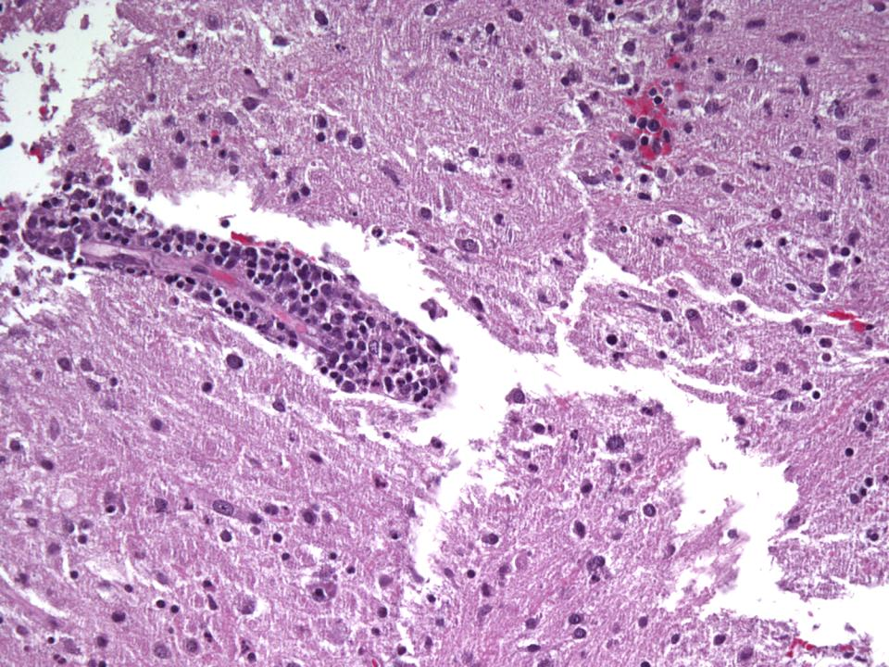
Biopsy 1

Slide 6
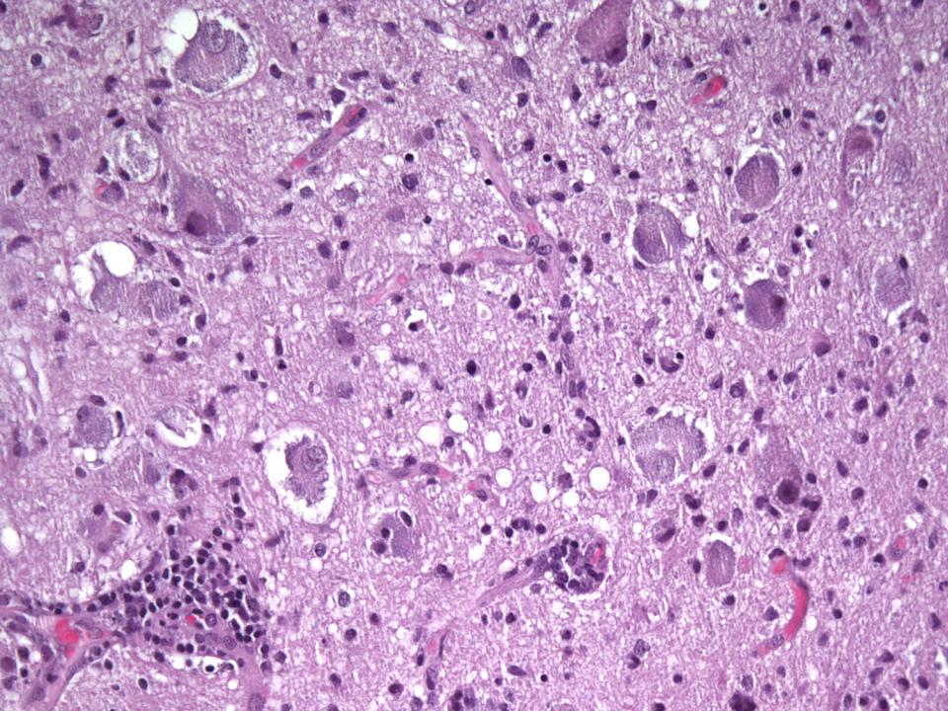
Biopsy 1

Slide 7
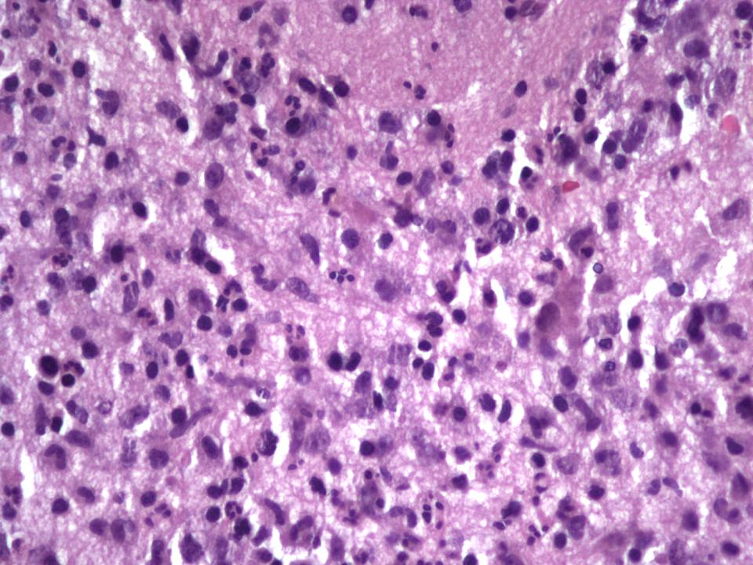

Slide 8
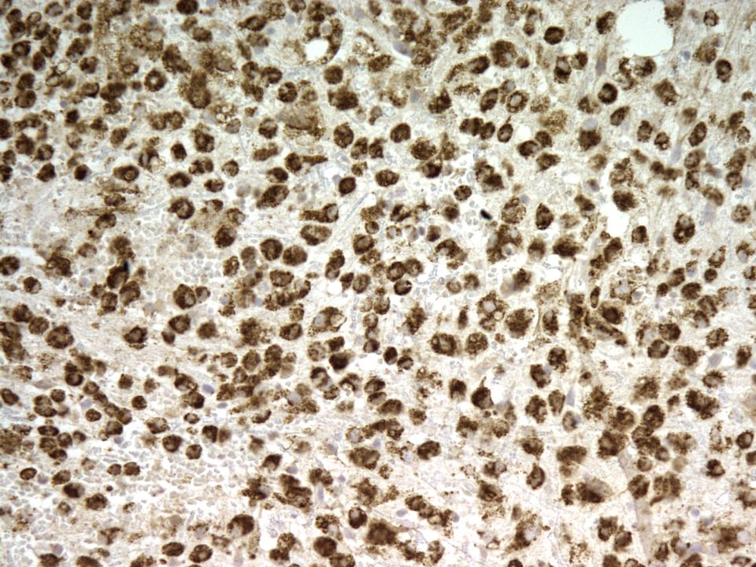
CD68

Slide 9
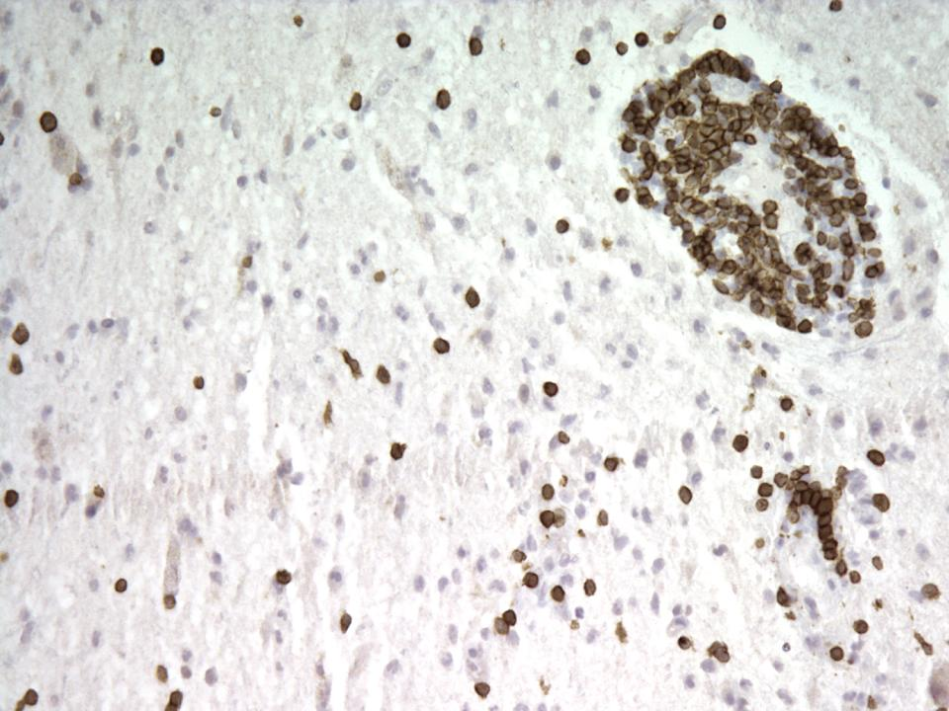
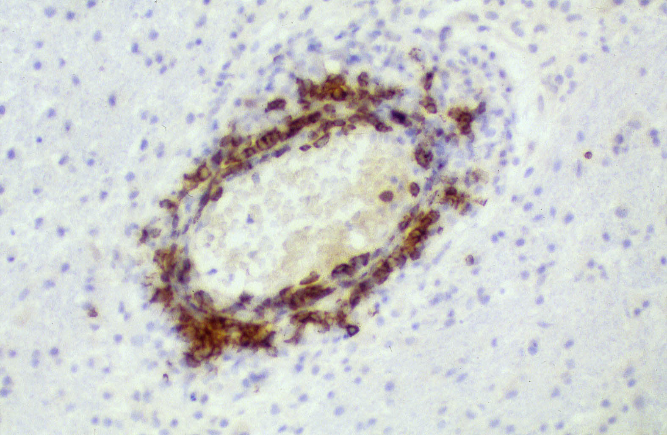
CD3 CD20
CD3

Slide 10
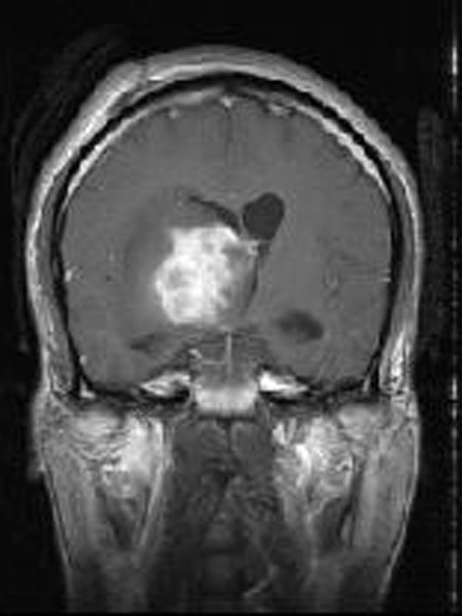
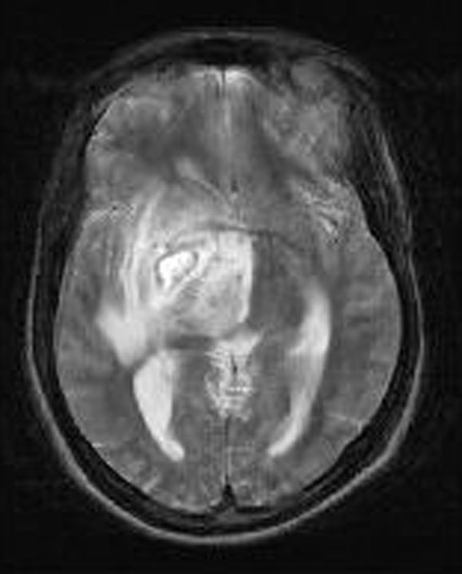

Slide 11
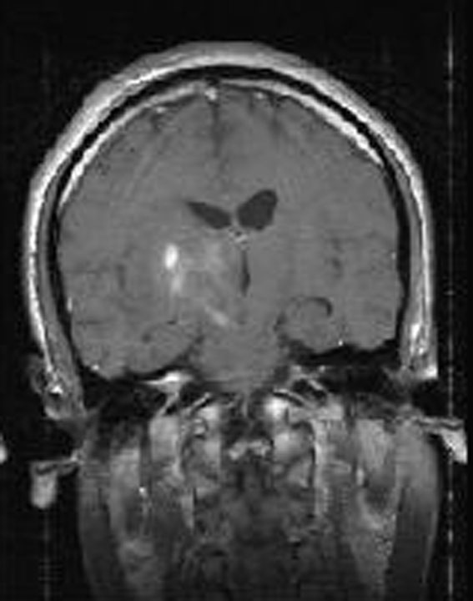

Slide 12
Diagnosis?

Slide 13
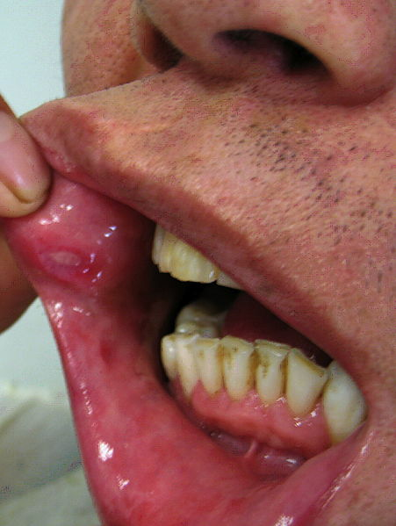

Slide 14
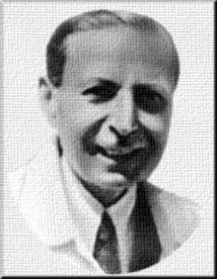
Behçet Disease
Idiopathic disorder classified as vasculitis
Common in Turkey and Middle East
  Silk Road Disease
Clinical features
  Recurrent oral and genital ulcers
  Uveitis
  Erythema nodosum
  Folliculitis
  Meningitis or central nervous system vasculitis (Neuro-Behçet)

Slide 15
Neuro-Behçet Disease
Clinical features
Headache
Behavioral changes
Hemiparesis
MRI
Scattered contrast enhancing lesions in basal ganglia, brainstem, or internal capsule
Neuropathological Findings
Perivascular infiltration of inflammatory cells, with or without necrosis
  Mononuclear
  Polymorphonuclear
  Rare eosinophils

Slide 16
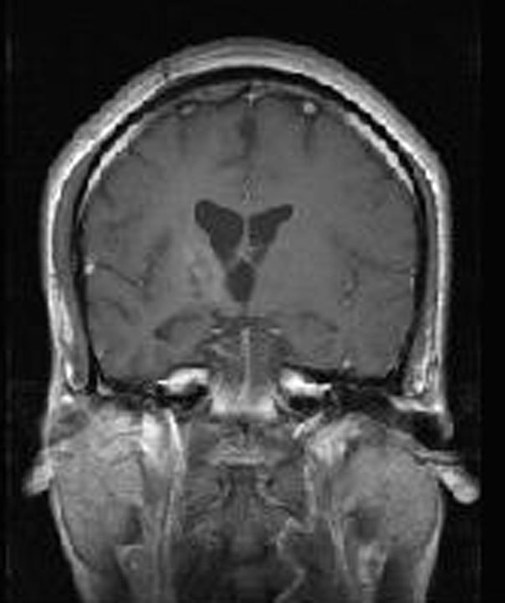
Follow-up
Treated with Cellcept
  Symptom free for four years
Serial MRIs stable

Slide 17
Final Diagnosis
Behçet Disease
  with Neuro-Behçet presentation

Slide 18
References
Taskapilioglu O, Seferoglu M, Akkaya C, Hakyemez B, Yusufoglu C, Basak AN, Gundogdu A, Bora I. AN, Gundogdu A, Bora I. Delayed diagnosis of a neuroBehçet patient with only brainstem and cerebellar atrophy: literature review. J Neurol Sci. 2009;277(1-2):160-3.
Borhani Haghighi A, Sharifzad HR, Matin S, Rezaee S. The pathological presentations of neuroBehçet disease: a case report and review of the literature. Neurologist. 2007;13(4):209-14.
Arai Y, Kohno S, Takahashi Y, Miyajima Y, Tsutusi Y.Autopsy case of neuro-Behçet's disease with multifocal neutrophilic perivascularinflammation.Neuropathology. 2006;26(6):579-85.

