Slide 1
DSS Case #3
*Grant R. Kolar, M.D., Ph.D., °Terrence Holekamp, MD., Ph.D., *Richard Perrin, M.D., Ph.D.
*Division of Neuropathology and °Department of Neurosurgery, Washington University in St. Louis

Slide 2
Disclosure
There are no financial relationships to disclose.

Slide 3
Brief History Received
60 year old man transferred after 4 days (presented at 1 day) of worsening confusion and memory deficits
PMHX: CAD, MI, HTN
Physical Exam: Drowsy and uncooperative, saccadic intrusions of ocular pursuits, right pronator drift, mild bradykinesia
Social HX: 8 drinks or more per day

Slide 4
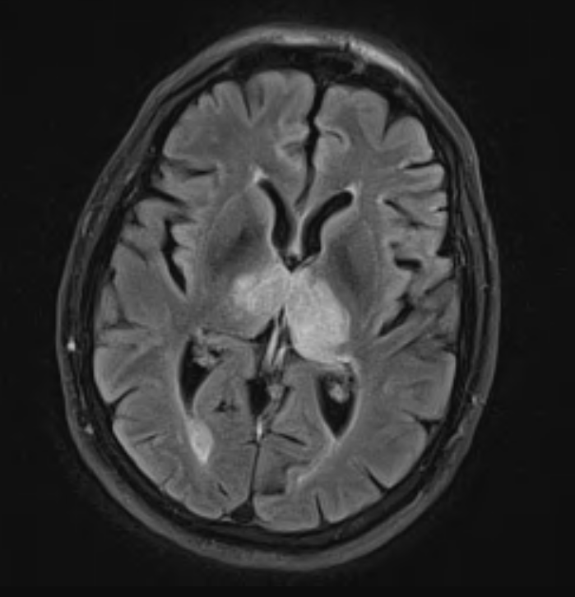
MRI (FLAIR)
Compression of 3rd ventricle
Bilateral thalamic T2 hyperintensities with homogeneous enhancement
Scattered nonspecific T2 hyperintensities in cortex
DDX:
Lymphoma
Glioma
Encephalitis
Wernicke’s encephalopathy
CO poisoning
PET
  Mild asymmetric hypermetabolism
  DDX: lymphoma or high grade glioma

Slide 5
Stereotactic Needle Biopsy

Slide 6
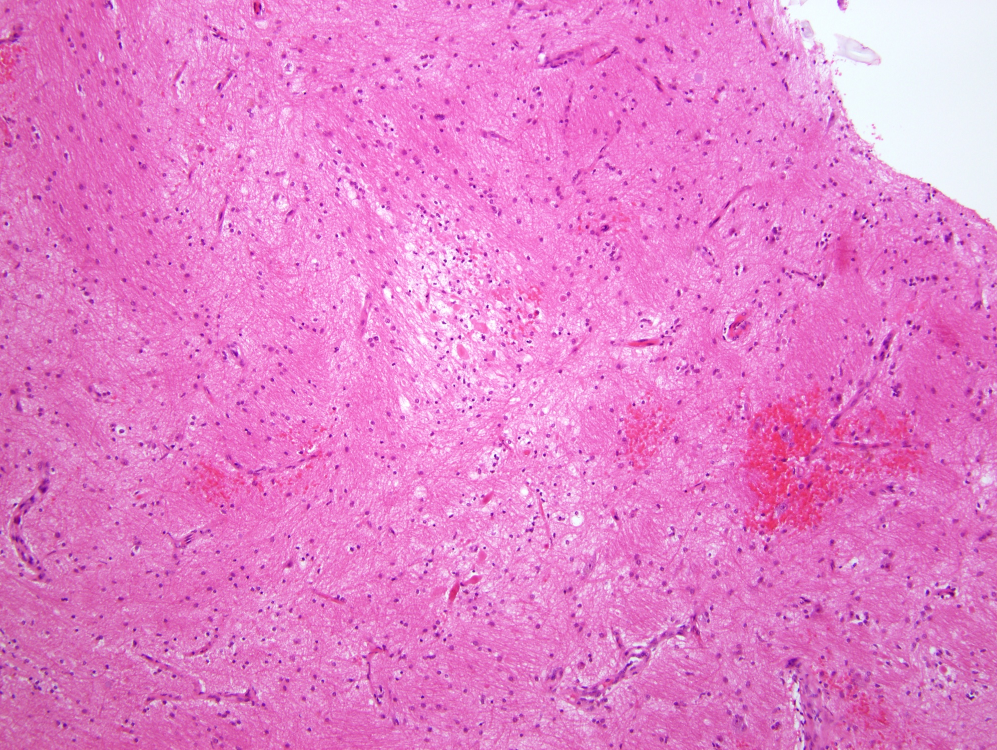

Slide 7
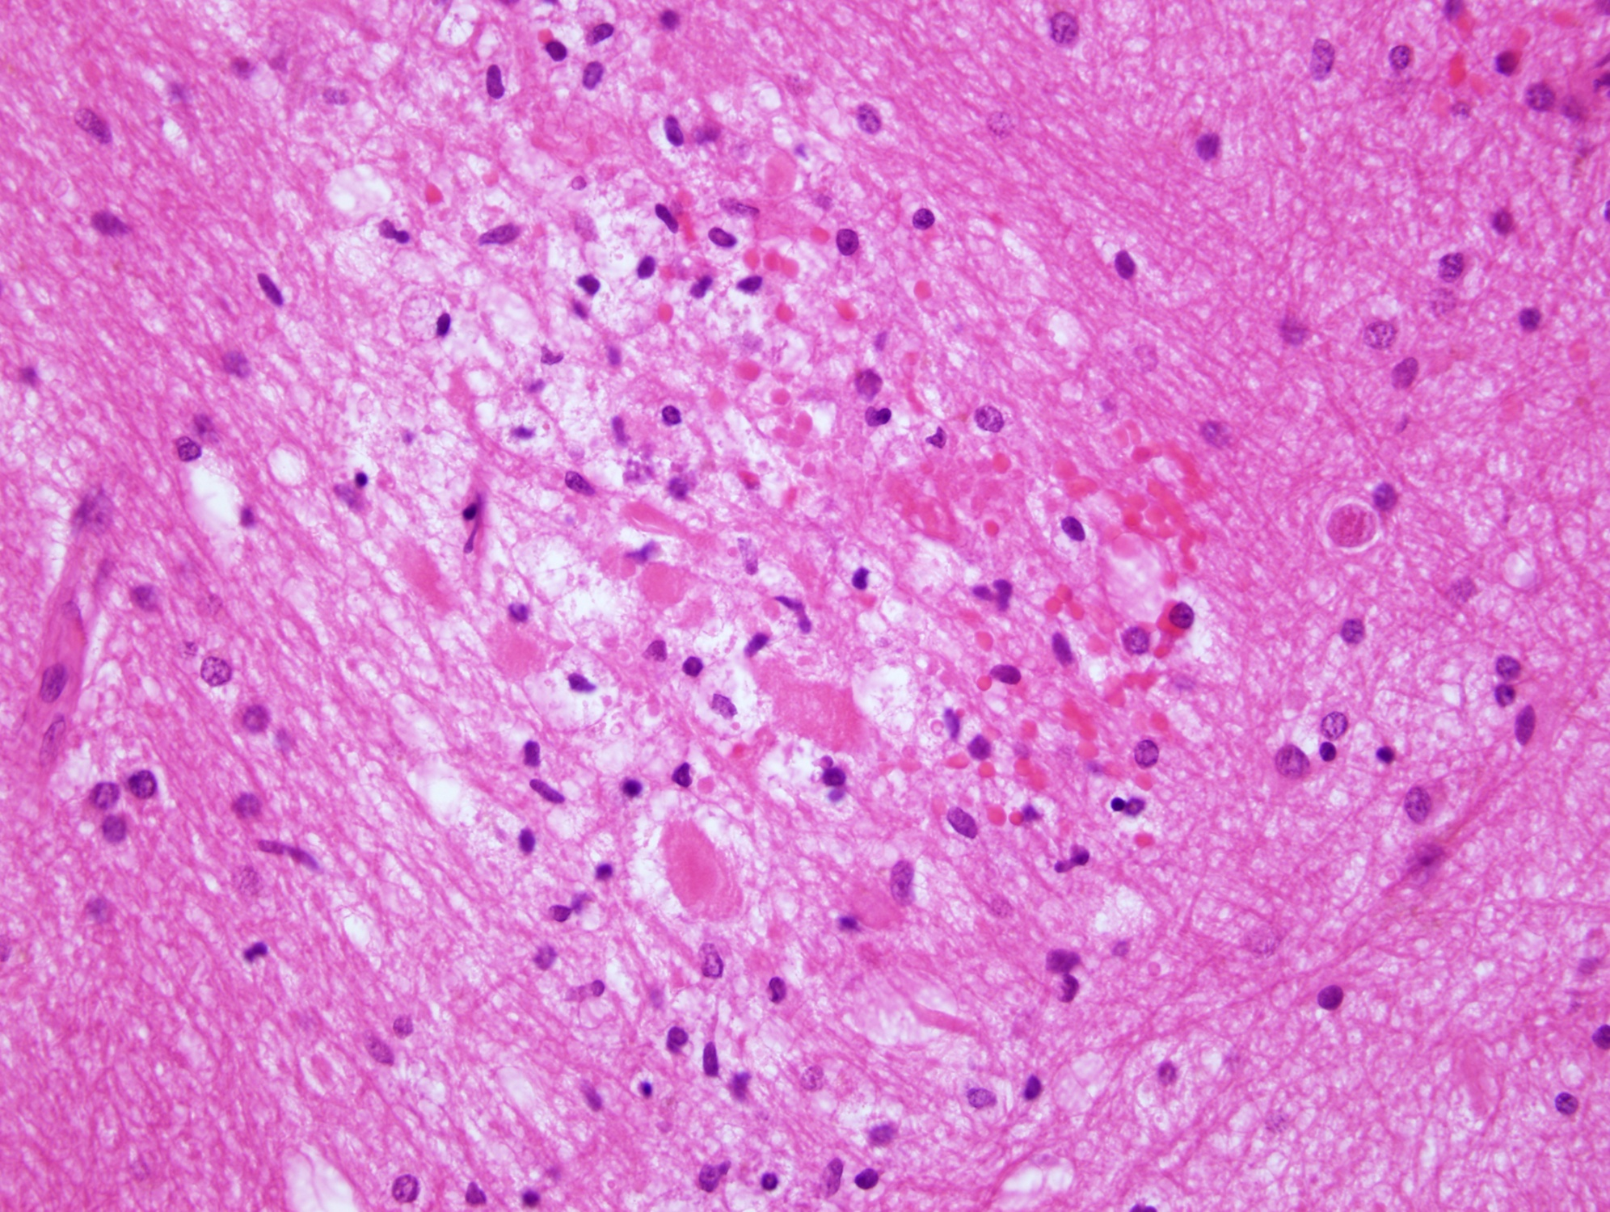

Slide 8
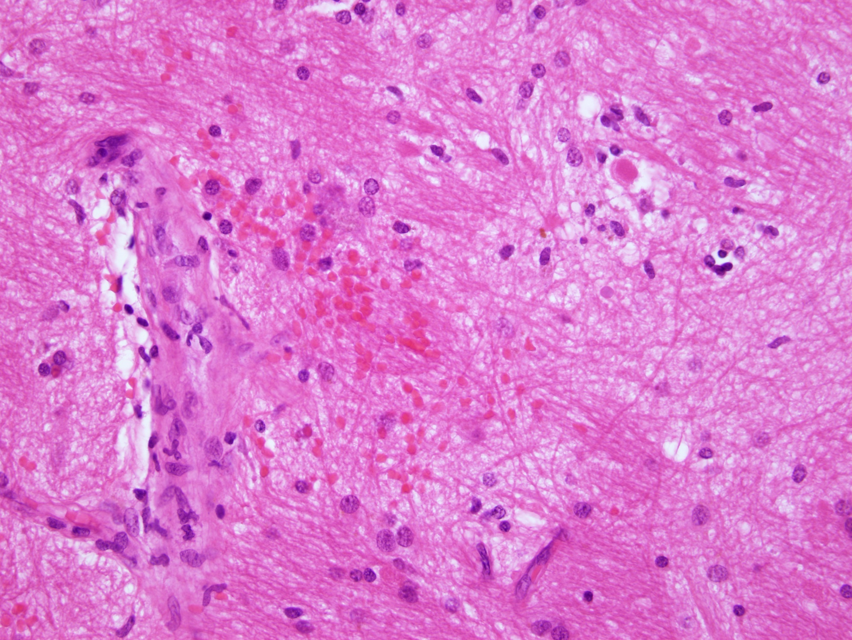

Slide 9
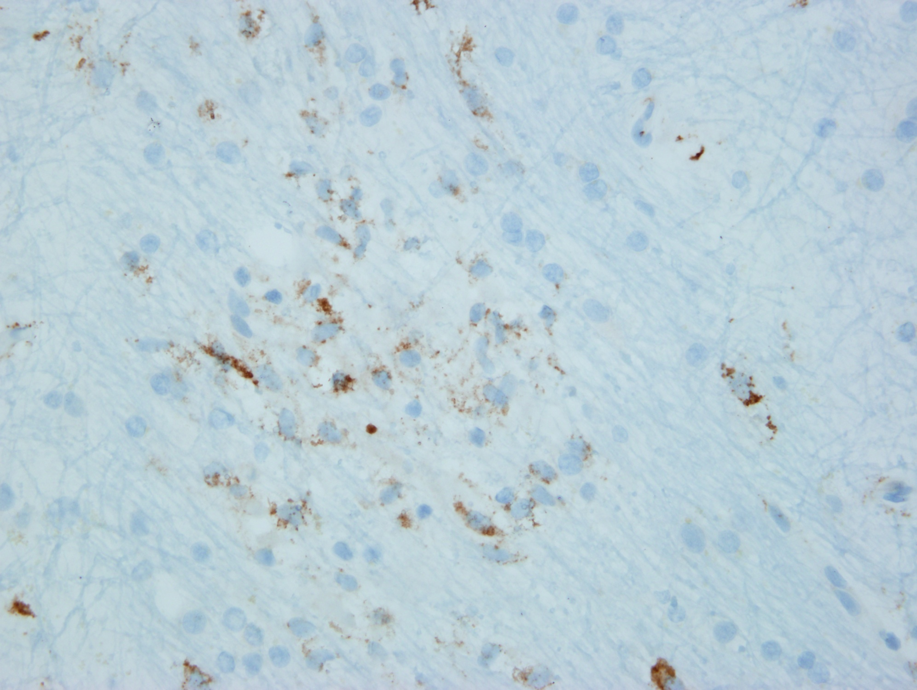
CD68

Slide 10
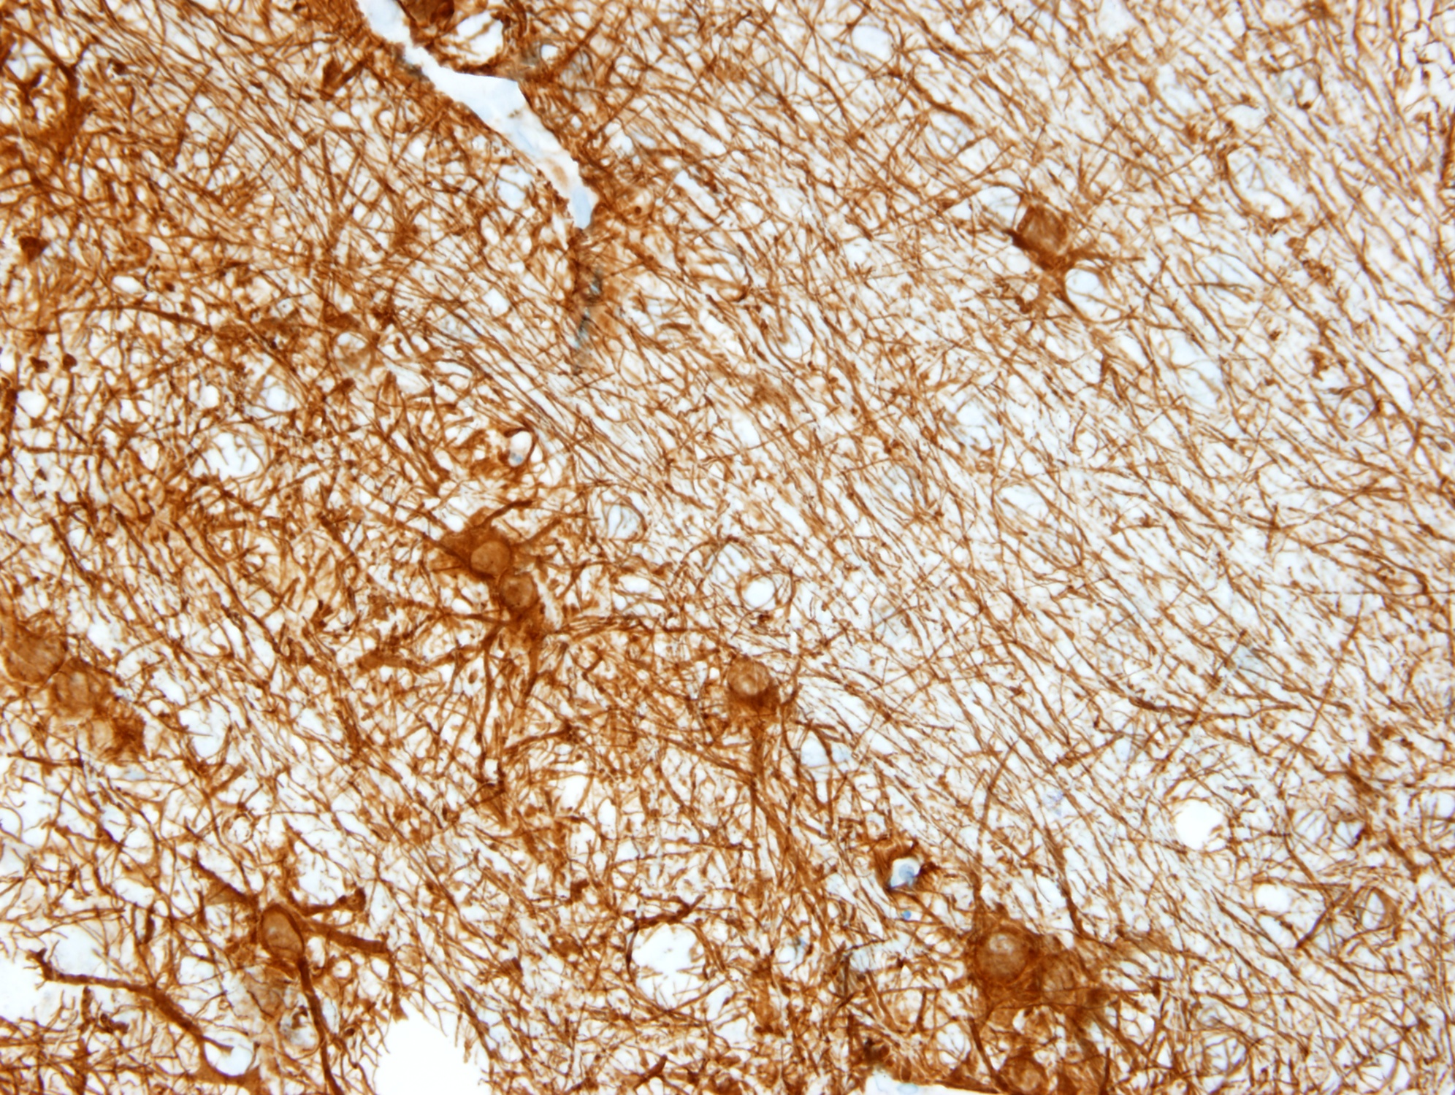
GFAP

Slide 11
Histopathology Summary
Reactive and mildly proliferative endothelial changes
Petechial hemorrhages, minute hemosiderin deposits
Mild reactive gliosis and mild edema
Microinfarcts w/spheroids, small foamy macrophages, rare red neurons, and sparing of adjacent neurons

Slide 12
Discussion and DDX

Slide 13
DDx
Arterial Infarction (Bithalamic – Artery of Percheron Infarction)
Tumor
  High-grade glioma
  Lymphoma
Toxicity
  Wernicke’s encephalopathy
  Carbon monoxide poisoning
  Hepatic encephalopathy
Deep venous system thrombosis
Thalamic venous hypertension

Slide 14
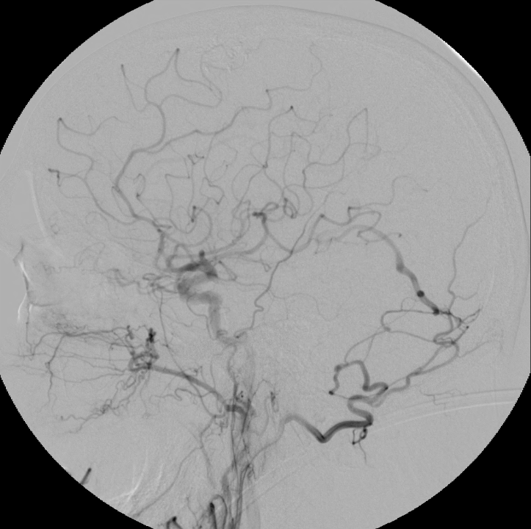
Followup MRA
Several weeks later …
Re-review of MRI noted large vein (originally not reported)
Showed abnormal venous channel (involving vein of Galen and confluence of sinuses) with arterialized flow
(right common carotid angiogram)

Slide 15
Internal Cerebral Veins (paired) and Vein of Galen
(Straight Sinus Thrombosed)
Dural Arteriovenous Fistula (dAVF)
Right Occipital Artery
Borden-Shucart Type III tentorial dAVF (Zipfel type 3s)

Slide 16
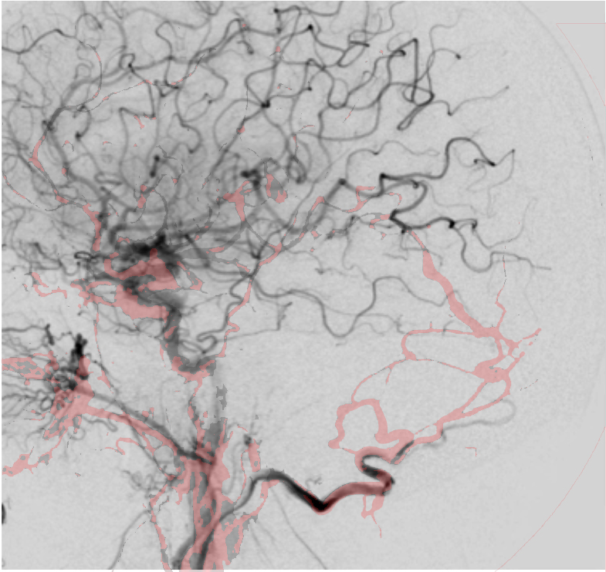
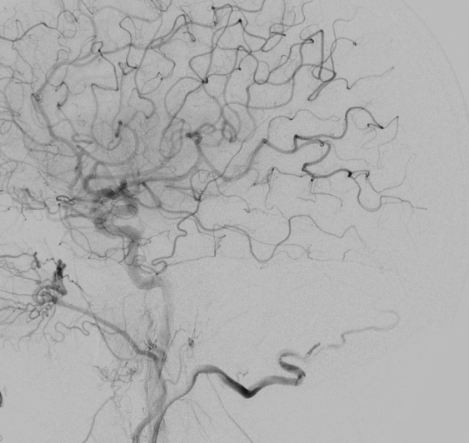
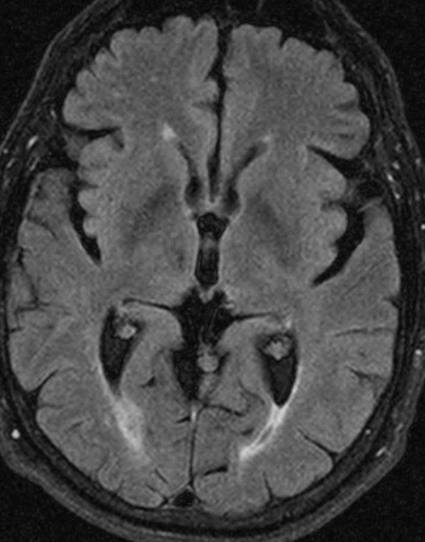
After Embolization and Surgical Ligation
Red = before treatment; Black = after treatment

Slide 17
Answer
Hypertensive Venous Infarction Secondary to a Tentorial Dural Arteriovenous Fistula

Slide 18
Dural Arteriovenous Fistulas
Rare vascular malformation
  10-15% of intracranial vascular malformations
Abnormal direct connection between dural arteries and cerebral venous system
  Most appear acquired with:
    Sinus thrombosis
    Intracranial venous hypertension
    Also may result from prior surgery, trauma, or idiopathic causes
  In contrast arteriovenous malformations (AVMs) are
    Parenchymal
    Congenital

Slide 19
Experimental Etiology of dAVFs
Other
Venous HTN
Sinus Thrombosis
Retrograde Flow and Enlargement of Veins
Chronic Regional Hypoperfusion
Induction of VEGF
Matrix Metalloproteinase 9
(MMP9)
dAVF Formation
Chen L, Mao Y, et al. Local Chronic Hypoperfusion Secondary to Sinus High Pressure Seems to be Mainly Responsible fo the Formation of Intracranial Dural Arteriorvenous Fistula. 2009. Neurosurgery 64:973

Slide 20
dAVF Clinical Presentation
Flow related
  Pulsatile tinnitis
  Opthalmological phenomenon
Incidental
*Intracranial hemorrhage
*Non hemorrhagic neurological deficits
  Often misdiagnosed and given unnecessary procedures
  Overall 25-55% rate in high grade dAVFs
  Focal neurological deficits
  Dementia-like syndrome
    20-27% of patients with high grade dAVFs
    Cortical vs Thalamic patterns
*Hemorrhage AND non-hemorrhagic neurological deficits signal high risk dAVFs
  Carry the same risk of future bleed

Slide 21
Imaging of Thalamic dAVFs
Cerebral angiography -- gold standard of diagnosis
  100% show multiple supply vessels
  90% involve branches of external carotid artery
  Venous drainage determines level of risk for future hemorrhage
    Cortical Venous Drainage vs. Direct Sinus Drainage
MRI
  Bithalamic T2 hyperintense signal (100%)
  Absence of diffusion weighted imaging (DWI) positivity (100%)
  Peripheral post-contrast enhancement
  Central hypointensity (hemosiderin deposition)
SPECT
  Abnormal thallium 201 can correspond to venous reflux
  May have low NAA and elevated lactate
PET
  Reduced cerebral blood flow (venous congestion)
  Increased oxygen extraction fraction (initially) followed by decrease (cellular death and compensation)

Slide 22
Histological Features of Thalamic dAVFs
Acute-subacute anoxic damage
  Anoxic change in neurons
  Scattered axonal spheroids
  Microinfarcts
  Lipid laden (foamy) macrophages
Moderate microvascular response
  Reactive endothelium

Slide 23
Treatment dAVF
Embolization
Craniotomy with clip ligation
Without treatment, higher grade thalamic dAVFs (reflux into internal cerebral veins) are usually fatal
Usually patients demonstrate remarkable progressive cognitive and radiological improvement if treatment is timely.

Slide 24
Conclusion
Differential diagnosis of bithalamic T2 hyperintensities and lack of DWI signal with cognitive decline must include a thalamic dural arteriovenous fistula
Cerebral angiogram is gold standard of diagnosis
Histologic features are relatively nonspecific
Outcome is correlated with rapid treatment (fatal if untreated)

Slide 25
References
Chen L, Mao Y, Zhou LF. Local chronic hypoperfusion secondary to sinus high pressure seems to be mainly responsible for the formation of intracranial dural arteriovenous fistula. Neurosurgery 64:973-8, 2009
Holekamp TF, Murphy RKJ, Kolar GR, Morparia NP, Derdeyn CP, et al. dAVF-Related Thalamic Dementia (DRTD) Syndrome: case series and literature review. Manuscript in progress/submitted.
Morparia N, Miller G, Rabinstein A, Lanzino G, and Kumar N. Cognitive decline and hypersomnolence: thalamic manifestations of a tentorial dural arteriorvenous fistula (dAVF). Neurocritical Care 17:429, 2012
Rodriguez FJ, Crum BA, Krauss WE, Scheithauer BW, Giannini C. Venous congestive myelopathy: a mimic of neoplasia. Mod Pathol. 18:710-8. 2005
Sugrue PA, Hurley MC, Bendok BR, Surdell DL, Gottardi-Littell N, Futterer SF, et al: High-grade dural arteriovenous fistula simulating a bilateral thalamic neoplasm. Clin Neurol Neurosurg 111:629-632, 2009
Hurst RW, Bagley LJ, Galetta S, Glosser G, Lieberman AP, Trojanowski J, et al: Dementia resulting from dural arteriovenous fistulas: the pathologic findings of venous hypertensive encephalopathy. Am J Neuroradiol 19:1267-1273, 1998

Slide 26
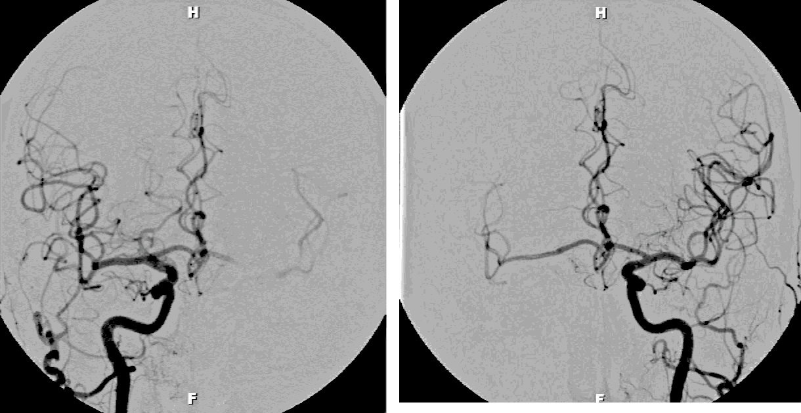
Coronal Angiogram
Right
Left

