Slide 1
AANP Diagnostic Slide Session Case 2013-4
Melike Pekmezci, MD
Arie Perry, MD

Slide 2
Conflict of interest
None to disclose

Slide 3
Clinical History
68-year-old woman
Missionary with recent travel history to Ghana
Ocular toxoplasmosis- on Bactrim
Presented with neutropenia, odynophagia, and fever
Mental status subsequently declined and progressed to a comatose state.
Neutropenia →Bone marrow biopsy → infarcts
Sickle cell trait

Slide 4
Radiology
Axial-T2 FRFSE
(Fast Recovery Fast Spin Echo)
Axial- T2 Gre
(Gradient Echo)
Notes:
MRI showed multiple small white matter lesions with signal properties suggesting petechial hemorrhages, prompting radiological differential diagnoses of acute hemorrhagic leukoencephalopathy and vasculitis.

Slide 5
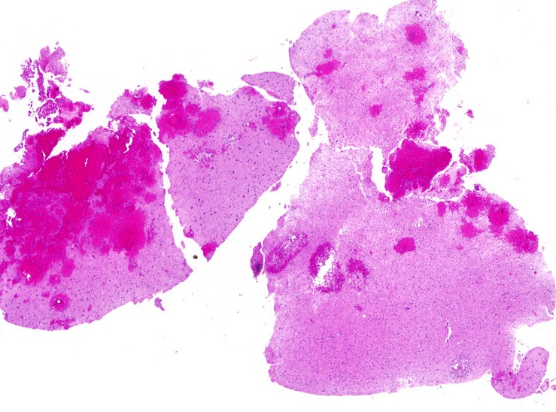

Slide 6
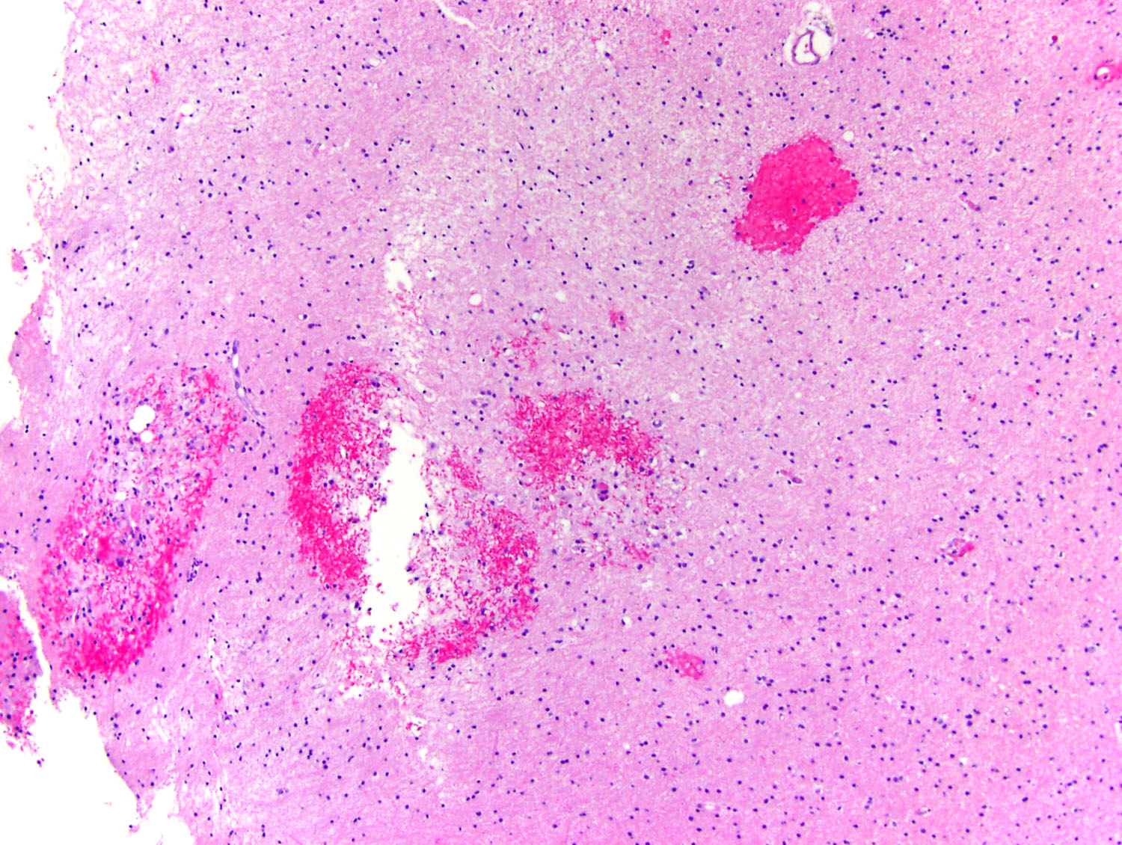

Slide 7
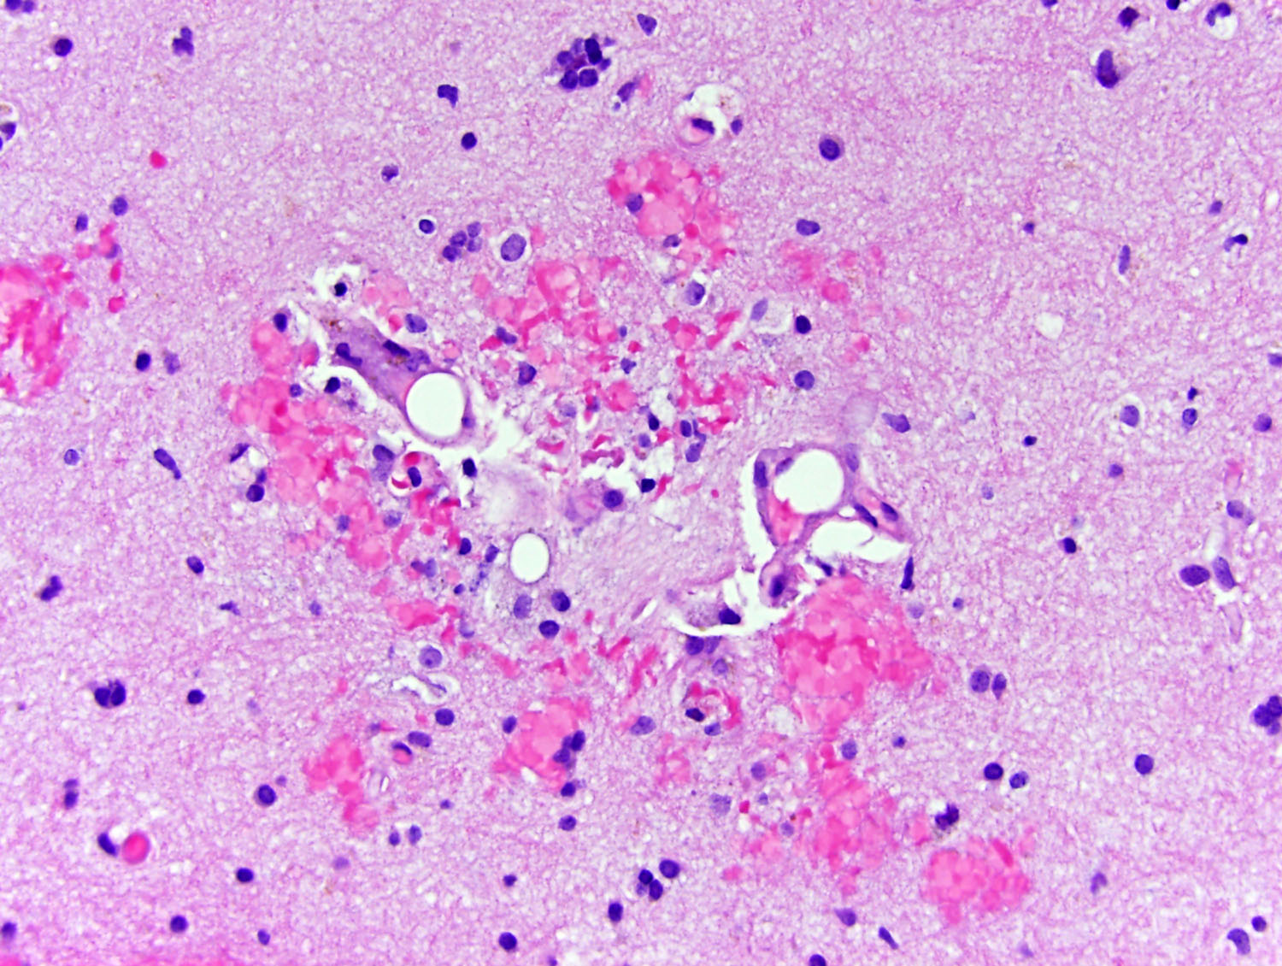

Slide 8
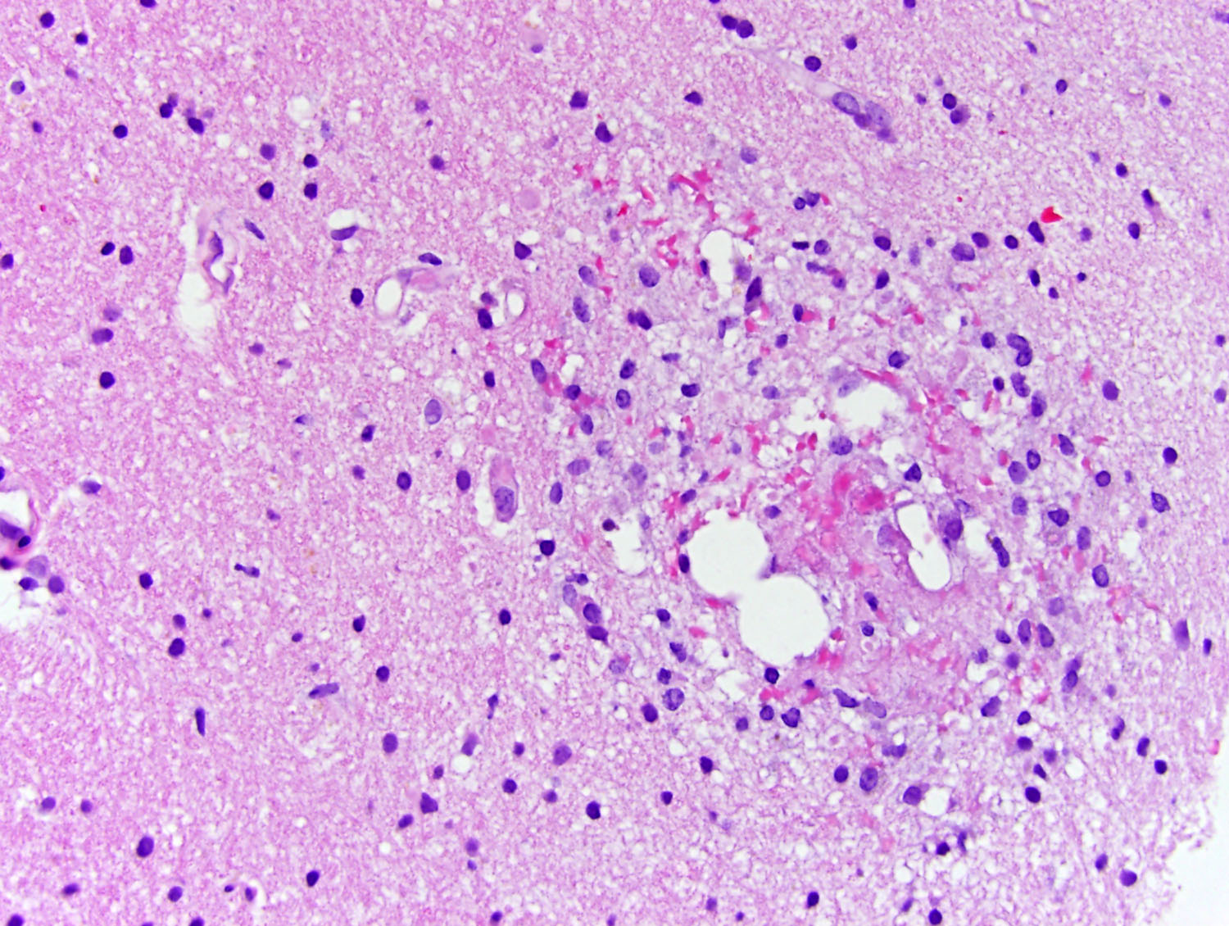

Slide 9
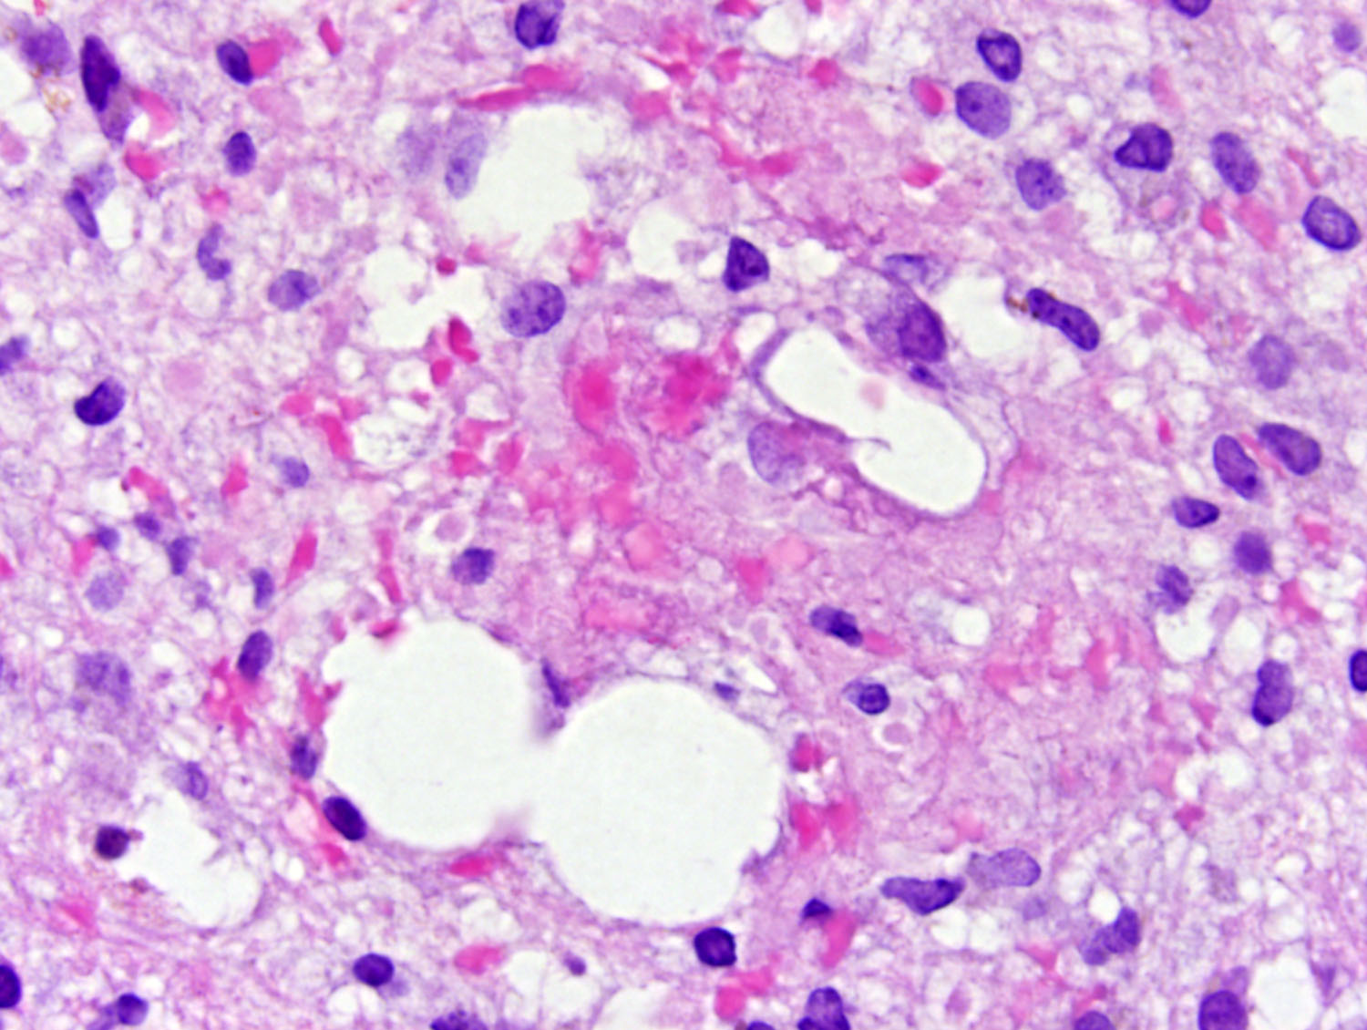

Slide 10
What is the differential diagnosis?
What special studies would you perform?

Slide 11
Diagnostic Considerations
Infectious
CNS Malaria
Toxoplasmosis
Inflammatory/autoimmune
ADEM/AHL
Lupus encephalitis
Toxic
Carbon monoxide poisoning
Notes:
Multiple microinfacts and petechial hemorrhages mostly involving the white matter.

Slide 12
Diagnostic Considerations
Vasculitis/vasculopathy
Microscopic polyangiitis
Binswanger (subcortical arteriosclerotic) encephalopathy
CADASIL
Cerebral amyloid angiopathy

Slide 13
Diagnostic Considerations
Embolic
DIC/TTP
Air embolism
Fat embolism
Other
Sickle cell disease/crisis

Slide 14
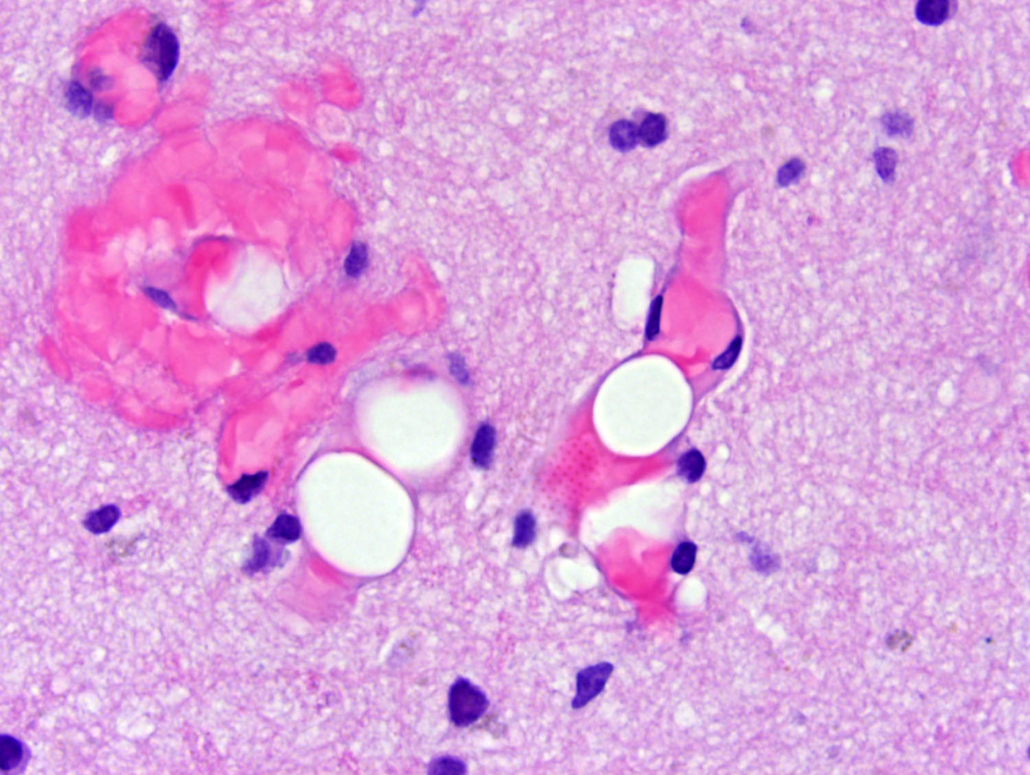

Slide 15
LFB-PAS
Neurofilament

Slide 16
CD68
GFAP

Slide 17
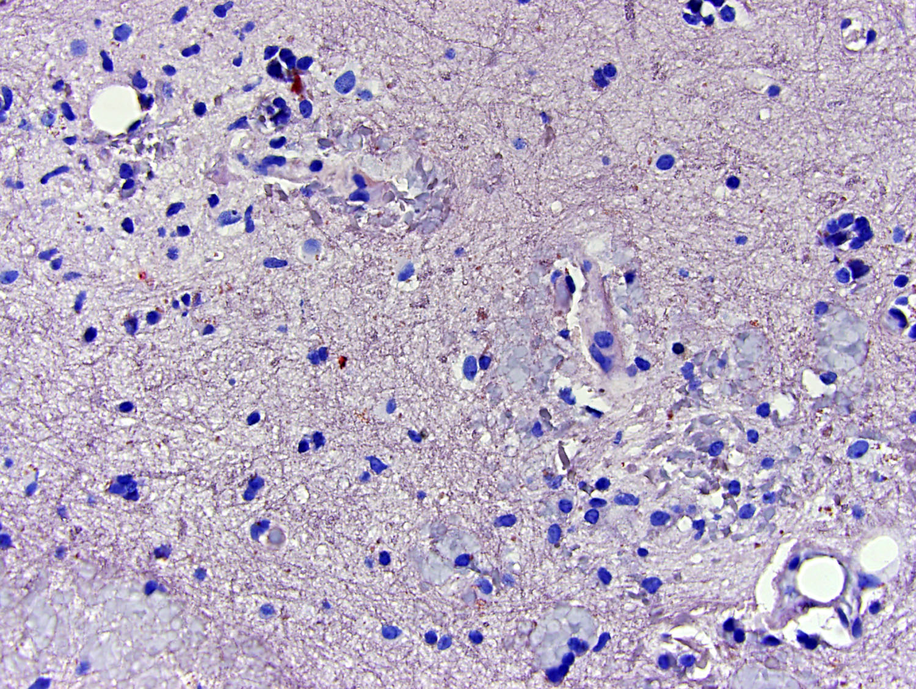
Oil Red-O

Slide 18
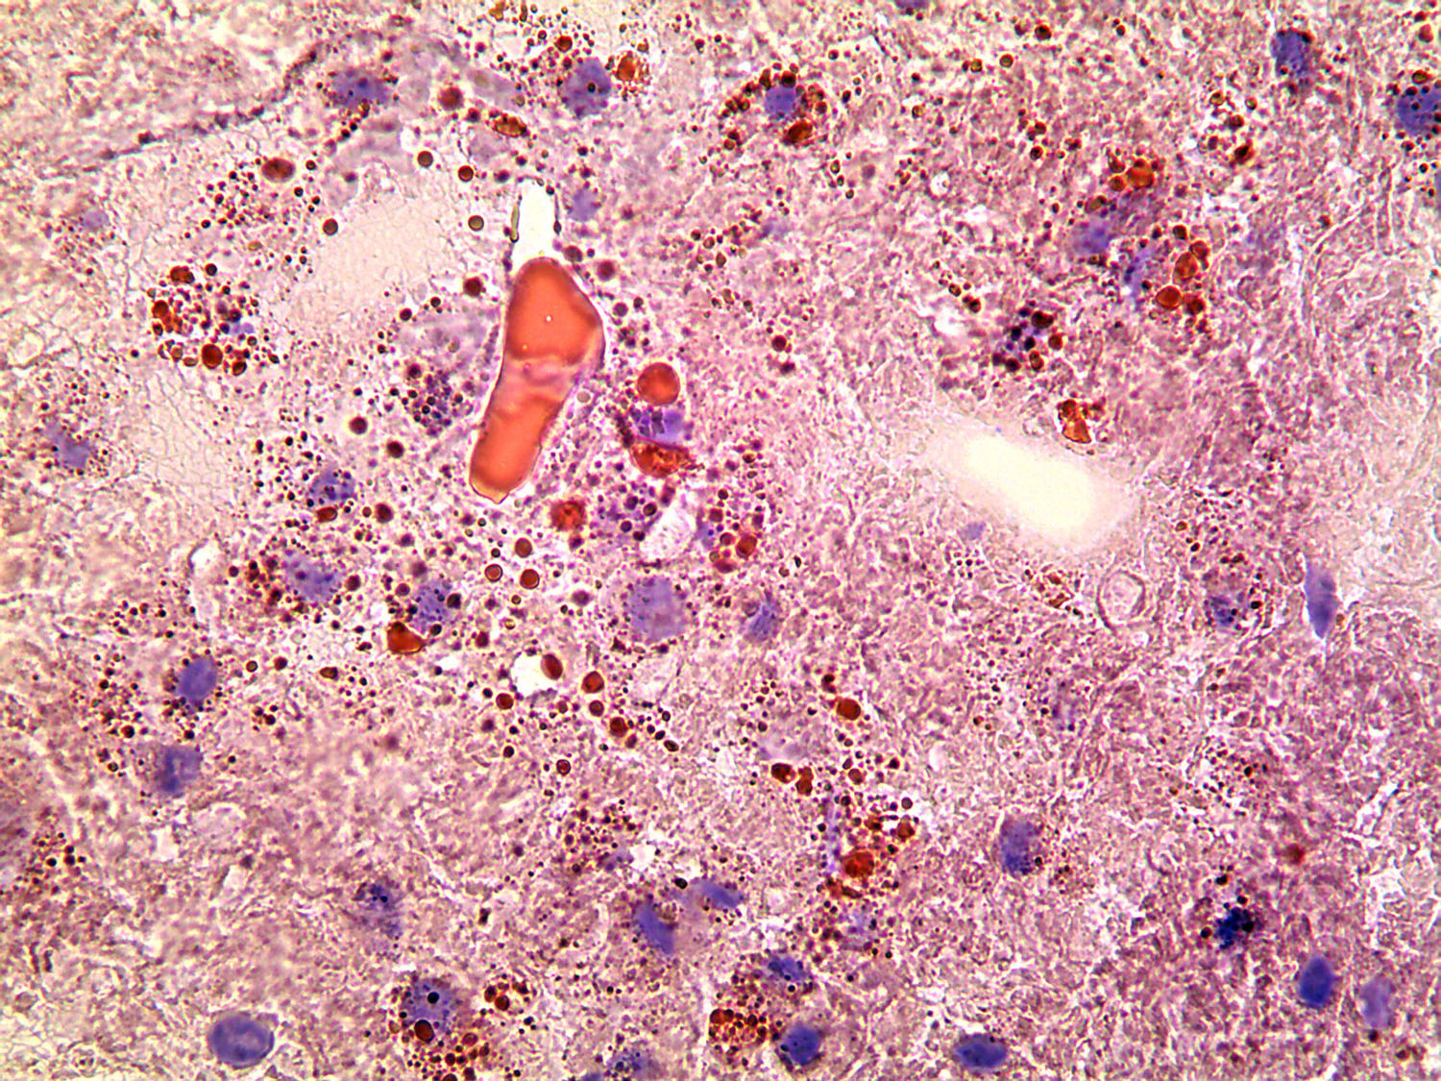
Sudan IV

Slide 19
Predisposing Factors for Fat Embolism
Traumatic
Long bones
Viscera: Liposuction
Non-traumatic
Metabolic (pancreatitis)
Burn injury
Parenteral nutrition
Sickle cell or thalassemias
(with bone marrow infarcts)

Slide 20
Pathogenesis
Mobilization of fat globules (or bone marrow) to microcirculation
Delayed effects of fat embolism are secondary to toxic effects of free fatty acids
Nitric oxide inducible NO synthase (iNOS)
Phospholipase A2
Free radical and inflammatory cytokines (TNFα, IL-1β, IL-6)
Alveolar macrophages (iNOS), neutrophil elastase and myeloperoxidase

Slide 21
Diagnosis
Clinical suspicion
Acute chest syndrome in Sickle cell disease…
Cardiac defects increase the risk of CNS embolism, but are not required.
Notes:
No diagnostic test is sensitive or specific for fat embolism
In most cases, CNS emboli happens after pulmonary capillary bed is overwhelmed, while in a smaller subset there is an underlying right to left cardiovascular shunt of some sort.

Slide 22
Treatment
Good arterial oxygenation (oxygen, PEEP, ventilator)
Maintenance of intravascular volume
Albumin
Blood transfusion
Steroids/Heparin/Alcohol/Dextran
provides intravascular volume + binds fatty acids
may have a role in sickle cell or thalassemias
are not helpful

Slide 23
Prognosis
Mortality rate 5-15%, better when it is not associated with sickle cell disease.
Rarely fulminant form may lead to death within hours of injury
Hypoxia and neurologic deficits for days-weeks
Subtle personality changes, memory problems

Slide 24
Thank you…

Slide 25
Sickle Cell Trait and crisis
Increased activity
Professional athletes and military
High altitude
Medications
Bactrim
9 out of 26,627 side effects reported to FDA by June 2013
All less than 1 month treatment
Mostly children (10-19 y) one adult (50-59 y)
Decongestants-pseudoephedrine

