Slide 1
Case 2013-7
Sarah A. Brooks, MD and Cynthia T. Welsh, MD
Medical University of South Carolina

Slide 2
Disclosure
I have no financial relationships to disclose.

Slide 3
Clinical History
46 year old male with fatigue and progressive neurologic dysfunction
PMHx: Panhypopituitarism beginning with DI

Slide 4
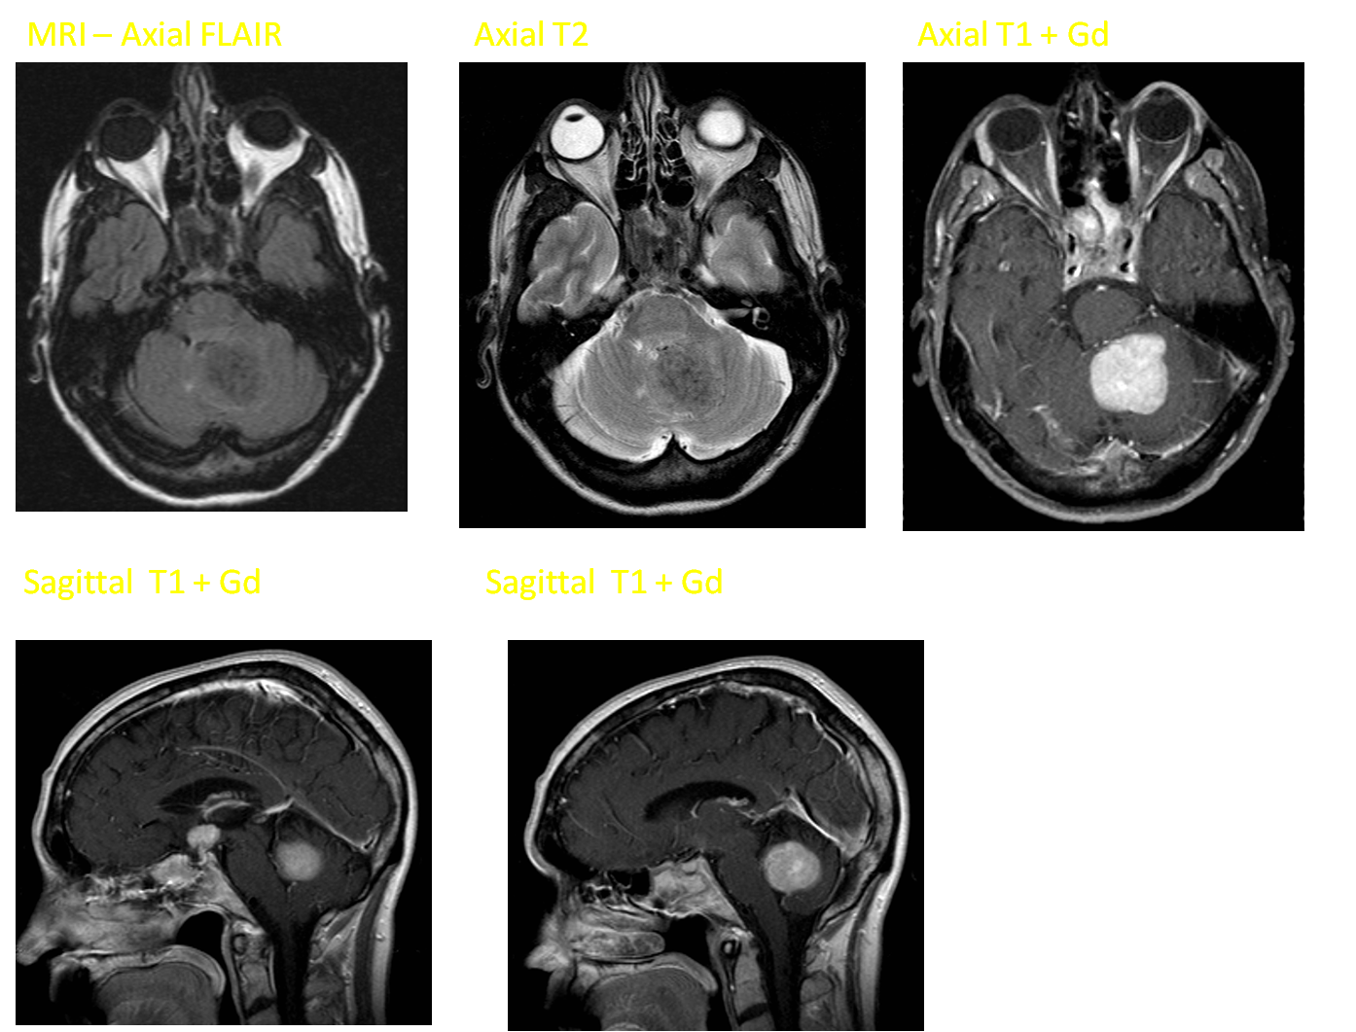

Slide 5
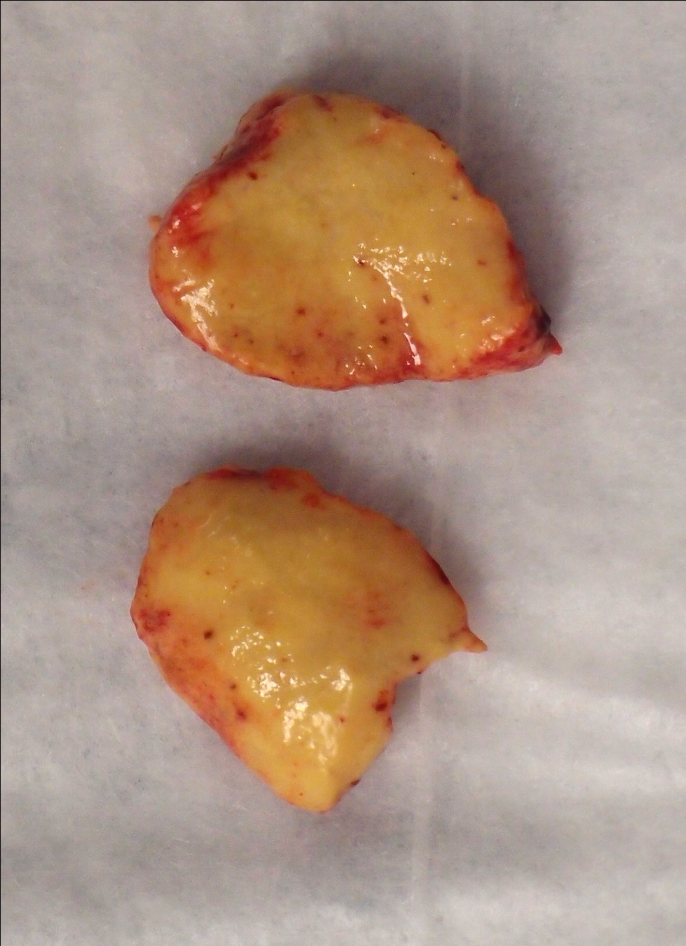

Slide 6
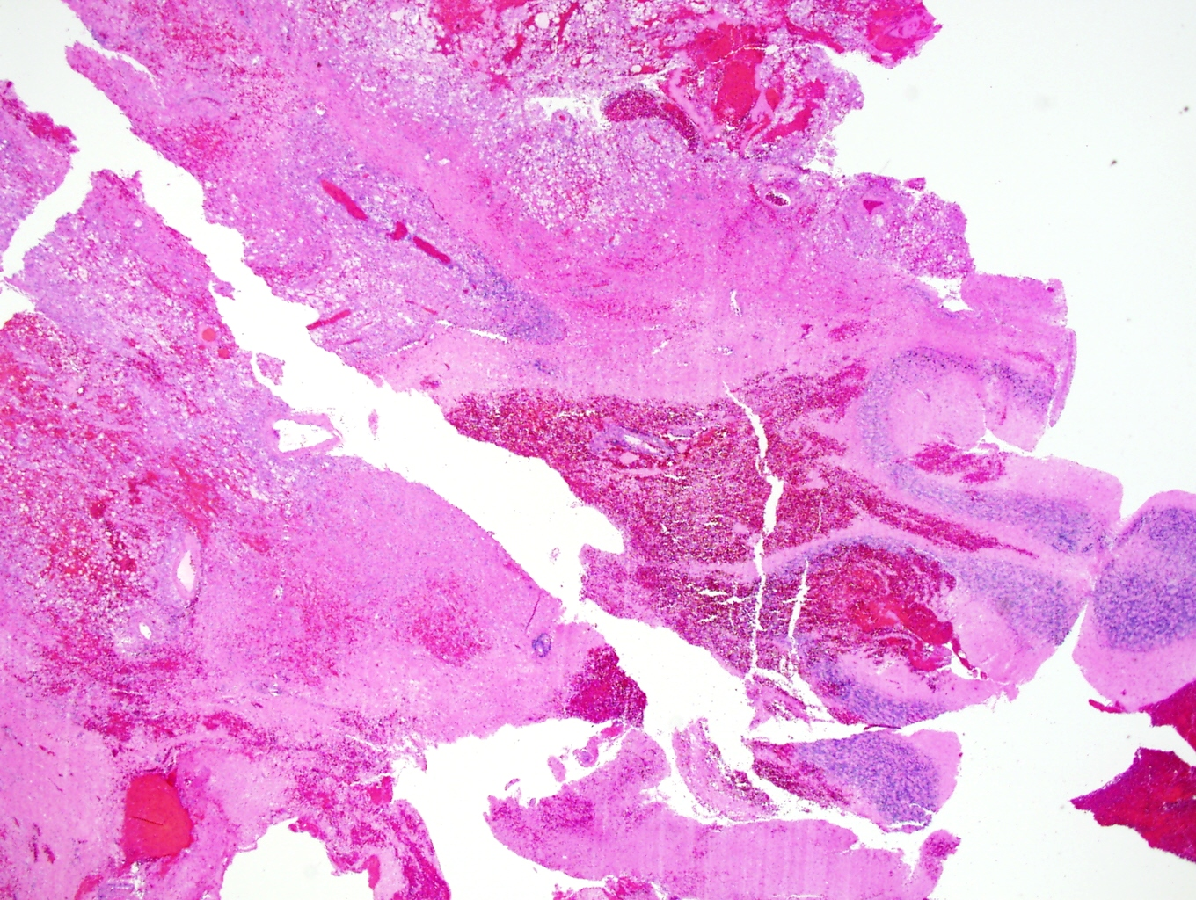

Slide 7
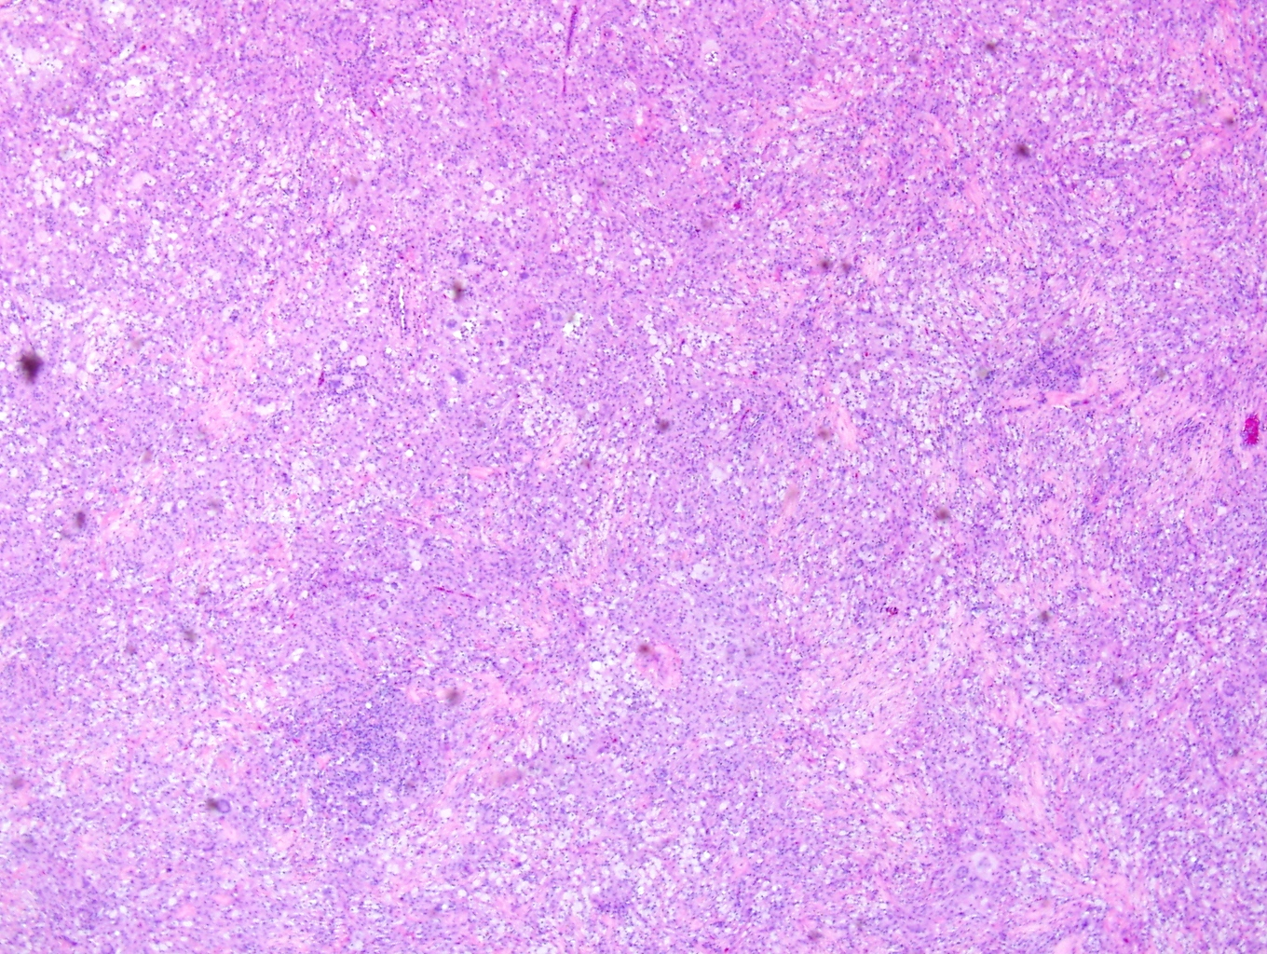

Slide 8
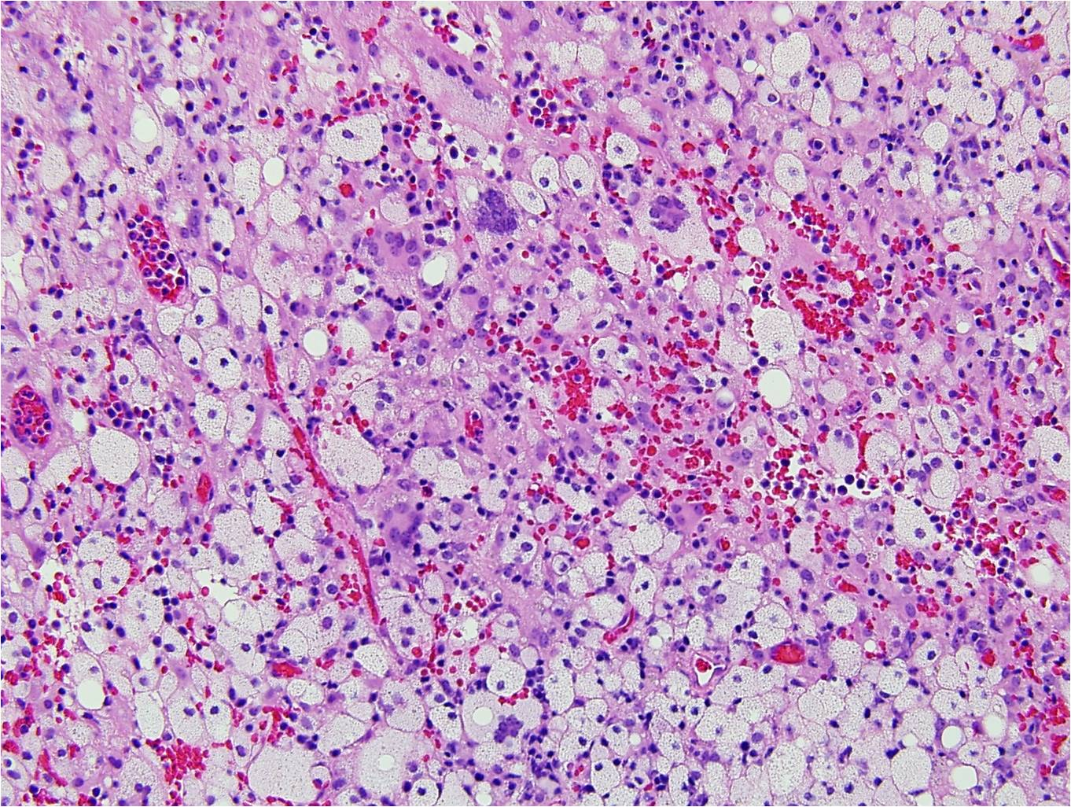

Slide 9
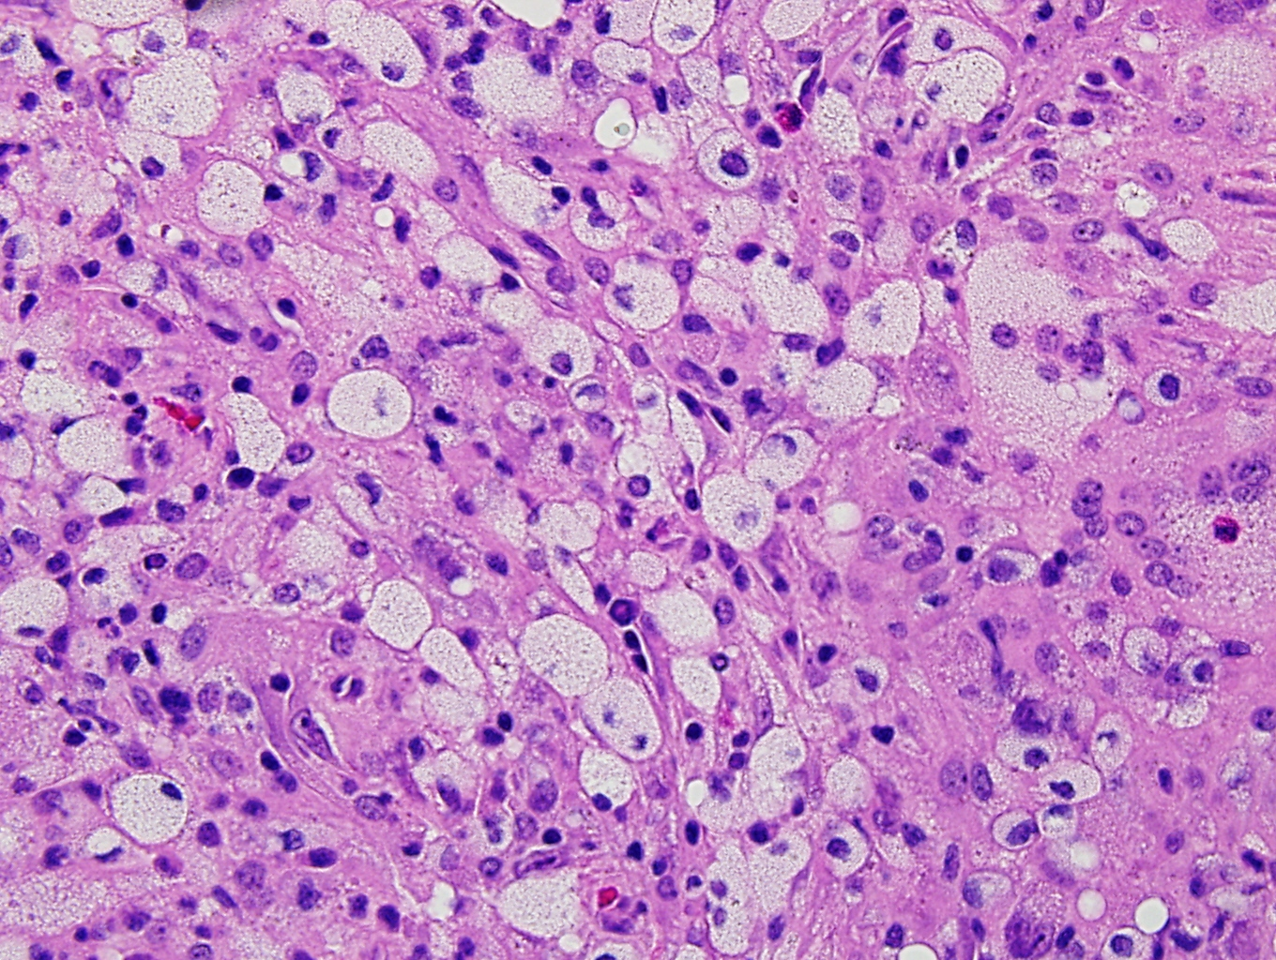

Slide 10
Diagnosis?

Slide 11
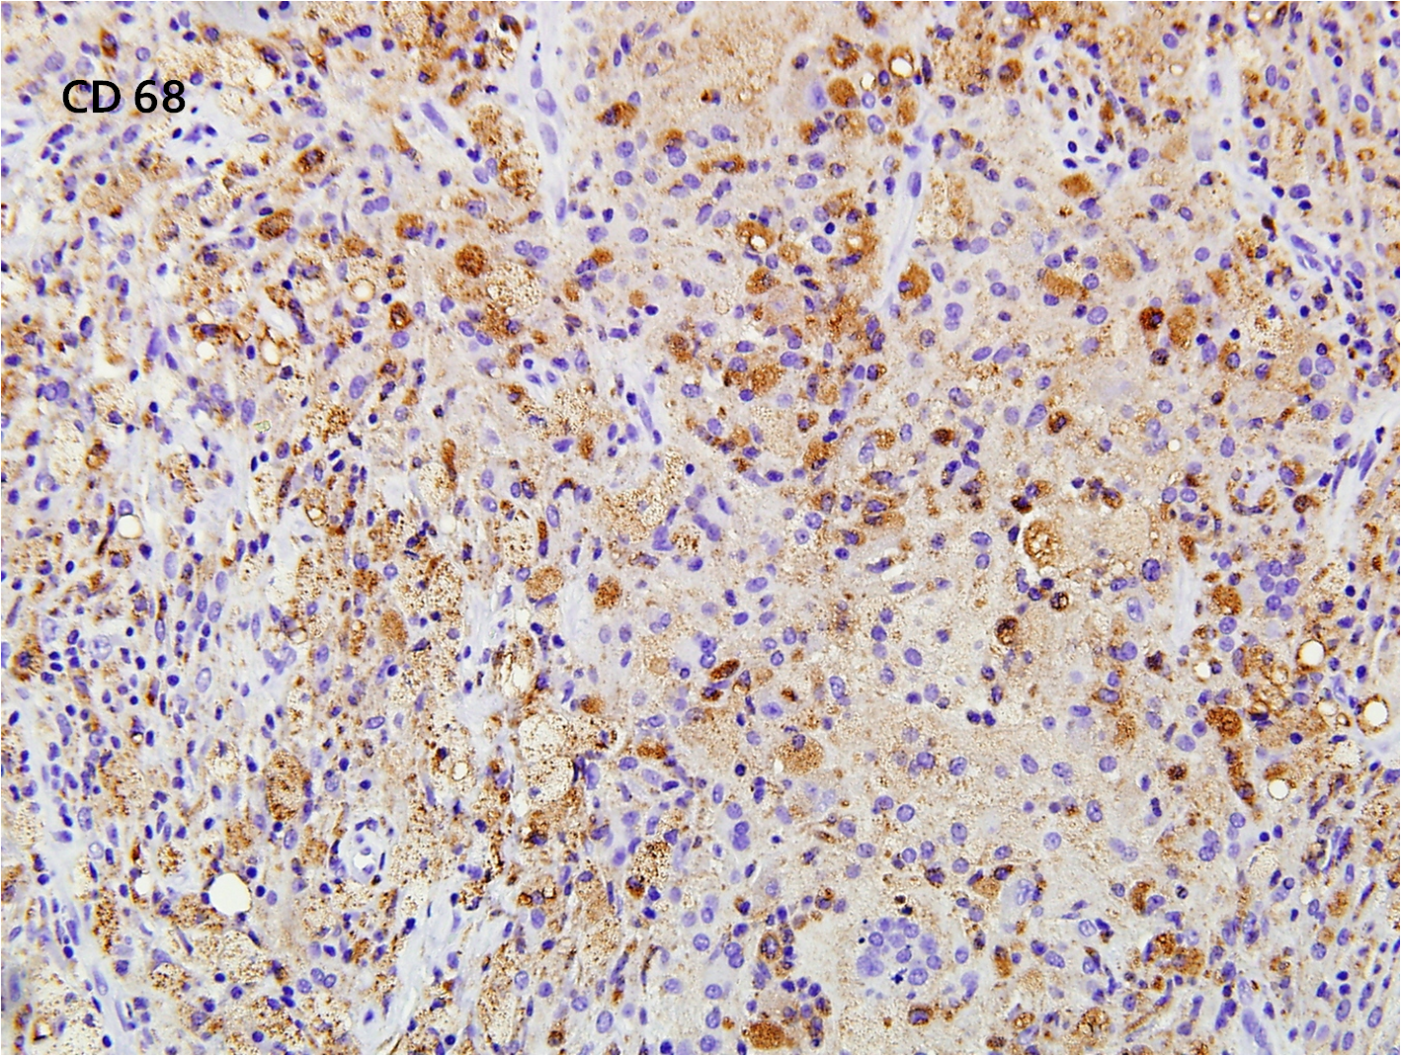

Slide 12
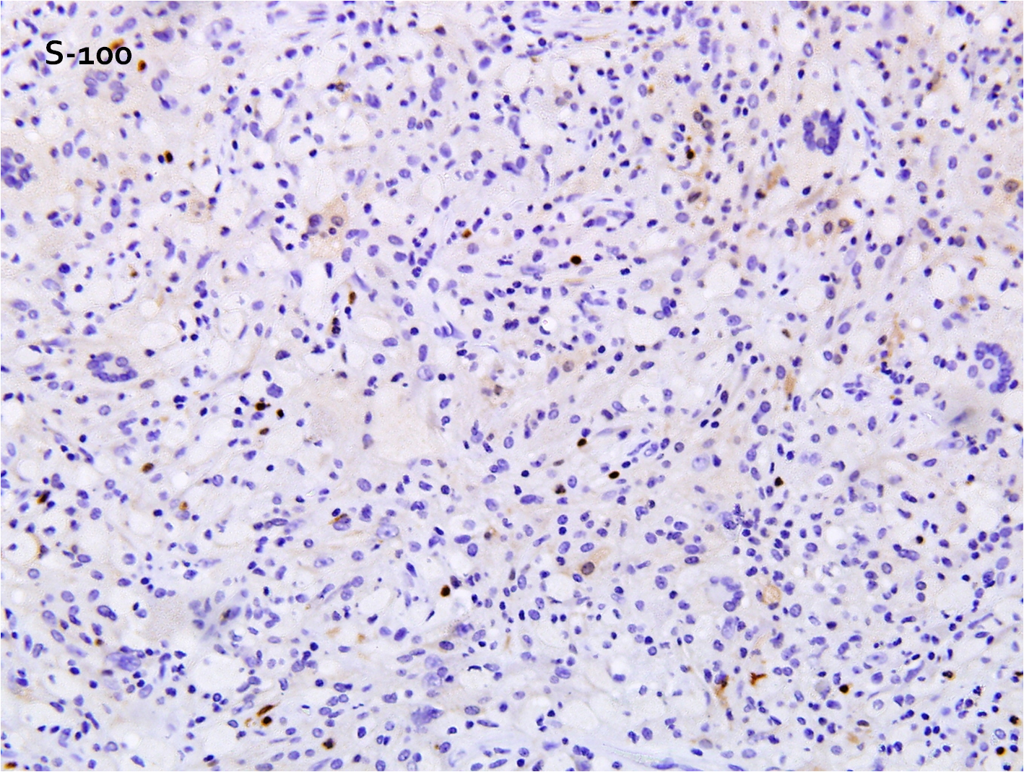

Slide 13
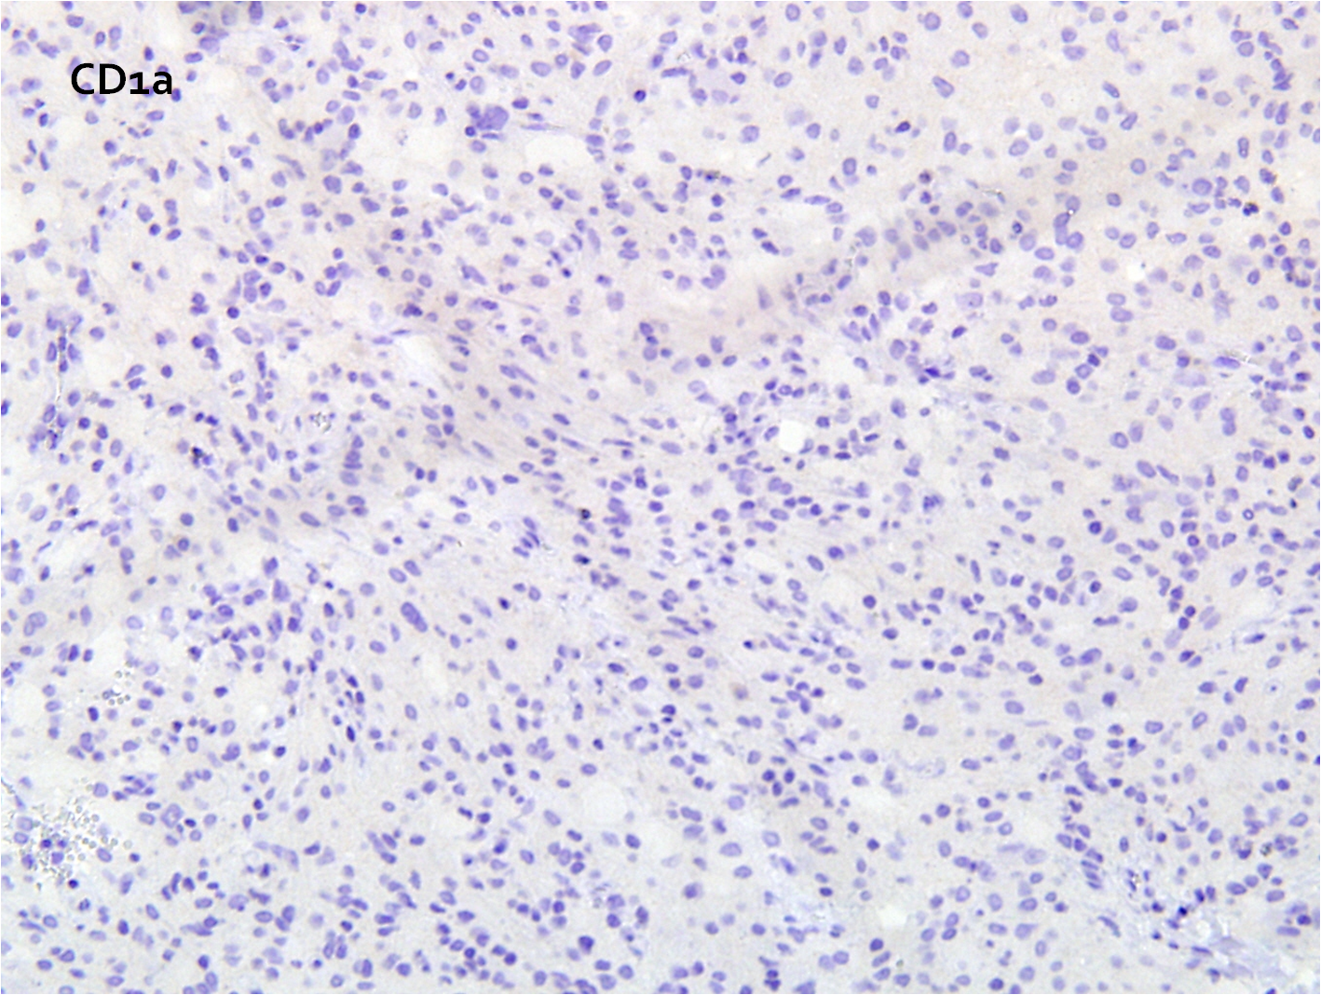

Slide 15
Erdheim-Chester Disease

Slide 16
Histiocytic Lesions
Langerhans cell histiocytoses
Non-Langerhans cell histiocytoses
Cutaneous non-LCH
The Juvenile xanthogranuloma family
Benign cephalic histiocytosis
Juvenile xanthogranuloma
Generalized eruptive histiocytoma
Adult xanthogranuloma
Progressive nodular histiocytosis
Non-JXG cutaneous histiocytoses
Solitary reticulohistiocytosis
Non-LCH dendritic cell histiocytosis
Indeterminate histiocytosis
Cutaneous with a major systemic component
JXG family
Xanthoma disseminatum
Non-JXG family
Multicentric reticulohistiocytosis
Systemic non-LCH
JXG family
Erdheim-Chester disease
Non-JXG family
Sinus histiocytosis with massive lymphadenopathy (R-DD)

Slide 17
Non-Langerhans cell histiocytoses – JXG family
Diverse group of disorders defined by the accumulation of histiocytes that do not meet the phenotypic criteria for the diagnosis of LCs.
Identical immunophenotype: FactorXIIIa, CD68, CD163, fascin, and CD14 positive. Negative for S100 and CD1a
?Spectrum of same disorder and derive from same precursor cell

Slide 18
Erdheim-Chester Disease
Variant of the JXG family
IHC – XIIIa, CD68, and CD163 positive; CD1a and S-100 negative
Characterized by dense infiltrate of histiocytes with foamy or eosinophilic cytoplasm and Touton giant cells
Absence of Birbeck granules
Differential Diagnosis with Rosai-Dorfman disease
  Systemic histiocytosis, Non JXG family
  – S-100+, CD1a-, CD68+, Fascin+, CD163+ histiocytes with emperipolesis

Slide 19
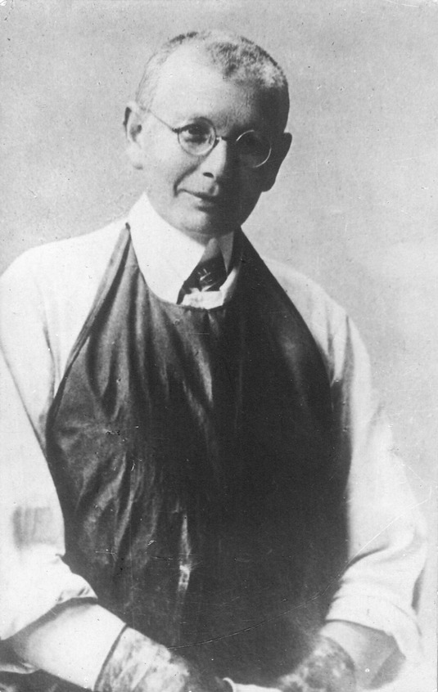
Erdheim-Chester Disease
First described in 1930 by William
  Chester, a pupil of Viennese Pathologist
  Jakob Erdheim
  Initially called “lipid granulomatosis”
1972 Jaffe described in detail the
  clinical, radiological, and pathological characteristics
  and coined “Erdheim-Chester Disease”
Rare
  About 341 reported cases; 259 biopsy proven

Slide 20
Erdheim-Chester Disease Clinical Manifestations
Bilateral knee and ankle pain
most common complaints in
patients
  Characteristic bilateral symmetric osteosclerosis of long bones
Extraskeletal organ involvement more than 50% of the time
  Kidney, retroperitoneum, skin, brain, and lung

Slide 21
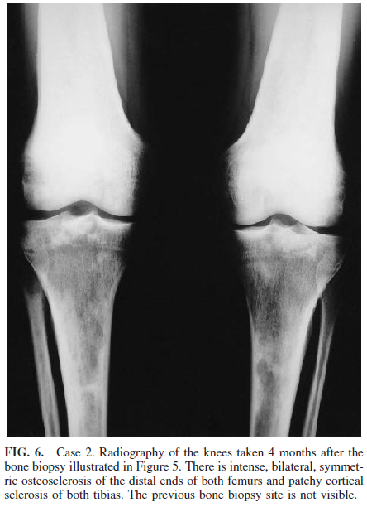
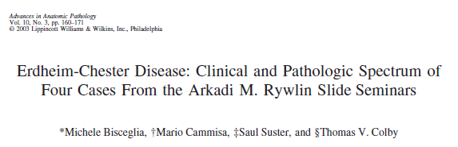
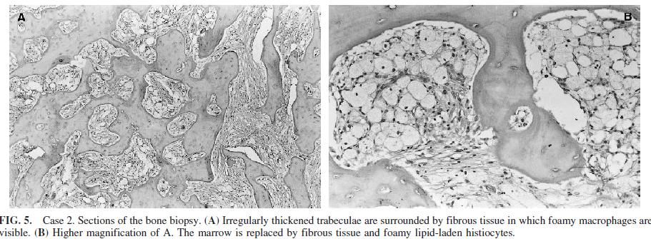

Slide 22
Erdheim-Chester Disease Clinical Manifestations
Cavalli, et al reviewed 259 biopsy proven cases in the English literature
Results:
  60% Male
  Median age disease onset: 49 years
  Median age disease diagnosis: 53 years
  Median diagnostic delay: 1 year

Slide 23
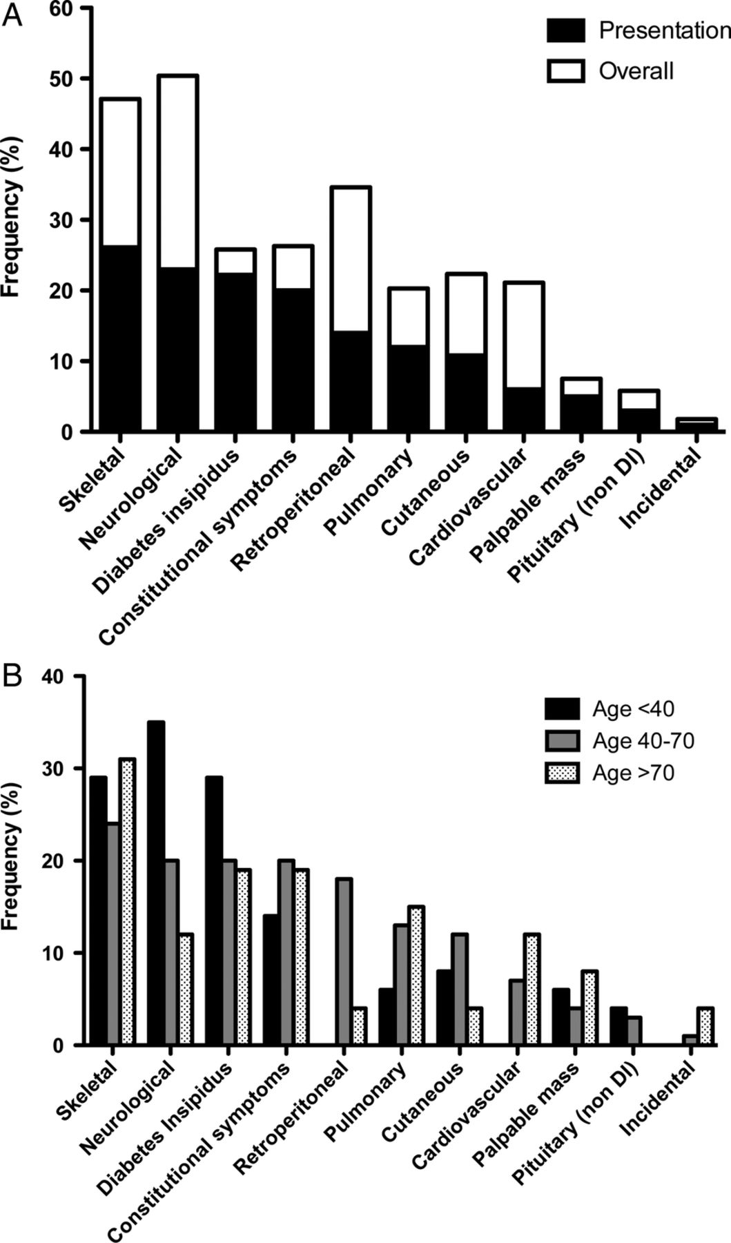

Manifestations of Erdheim–Chester disease (ECD) at onset and over the course of the disease.
Cavalli G et al. Ann Rheum Dis doi:10.1136/annrheumdis-2012-202542
©2013 by BMJ Publishing Group Ltd and European League Against Rheumatism
Notes:
Manifestations of Erdheim–Chester disease (ECD) at onset and over the course of the disease. The frequency of different clinical presentations of ECD was analysed in a cumulative cohort of 259 patients. (A) Depicts the cumulative frequency of the different clinical disease manifestations at the time of onset (black boxes) and over the subsequent course of the disease (white boxes). The most frequent presentations of ECD included skeletal and neurological manifestations, diabetes insipidus, and constitutional symptoms. (B) Represents the initial clinical manifestations of ECD in patients divided in different groups according to their age at disease onset (<40 years (n=49); 40–70 years (n=184); >70 years (n=26)). In patients aged less than 40 years, ECD onset was most frequently characterised by neurological and skeletal manifestations and diabetes insipidus, whereas it never featured retroperitoneal involvement. In patients aged 40–70 years, other manifestations such as constitutional symptoms, retroperitoneal, pulmonary and cutaneous involvements started to emerge. In patients who were over 70 years at disease onset, pulmonary and cardiovascular involvements also were not infrequent presentations. DI, diabetes insipidus.

Slide 24
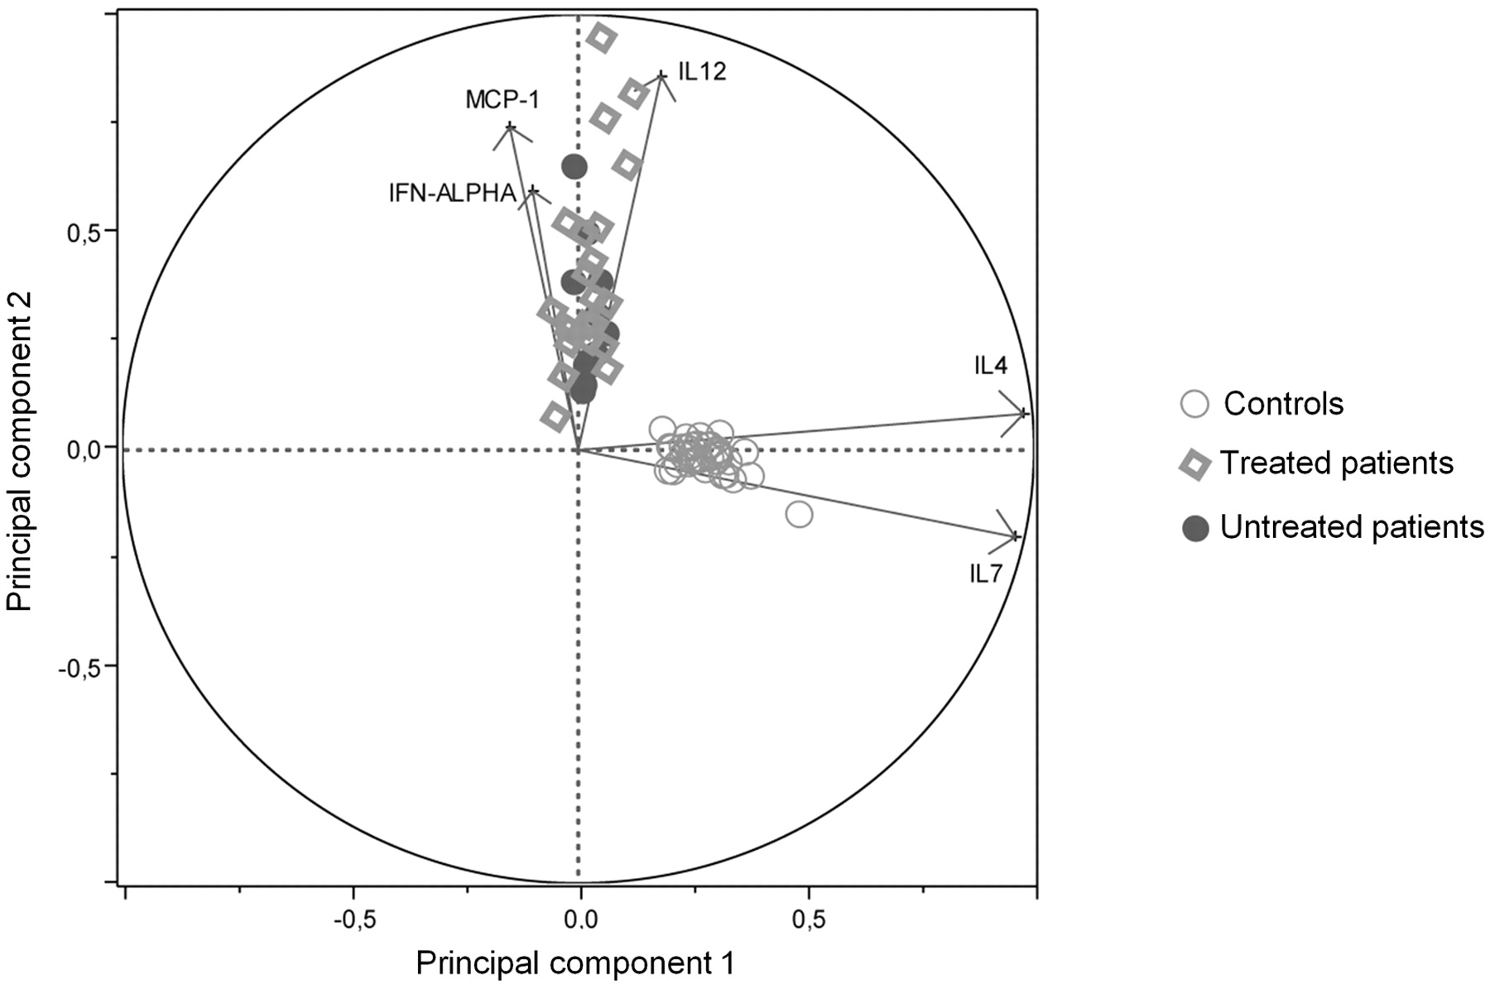
Erdheim-Chester Disease Pathogenesis
Clonality studies have
produced varied results
Arnaud, et al described a
cytokine profile from
serum samples - IFN-α, IL-1/IL-1-RA, IL-6, IL-12
and MCP-1
Dagna, et al demonstrated TNF-α, IL-6, and CXCL8/IL-8 are released by the lesional histiocytes
Arnaud L et al. Blood 2011;117:2783-2790

Slide 25
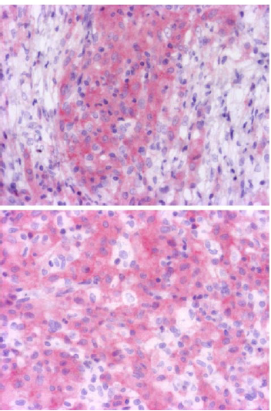
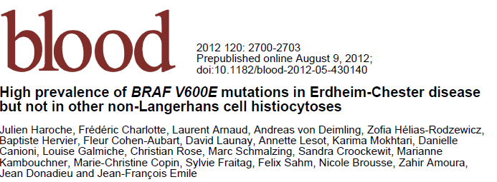
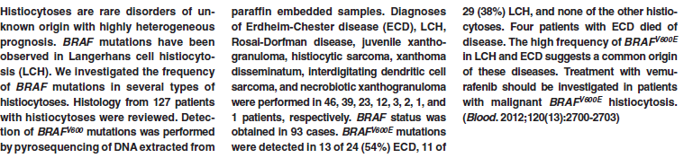

Slide 26
ECD Treatment
No standard treatment
Interferon α
Systemic chemotherapy (vinblastine and etoposide)
IL-1-Ra (anakinra)
Imatinib (gleevac)
Methotrexate
Infliximab (Remicade, anti-TNFα)
Vemurafenib (BRAF enzyme inhibitor)
Radiation therapy

Slide 27
Summary of our patient
Treated with interferon
Treated with vinblastine, 6-mercaptopurine, and prednisone
  Slight improvement in lesions but worsening fatigue
Switches to Gleevac
  Increase in size of lesions
Radiation therapy
  Increase in size of lesions
Surgery
Tries to start anakinra, but can’t afford
BRAF testing negative
Continued worsening of symptoms, wheelchair bound

Slide 28
References
Arnaud, et al. Systemic pertrbation of cytokine and chemokine networks in Erdheim-Chester disease: a single-center series of 37 patients. Blood. 2011; 117: 2783-2790.
Aouba, A., Larousserie, F., Le Guern, V., Martin, A., and Guillevin, L. Spumous histiocytic oligoarthritis coexisting with systemic Langerhans’ cell histiocytosis: case report and literature review. Joint Bone Spine. 2009; 76:701-704.
Bisceglia, M., Cammisa, M., Suster, S., and Colby, T. Erdheim-Chester disease: clinical and pathologic spectrum of four cases from the Arkadi M. Rywlin Slide Seminars. Adv in Anat Pathol. 2003; 10:160-171.
Cavalli, G., Guglielmi, B., et al. The multifaceted clinical presentations and manifestations of Erdheim-Chester disease: comprehensive review of the literature and of 10 new cases. Ann Rheum Dis. 2013; 0:1-5.
Conley, A., Manjila, S., Guthikonda, M., Kupsky, W.J., and Mittal, S. Non-Langerhans cell histiocytosis with isolated CNS involvement: An unusual variant of Erdheim-Chester disease. Neuropathology. 2010; 30: 634-647.
Dagna, L., Girlanda, S., Langheim, S., Rizzo, N., Bozzolo, E.P., Sabbadini, M.G., and Ferrarini, M. Rheumatology. 2010; 49: 1203-1206.
Haroche, J., et al. High prevalence of BRAF V600E mutations in Erdheim-Chester disease but not in other non-Langerhans cell histiocytoses. Blood. 2012; 120: 2700-2703.
Khezri, F., Gibson, L.E., and Tefferi, A. Xanthoma Disseminatum. Arch Dermatol. 2011; 147:459-464.
Mills, J.A., Gonzalez, R.G., and Jaffe, R. Case 25-2008: A 43-year old man with fatigue and lesions in the pituitary and cerebellum. N Engl J Med. 2008; 359: 736-747.
Ng-Cheng-Hin, B., O’Hanlon-Brown, C., Alifrangis, C., and Waxman, J. Langerhans cell histiocytosis: old disease new treatment. Q J Med. 2011; 104:89-96.
Weitzman, S. and Jaffe, R. Uncommon histiocytic disorders: the non-Langerhans cell histiocytoses. Pediatric Blood Cancer. 2005; 45:256-264.
Wilejto, M. and Abla, O. Langerhans cell histiocytosis and Erdheim-Chester disease. Curr Opin Rheumatol. 2012; 24:90-96.

