Slide 1



Diagnostic Slide Session, Case #1
EIGHTY-NINTH ANNUAL MEETING OF THE AMERICAN ASSOCIATION OF NEUROPATHOLOGISTS
June 20-23, 2013 Charleston, SC
Murad Alturkustani
Lee-Cyn Ang

Slide 2
Disclosure
No conflict of interest to disclose

Slide 3
Clinical Summary
Forty eight year-old male
Psychiatric & behavioral abnormalities
Period: 2 years
PMH: controlled hypertension
Family history: not contributory

Slide 4
Frontal area

Slide 5
Relatively preserved myelin
LFB x400
Neurofilament x400

Slide 6
Moderate-severe myelin loss
LFB x400
Neurofilament x400

Slide 7
Severe myelin loss
LFB x400
Neurofilament x400

Slide 8
Pigments
LFB x400
LFB x400

Slide 9
Pigments
D-PAS x400
Masson Fontana x400

Slide 10
Pigments
Perrl’s Prussian Bluex400
Perrl’s Prussian Bluex400

Slide 11
Pigments
CD68 x200
CD68 x400

Slide 12
Cerebellum
LFB
LFB x400

Slide 13
Sent slides

Slide 14
Differential Diagnosis & Discussion?

Slide 15
Diffuse demyelination/myelin loss

Slide 16
Differential diagnosis
  Infective leukoencephalopathies (e.g. HIV, and PML)
  Toxic leukoencephalopathy (e.g. hexacarbon, glue sniffing)
  Vascular leukoencehalopathies (e.g. CADASIL, Binswanger’s disease)
  Leukodystrophy in adult
    late-onset childhood form
    Adult-onset leukodystrophy

Slide 17
Axonal spheroids
LFB x400
Neurofilament x400

Slide 18
Specific differential
Seiterberger classification of neuraxonal dystrophy:
  Neuroaxonal leukodystrophy (NALD)/ neuroaxonal leukoencephalopathy:
    Dermatoleukodystrophy with spheroids (DLDS)
    Nasu-Hakola disease
    Hereditary diffuse leukoencephalopathy with spheroids (HDLS)
Notes:
Yazawa paper:
Seiterberger classified such patients in a group of NAD, which he called neuroaxonal leukodystrophy (NALD), and provided several examples (Seiterberger, 1986), including
those of two siblings who had dermatoleukodystrophy with spheroids (DLDS) (Matsuyama et al., 1978), and patients with Nasu-Hakola disease (Minagawa et al., 1980, 1985), those with hereditary diffuse leukoencephalopathy with spheroids (HDLS) (Axellson et al., 1984), and Patients III-3 and III-4 of our family (Oda et al., 1981).
Van der knapp:
Dermatoleukodystrophy with neuroaxonal spheroids has an early infantile onset and results in early death.
Primary NAD:
Neuroaxonal Leukodystrophy
Hereditary diffuse leukodystrophy with spheroids
Nasu-Hakola diease
Dermatopathy associated neuroaxonal leukodystrophy
Hallervorden-Spatz disease
Infantile neuroaxonal dystrophy
Late infantile and juvenile NAD

Slide 19
Diagnosis

Slide 20
Diagnosis
Hereditary diffuse leukoencephalopathy with spheroids
Adult-onset leukodystrophy with axonal spheroids
Adult-onset leukoencephalopathy with axonal spheroids and pigmented glia
Adult-onset leukoencephalopathy with neuroaxonal spheroids
Leukodystrophy with neuroaxonal Spheroids
Neuroaxonal leukodystrophy
Diffuse leukoencephalopathy with axonal spheroids
Leukoencephalopathy with neuroaxonal spheroids
Neuroaxonal leukoencephalopathy with spheroids
Neuroaxonal leukoencephalopathy with axonal spheroids

Slide 21
Historical review
 | HDLS (ALAS) | POLD (Pigmented Orthochromatic Leukodystrophy)
First case | 1986 Axelsson et al.¹ | 1936 Van Bogaert & Nyssen²
Familial or sporadic | Mostly familial (AD) with few sporadic | Mostly sporadic with few familial (AR)
2004 Marotti et al.³ | Spheroids can be seen in POLD + pigmentation can be seen in HDL-S = “Adult onset leukodystrophy with neuroaxonal spheroids and pigmented glia”
Genetic | 2012 Rademakers et al.⁴ CSF1R (5q36) mutation in HDL-S |  | 2013 similar genetic mutation

Slide 22
Clinical features
Kleinfeld et al.⁵ 2012:
  56 patients (HDLS & POLD)
  Average age of onset: 42
  Average age death: 48
  Presenting features:
    Cognitive decline
    Behavioral and personality changes
    Motor symptoms
Notes:
Kleinfeld K, Mobley B, Hedera P, Wegner A, Sriram S, Pawate S. Adult-onset leukoencephalopathy with neuroaxonal spheroids and pigmented glia: report of five cases and a new mutation. J. Neurol. 2012 Sep 30.

Slide 23
Hereditary or Sporadic?
Best known as AD
AR and sporadic cases reported
More history for the current case
  2009: brain autopsy for his sister (59 year) with history of dementia for 8 years
    Diagnosis: ALAS
  Mother had dementia in her 70s

Slide 24
Adult-onset leukosytrophy/ leukoencephalopthy
Adult-onset leukoencephalopathy/leukodystrophy with axonal spheroids (ALAS)
Autosomal dominant adult-onset leukodystrophy (ADLD)
“Pigmented” orthochromatic leukodystophy
No well-defined diagnostic criteria
Our approach

Slide 25
Leukodystrophy in adult
Exclude childhood late-onset leukodystrophy (biochemical and enzymatic tests)
Early autonomic dysfunction?
No
Pathology
No distinctive pathology
Yes
Evidence of axonopathy (Numerous spheroids in relatively preserved myelin) +/- pigmented cells
Tigroid appearance
Preserved oligodendoglia
White matter vacuolation
Mild astrocytosis
Pigmented glia?
Bone cysts and membranous lipodystrophy?
Yes
No
Yes
No
ADLD
LMNB1
Nasu-Hakola’s disease
TREM2/DAP12
ALAS
CSF1R
POLD
OLD

Slide 26
Review previous cases
Search DSS archives 1959-2012
Leukodystrophy then adult

Slide 27
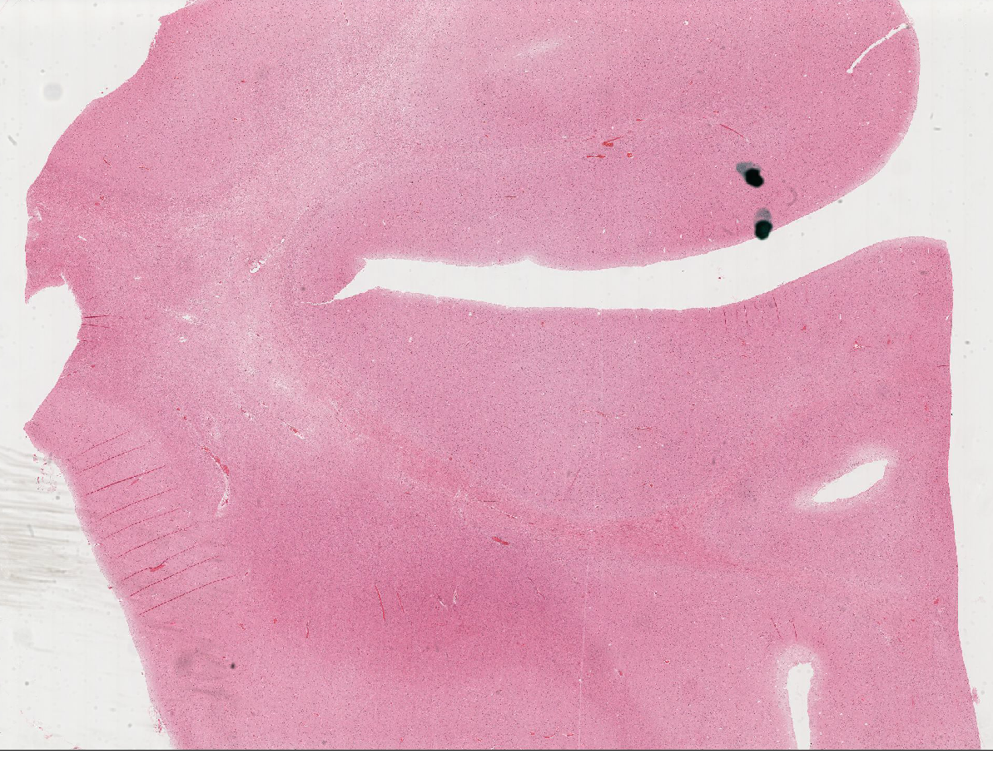
Case 1999-9
Diffuse hereditary leukoencephalopathy with axonal spheroids
Notes:
Comment: The changes were confined to the white matter, with no involvement of the
gray matter. The pathology appeared to have three stages, with axonal swellings first,
progressing to loss of axons and vacuolation of white matter, with complete loss of axons,
myelin and oligodendrocytes as the end stage. The white matter changes were restricted
to the dorsal cerebral hemispheres and the corpus callosum. Similar conditions mentioned
by members of the audience included solvent abuse leukoencephalopathy and Nasu Hakala disease, in which there are also bone lesions.
References:
1. Axelsson et al. Hereditary diffuse leucoencephalopathy with spheroids. Acta Psych
Scand (Suppl) 1984; 314:1-65.

Slide 28
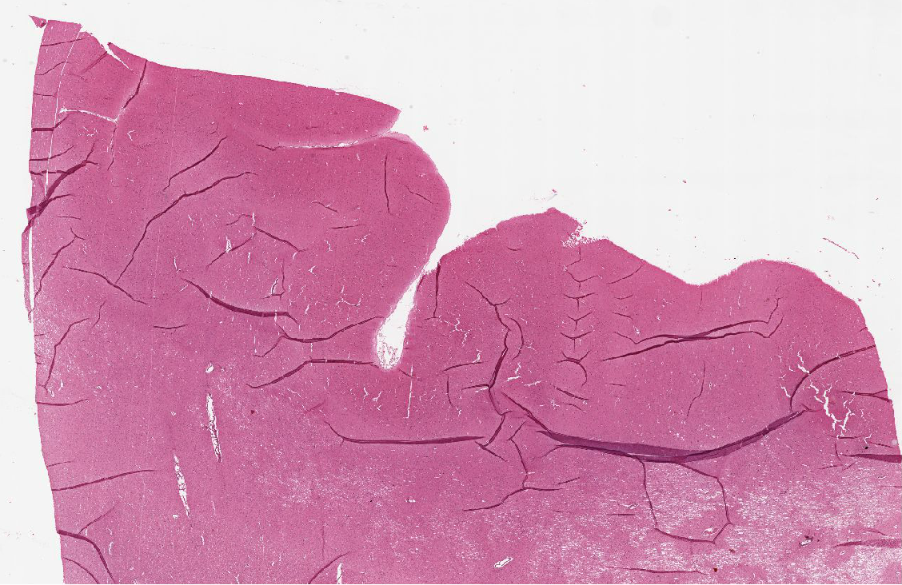
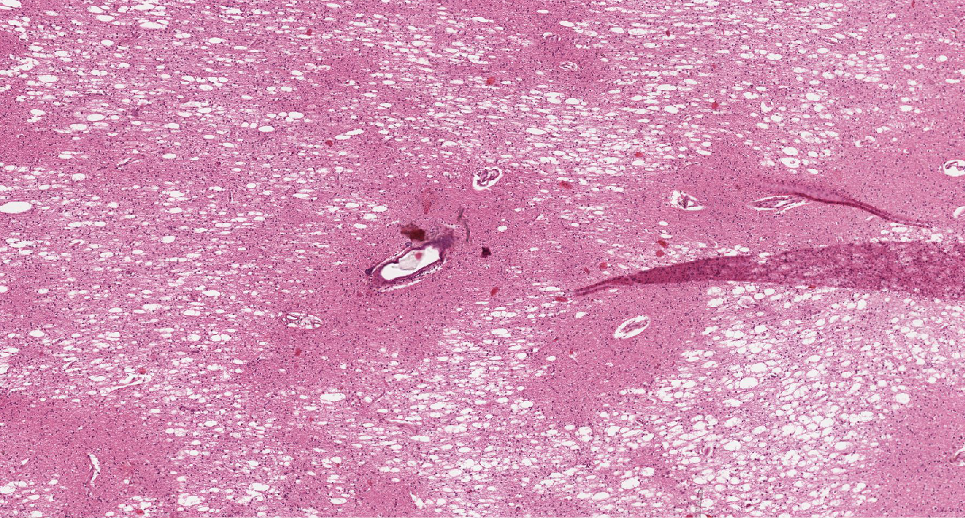
Case 1989-1
Hereditary Adult-Onset Leukodystrophy
  Autosomal dominant adult-onset leukodystrophy (ADLD)
Notes:
References
Eldridge R, Anoyiotos CP, Schlesinger 5, Cowen D, Bever C, PaiTonas H, McF orland H. Hereditary adult-onset leukodystropy simulating chronic progressive multiple sclerosis. New Eng J Med j 984; 311 :948-953.
Seitelberger F. Pelizaeus-Merzbacher disease. Vinken PJ, Bruyn GW, eds. In: Handbook of Clinical Neurology. Amsterdam, North Holland, 1970, Vol 10, pp 150-202.

Slide 29
References
Axelsson, R. (1984). Hereditary diffuse leucoencephalopathy with spheroids. Acta Psychiatrica Scandinavica.
Van Bogaert L, Nyssen R (1936). Le type tardifde la leukodystrophie progressive familiale. RevNeurol (Paris) 65:21–45.
Marotti JD, et al. (2004) Adult onset leukodystrophy with neuroaxonal spheroids and pigmented glia: report of a family, historical perspective, and review of the literature. Acta Neuropathol (Berl) 107:481–488
Rademakers R, et al. 2011. Mutations in the colony stimulating factor 1 receptor (CSF1R) gene cause hereditary diffuse leukoencephalopathy with spheroids. Nat Genet 44(2):200–205.
Kleinfeld, Kirk, et al. "Adult-onset leukoencephalopathy with neuroaxonal spheroids and pigmented glia: report of five cases and a new mutation." Journal of neurology 260.2 (2013): 558-571.

Slide 30
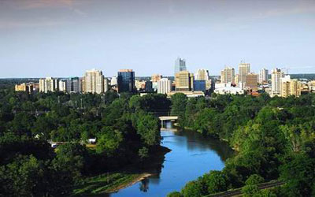
Questions?

