Slide 1
CASE 2015 - #6
Case submitted by:
Drs. Armine Darbinyan¹, Jessica Robinson-Papp, Michelle Jacobs, Catherine Cho, Susan Morgello*
¹ Presenter: Armine Darbinyan, M.D.
Neuropathology Fellow
The Joseph Schein, M.D. Endowed Fellow in Experimental/Molecular Pathology
Icahn School of Medicine at Mount Sinai
One Gustave L. Levy Place – Box 1194
New York, NY 10029 armine.darbinyan@mountsinai.org
215-776-5131
212-241-0546
*Sponsor: Susan Morgello, M.D.
Professor of Neurology, Neuroscience, and Pathology
Mount Sinai Medical Center
Annenberg Building Room 14-66
Box 1137
1 Gustave L. Levy Place
New York, NY 10029
Phone: 212 241-9118
FAX: 212 241-2972 susan.morgello@mssm.edu

Slide 2
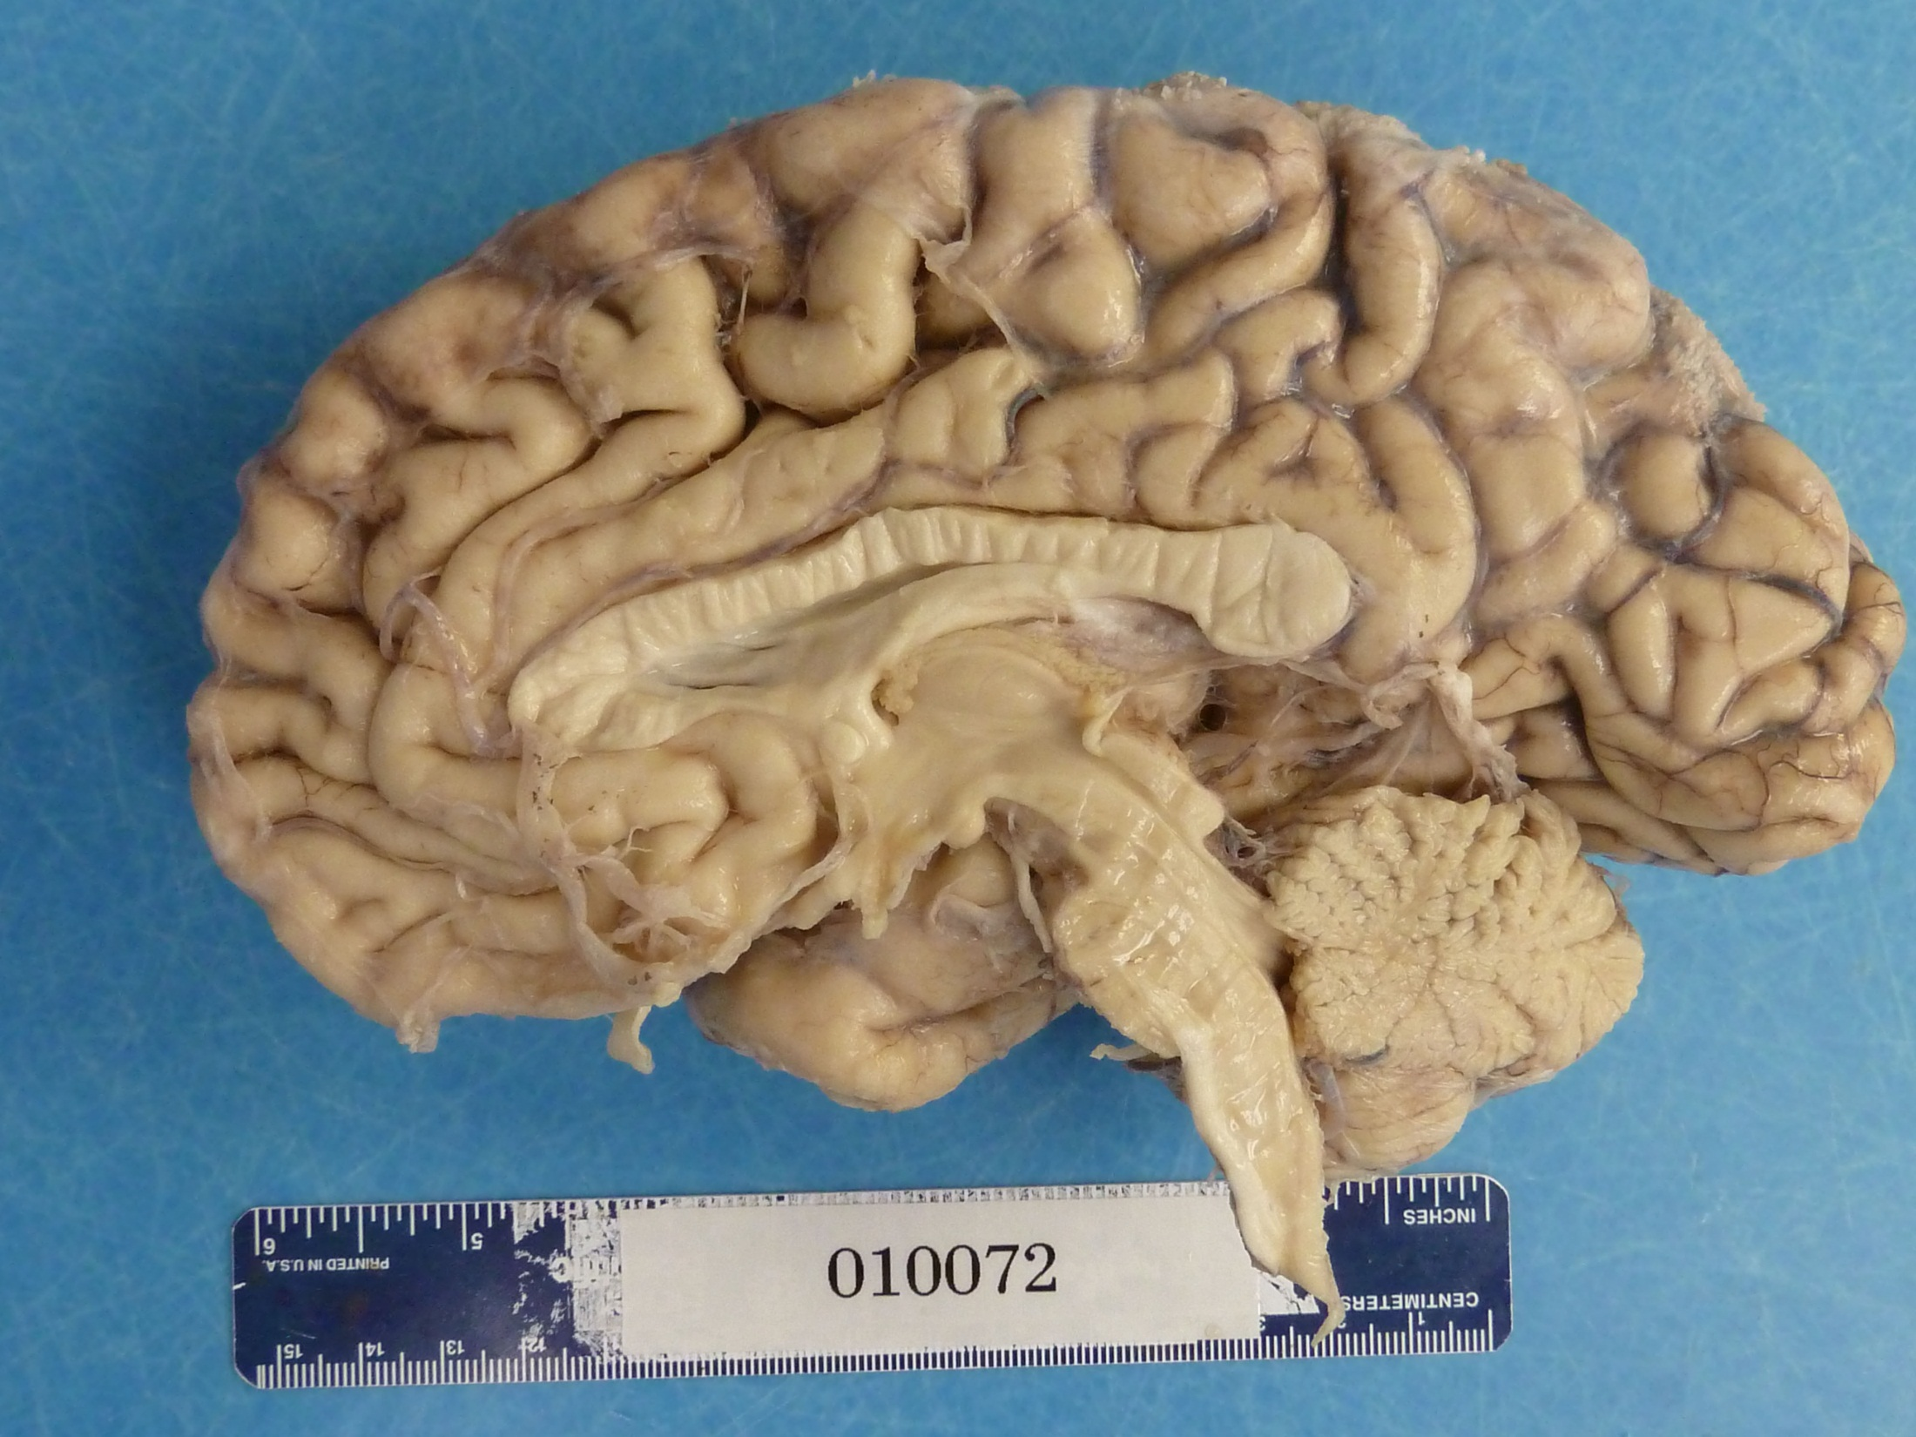

Slide 3
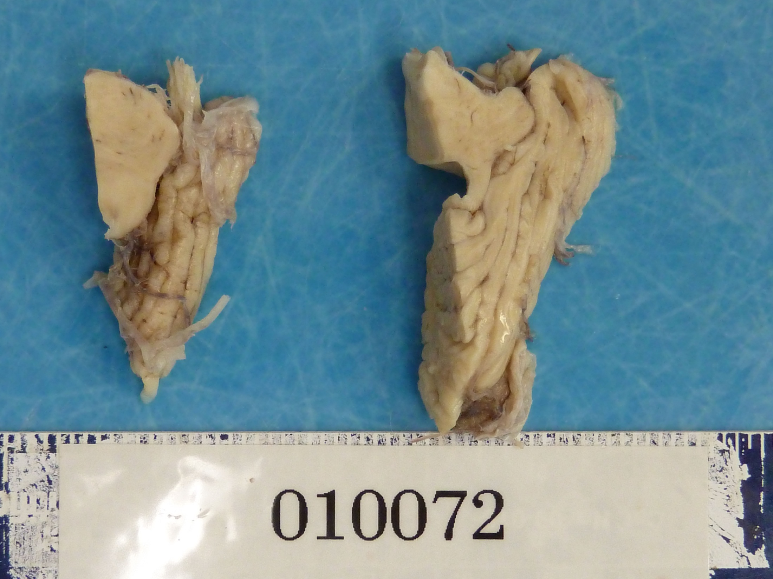

Slide 4
